Slide 1
Core Collapse Supernova Modeling
and
Gravitational Wave Emission Prediction:
The Next Ten Years
Anthony Mezzacappa
University of Tennessee, Knoxville
SN2025gw: First IGWN Symposium on Core Collapse Supernova Gravitational Wave Theory and Detection
University of Warsaw
July 25, 2025

Slide 2
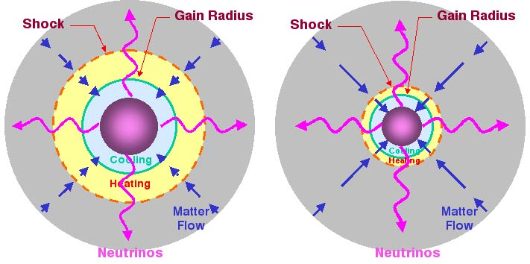
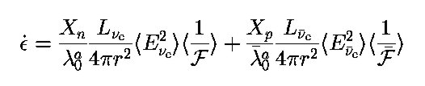

Physical Ingredients of a Neutrino-Driven Core Collapse Supernova Explosion
Proto-
Neutron
Star
Gain
Radius
SASI-Distorted
Shock
Standing Accretion Shock Instability
Neutrino Heating
Proto-Neutron Star Instabilities
Neutrino-Driven Turbulent Convection
Boltzmann Kinetics
Newtonian
GR
$$f(t,r,θ,φ,ε,θ_{p},φ_{p})$$
Quantum Kinetics
Dasgupta, Mirizzi, and Sen, JCAP 1702, 019 (2017)
Bruenn, DeNisco, and AM, Ap.J. 560, 326 (2001)
Rotation and Magnetic Fields

Slide 3
Physical Ingredients of a Neutrino-Driven Core Collapse Supernova Explosion
Shock
Nuclear Mattter
Nuclei
and
Nucleons
in NSE
Nuclei
in
non-NSE
(need for a
nuclear
burning
network)
Janka et al. Prog. Theor. Exp. Phys. 2012, 01A309
Navo’ et al. Ap.J. 951, 112 (2023)
Nuclear Burning:
Lowers Preshock Ram Pressure
Changes Composition/Neutrino Heating
Bollig et al. PRL 119, 242702 (2017)
Tews et al. Ap.J. 848, 105 (2017)

Slide 4
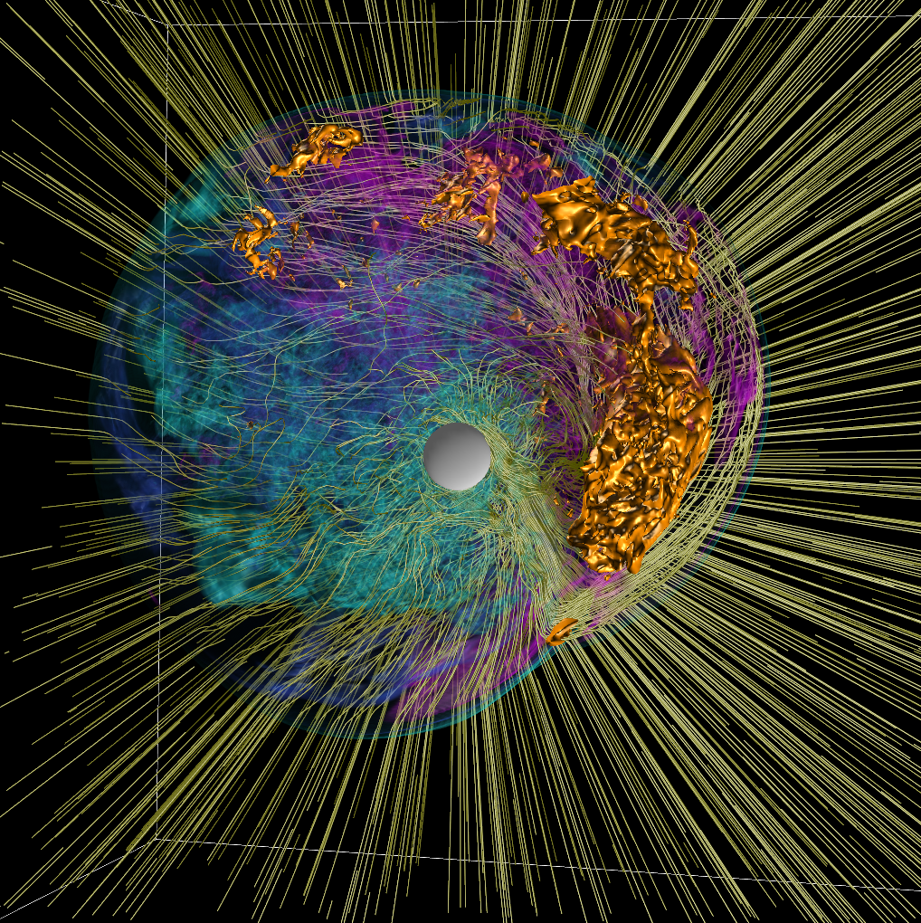
Core Collapse Supernova Model Requirements
General Relativistic Gravity
General Relativistic Magnetohydrodynamics
General Relativistic Boltzmann Neutrino Kinetics
Nuclear Reaction Network
3D
Industry Standard Weak Interaction Set
Industry Standard Nuclear Equation of State

Slide 5
Core Collapse Supernova Model Requirements
General Relativistic Gravity
General Relativistic Magnetohydrodynamics
General Relativistic Boltzmann Neutrino Kinetics
Nuclear Reaction Network
3D
Industry Standard Weak Interaction Set
Industry Standard Nuclear Equation of State
Two-Moment
Kuroda Ap.J. 906, 128 (2021)

Slide 6
Moments: A Blessing and a Curse
Infinite hierarchy of angular moments
contains the angular information in the
one distribution function.
Truncate the infinite hierarchy at the
equation for the second angular moment
(a vector).
Third and fourth angular moments are
still present.
Laiu et al. JCP 520 113477 (2025)
Closure Problem
Most commonly used closure valid for
Maxwell–Boltzmann statistics, not
Fermi–Dirac statistics.
Realizable region for classical particles.
Realizable region for Fermions.
Chu et al. JCP 389, 62 (2019)
For a review, see: AM, Endeve, Bruenn, and Messer LRCA 6:4 (2020)

Slide 7


Flavor Mixing: It’s still all about the angular distributions!
flavor mixing due to
fast flavor instability (FFI)
collisional flavor instability (CFI)
flavor mixing due to
neutrino forward scattering
on neutrinos
flavor mixing due to
neutrino forward scattering
on electrons
MSW
$$R_{ν}$$
$$R_{S}$$
$$R_{star}$$
Tamborra I. and Shalgar S. ARNPS 2021 71, 165
Duan, H., Fuller, G. M., & Qian, Y.-Z. 2010, ARNPS 60, 569
not as well understood
well understood
$$R_{S}$$
FFI
$$R_{ν}$$
CFI
Dasgupta, Mirizzi, and Sen, JCAP 1702, 019 (2017)
Akaho et al. PRD 109 023012 (2024)

Slide 8
The Mesoscale Challenge
Johns, Richers, and Wu, to appear ARNPS, arXiv 2503.05959
Neutrino Mean Free Path
Macroscopic Scale
Radius
Oscillation Length
This will not be resolvable.
We will need “subgrid” models.
Mesoscopic Scale
Neutrino Wave Packet
Microscopic Scale
Mixed Outcomes
  Ehring et al. PRD 107 103034 (2023)
  Nagakura PRL 130 211401 (2023)
  Ehring et al. PRL 131 061401 (2024)
  Mori et al. PASJ 77 L9 (2025)
Boltzmann vs. Two-Moment Kinetics
  Cornelius et al. arXiv 2506.20723v1 (2025)
Mean Field vs. Many Body Treatments
  Laraib and Richers arXiv 2507.02040v1 (2025)

Slide 9
Uncertainties in the Neutrino Weak Interactions
In-Medium Effects
Nucleons are Fermions (a zeroth-order correlation).
Nucleons are relativistic at high density.
Nucleons interact. Included via:
  Mean Field: Each nucleon moves in the
  mean field of all other nucleons.
  Includes:
    Forward Scattering
    Exchange Scattering
  Leads to
    Nucleon Effective Mass
  Correlations (RPA)
  Includes:
    Screening
Hartree–Fock
(Mean Field)
RPA
(Correlations)
Density-Dependent Nucleon–Nucleon Interaction
not fully constrained by low- and high-energy nuclear experiment or neutron star mass and radius observations
uncertainties in neutrino opacities and nuclear equation of state
Lin et al. PRC 107 015804 (2023)
Corrections for degeneracy, relativity, and the nucleon effective mass (the nucleon mass in medium) lead to small-energy neutrino–nucleon scattering, which was demonstrated to be important to neutrino shock reheating [e.g., see Mueller et al. Ap.J. 756 84 (2012)].

Slide 10
HS
DD2
SFHo
SFHx
FSUGold
IUFSU
Uncertainties in the Nuclear Equation of State
Hempel and Schaffner-Bielich, NPA 837 210 (2010)
Different RMF parameterizations.
(Different parameterizations of the nucleon–nucleon interaction.)
Tews et al. Ap.J. 848, 105 (2017)
Shen, Horowitz, and O’Connor PRC 83 065808 (2011)
SHO
SHO(FSU)
SHO(FSU2.1)
It’s going to be very difficult
to pin this down
Equations of state used in the past
have been ruled out by low- and
high-energy nuclear experiment
and observations of neutron star
masses and radii.
For reviews, see:
Oertel et al. RMP 89 015007 (2017)
Rajesh et al. LRR 27:3 (2024)
Notes:
What are the other EOS or broader classes of EOS in the “Allowed” region of the figure in Tews et al. (2017)?

Slide 11
Uncertainties in the Stellar Progenitors
AM, Marronetti, Landfield, et al. PRD (2023)
Not well understood.
Fairly well understood.
In this model, nuclear burning occurs
during collapse, perturbing the core.
Reflects what we should expect when we have 3D progenitors.

Slide 12
The Applied Mathematics Frontier
Exhibit Correct Asymptotics
Maintain Fermi-Dirac Statistics
Simultaneously Conserve Lepton Number and Energy
High-Fidelity Discretization
The discretization of our underlying integro-PDEs is
in and of itself a research frontier. For a review, see:
AM, Endeve, Bruenn, and Messer, LRCA 6:4 (2020)
Laiu et al. JCP 520 113477 (2025)
For a review, see:
AM, Endeve, Bruenn, and Messer LRCA 6:4 (2020)

Slide 13
Modal Analysis
Hydrodynamic Equilibrium
Spherical Averaging
Adiabatic Perturbations
Hydrodynamic Equilibrium
Spherical Averaging
Non-Adiabatic Perturbations
There are more things in Heaven and Earth, Horatio, than are dreamt of in your philosophy. – Shakespeare, Hamlet
Doubly Diffusive Instabilities – e.g., Neutron Fingers
S
High S, Low Y
Y
Low S, High Y
Heat Flow
Lepton Flow
Bruenn, Raley, and AM (2004) astro-ph/0404099

Slide 14
Making Progress
Classical General Relativistic Neutrino Radiation Magnetohydrodynamics
EOS
Neutrino Interactions
Quantum Kinetics
Progenitors
It is within our control and know-how
to develop three-dimensional general
relativistic models with classical two-
moment spectral neutrino kinetics, using
the current best equations of state, neutrino
opacities, and progenitors.
Furious ongoing activity to develop
the theory. Like stellar evolution, this
is an extremely challenging problem.
Progress has been rapid.
Stellar evolution in three dimensions is
an even more difficult challenge given
the length scales and time scales involved.
Progress will be slow.
List has been shrinking and treatments have
been improving due to increasing number of
constraints from experiment and observations.
List has been growing and treatments
have been improving since the advent
of electroweak theory.
The fundamental difficulty stems from the
uncertainty in the density dependence of the
nucleon–nucleon interaction.

Slide 15
Seven Tasks, One Wish, and Ten? Meetings for the Next Ten Years
1. Continued development (across groups) of three-dimensional, general relativistic, spectral two-moment, reactive
magnetohydrodynamics simulations of CCSNe with state-of-the-art EOS and neutrino weak interactions.
2. Continued development of methods to include neutrino mixing in two-moment–based models.
3. Early development and (targeted) implementation of Boltzmann neutrino kinetics in three-dimensional models.
4. Continued development of discretizations of our underlying equations that exhibit the right asymptotic properties, conserve
lepton number and energy simultaneously, and respect Fermi–Dirac statistics.
5. Continued improvement of neutrino weak interaction cross sections, particularly at high density.
6. Continued improvement of nuclear EOS, narrowing down the possible EOS through continued experiment and observation.
7. Continued extension of modal analyses to accommodate three-dimensional hydrodynamic scenarios and potentially new
instabilities.
Continued close collaboration with multimessenger observers to focus models, and to improve existing detection/parameter
estimation algorithms and develop new ones.
SN2026gw–SN2035gw

