Slide 1
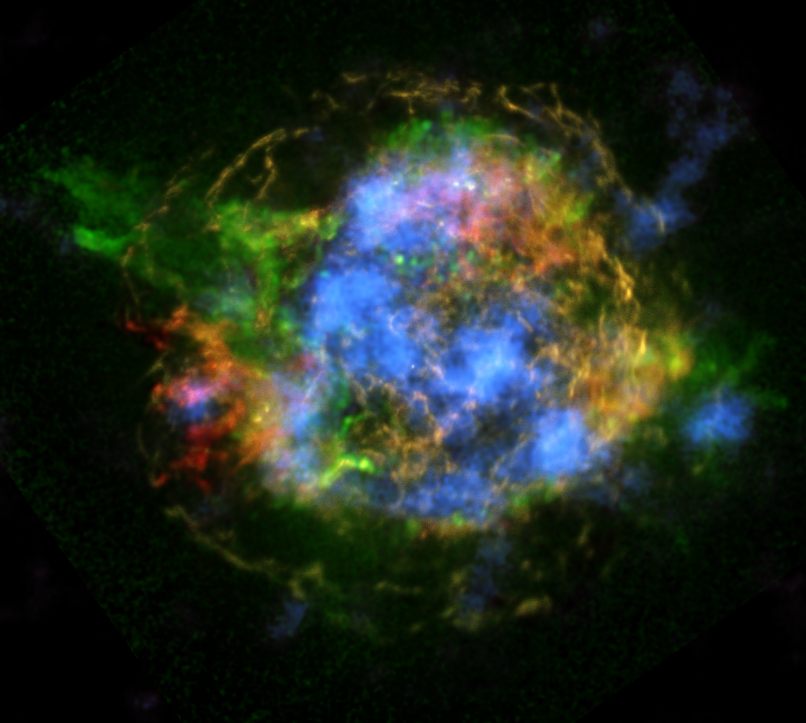
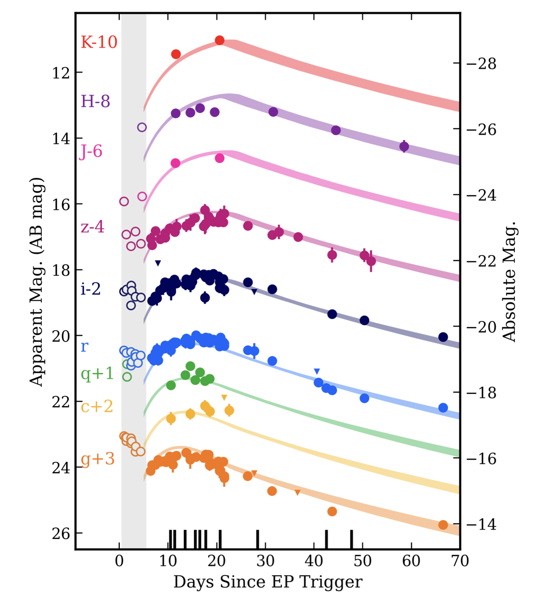
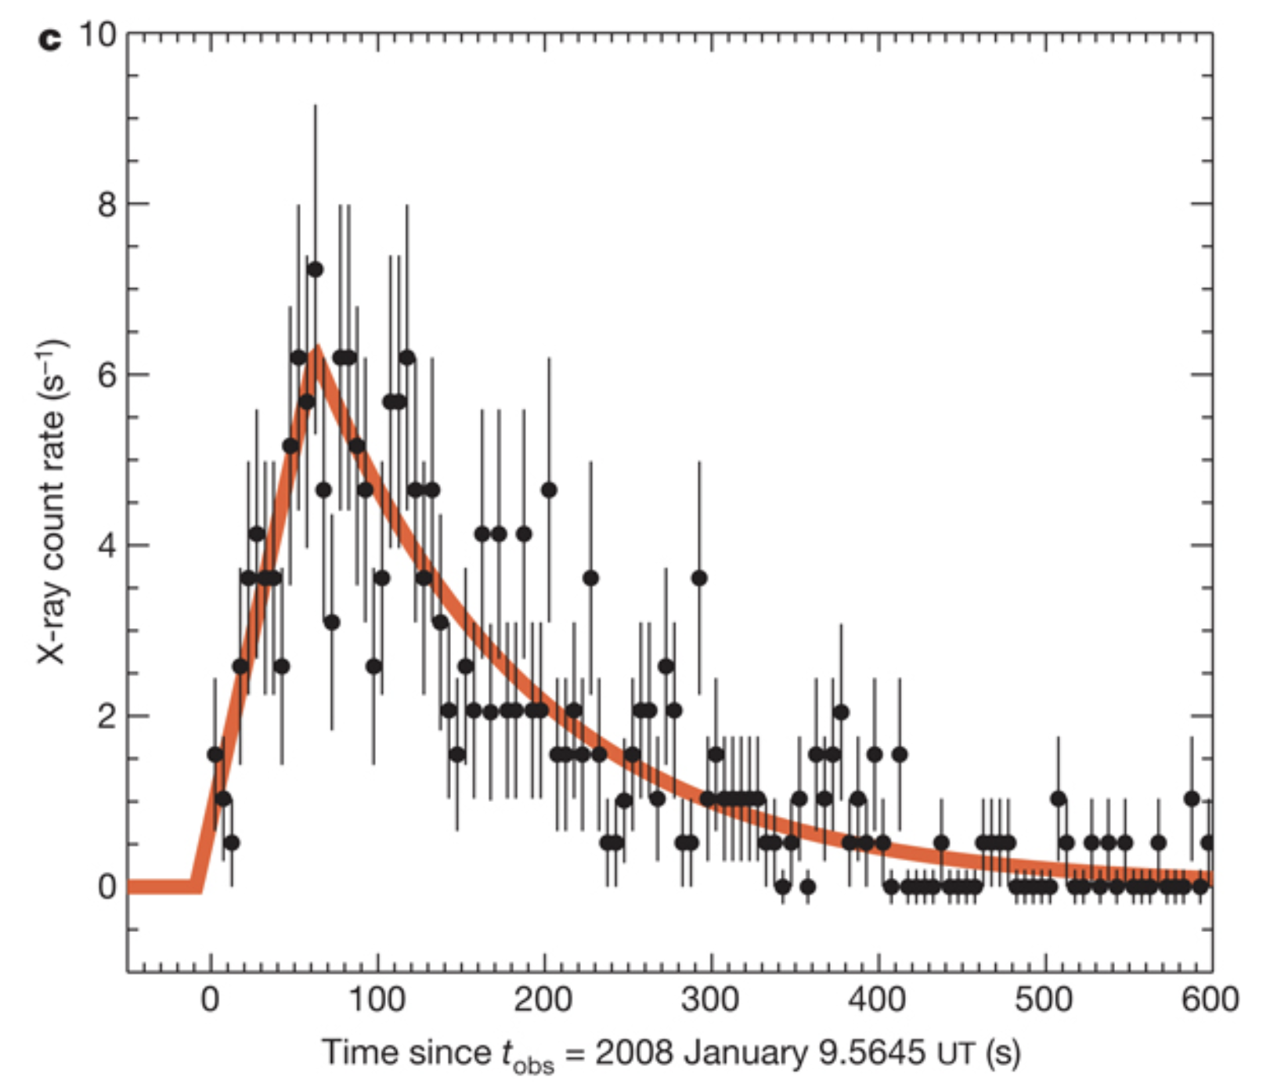
Electromagnetic Constraints on the Supernova Engine
Cassiopeia A: Chandra + NuSTAR
Chris Fryer (LANL)
Rastinejad et al. 2025
Soderberg et al. 2008d

Slide 2
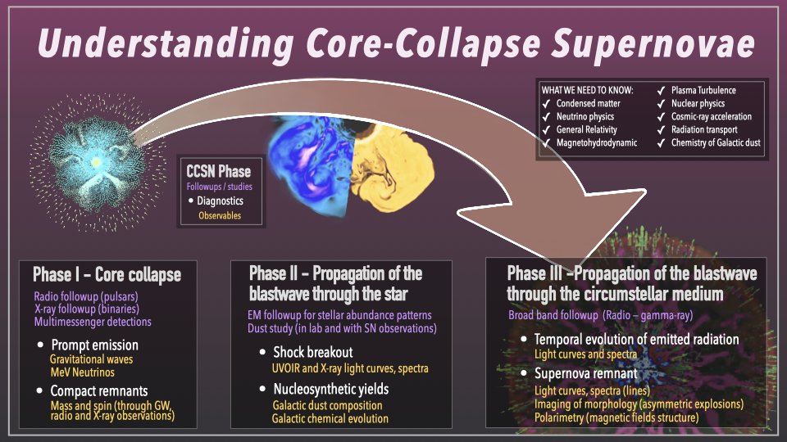

Slide 3
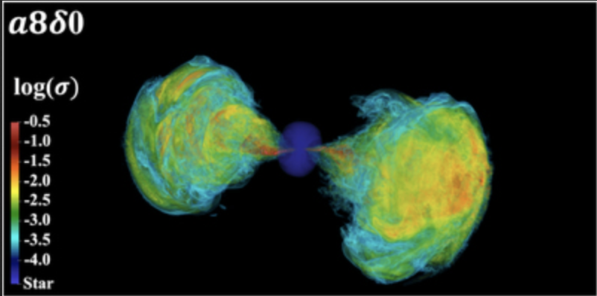
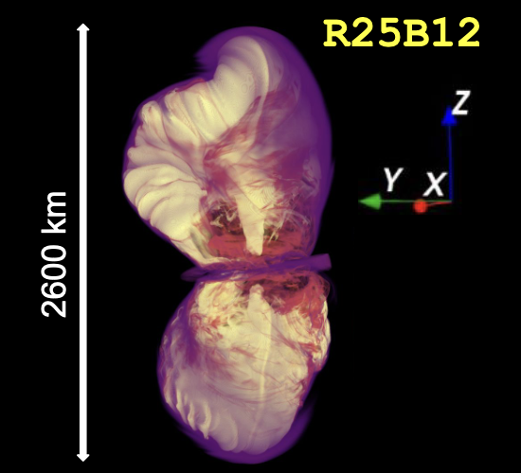
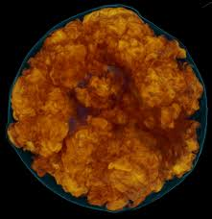
Question 1: What is the Engine?
Gottlieb et al. 2023
Convective Engine:
core collapse driven by electron capture until it reaches nuclear densities
the bounce shock leaves behind a convectively unstable region between proto-NS surface and stall of shock
convection converts energy from core/accretion to kinetic energy
convection also removes the pressure from the infalling star
Magnetar Engine
requires the development of magnetic fields after NS cools
requires high angular momenta (sub ms periods)
Mezzacappa, Messer, Hix
Shankar et al. 2025
Accretion Disk Engine (NS or BH)
Requires high angular momenta
Couch, Warren, …

Slide 4
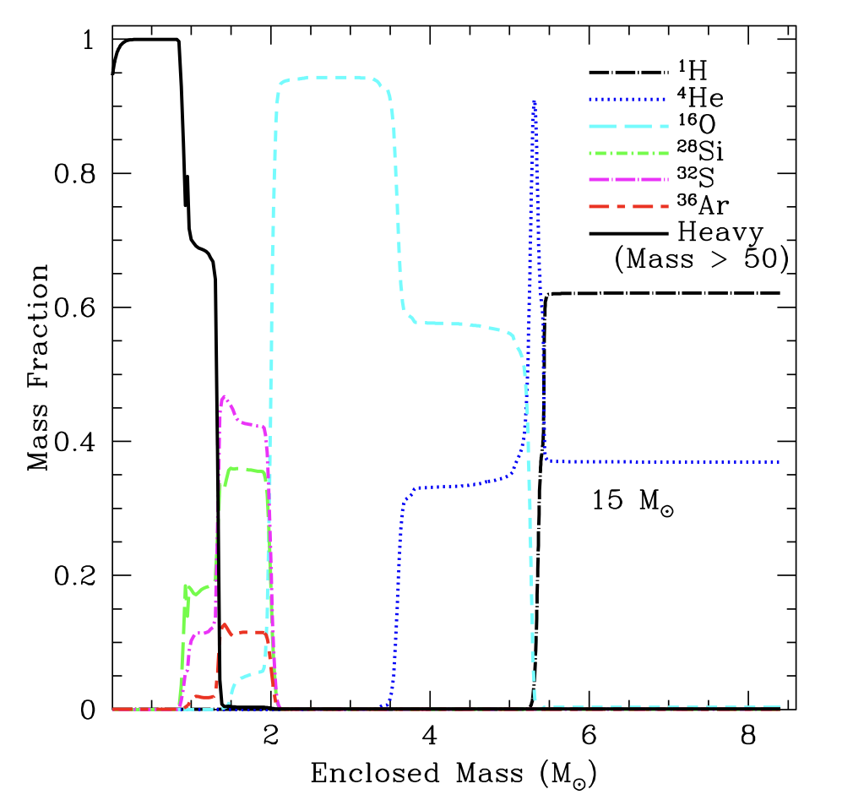
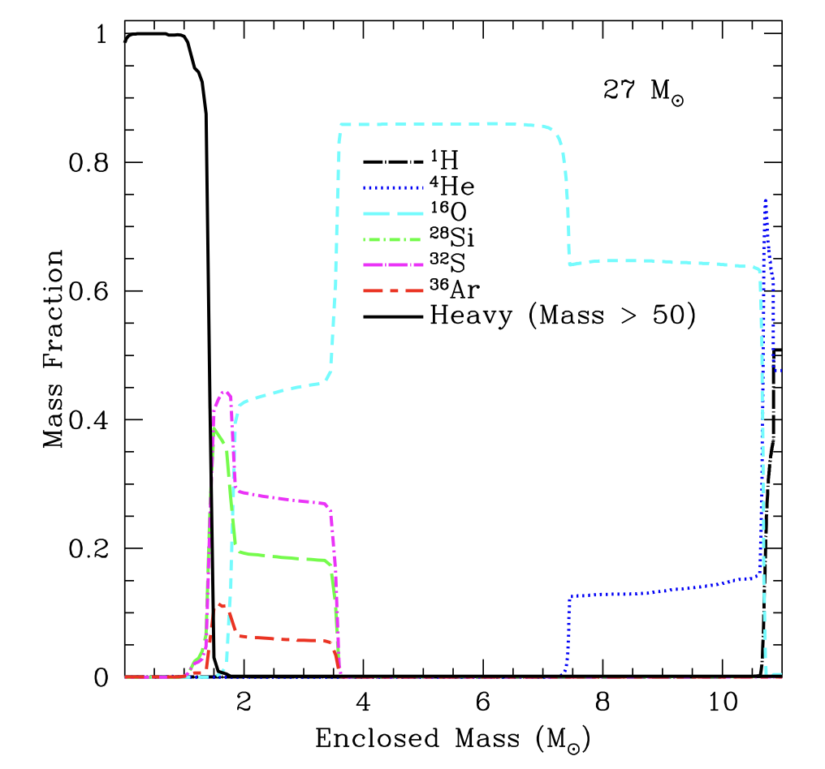
Question 2: What do our progenitors look like (fixing our initial conditions)?
There is a growing set of evidence that current stellar models have multiple flaws: e.g. mixing (including shell mergers), mass loss (line-driven winds, explosive burning, opacity inversions, …) …
Frey et al. 2013
Woodward, Herwig

Slide 5
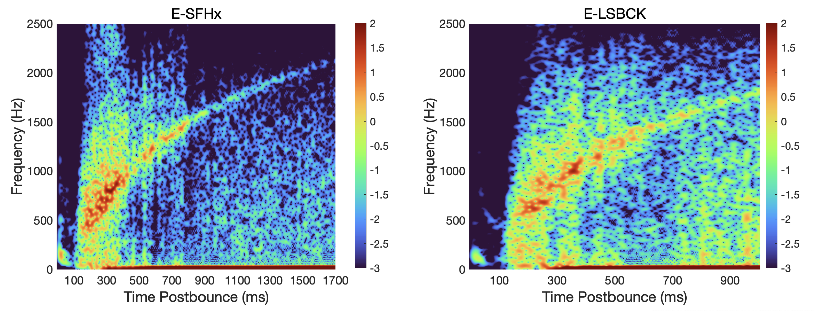
Gravitational Waves and Neutrinos vs. Electromagnetic observations
GWs and neutrinos directly probe the physics in the core. We have long known the GWs can determine if the collapsed core is rotating rapidly. But we will be limited by small number statistics.
We have a lot of EM data. But these observations require a lot of intermediate physics (not direct proof says Thomas). These calculations are pushing the limits of our ability to model complex physics and we are limited by our uncertainties. As a community, we are looking at how we can do better!
Murphy, D. et al. 2024, also recall Alejandro Casallas Lagos’ talk

Slide 6

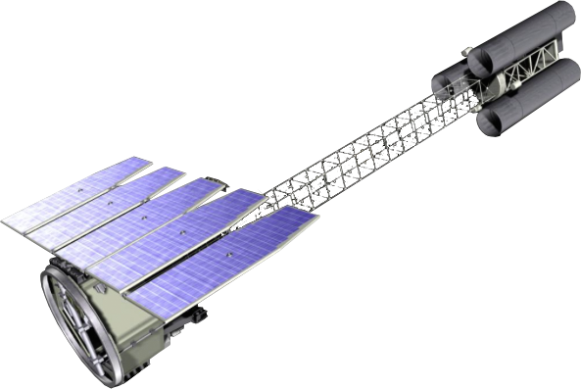
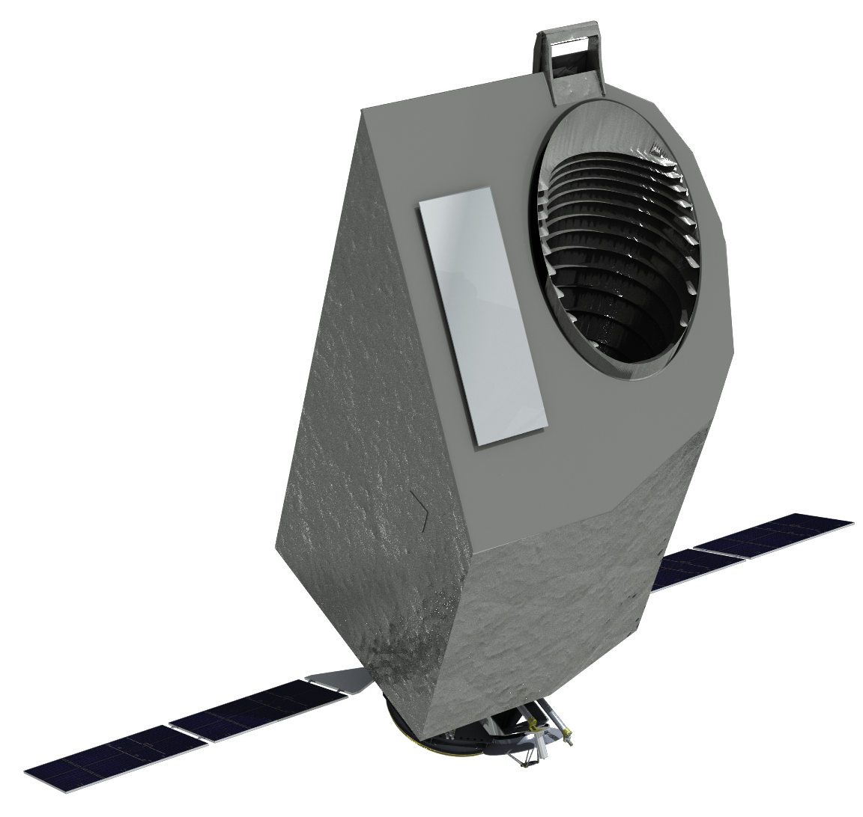
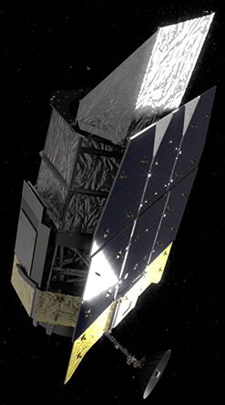
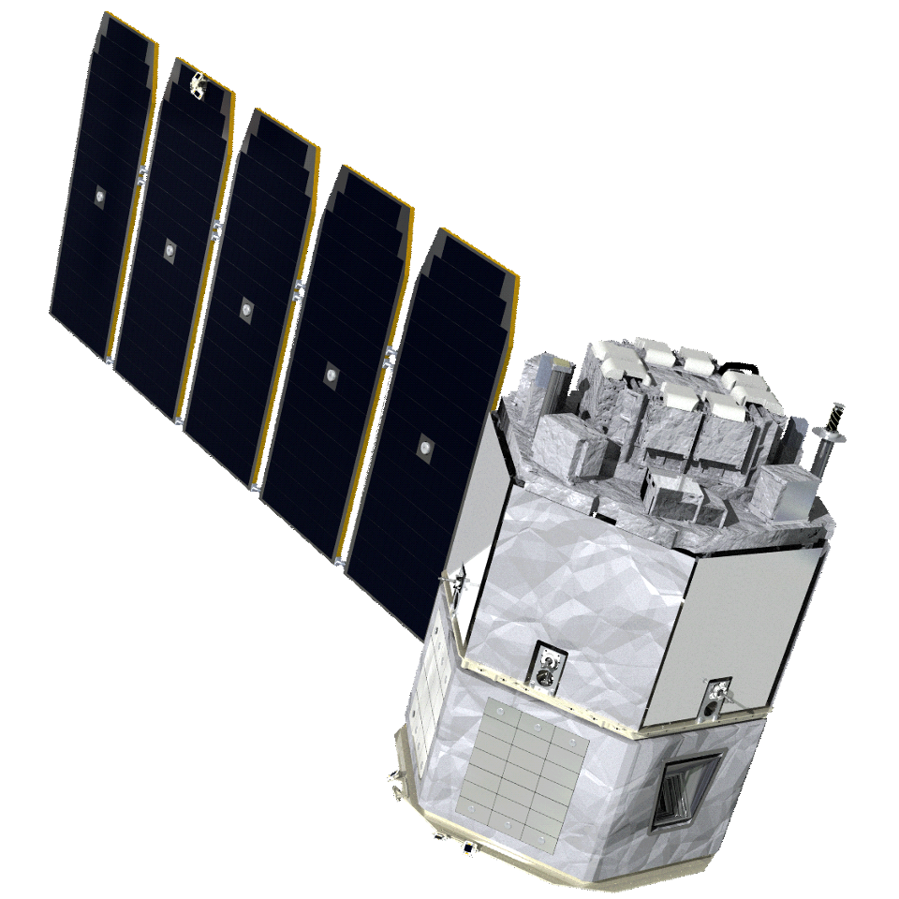
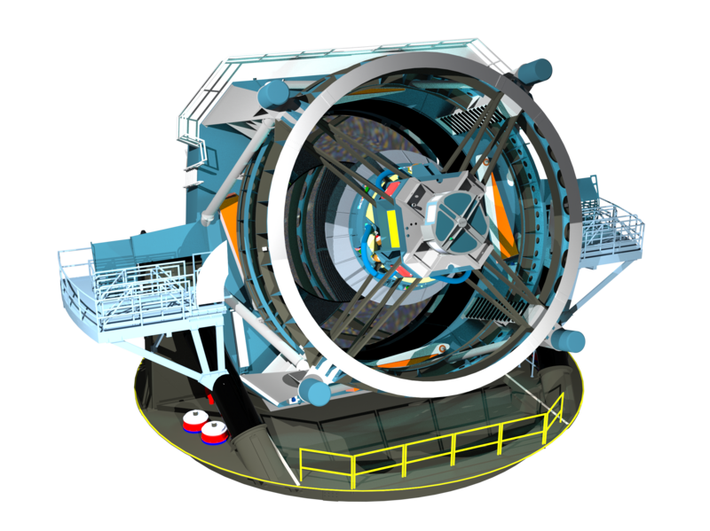
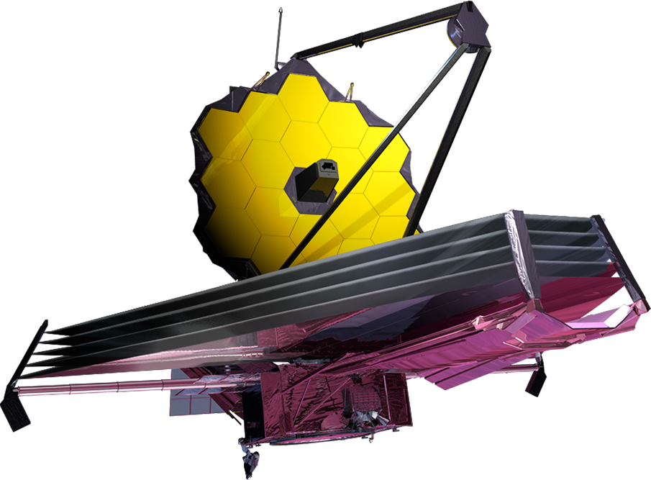
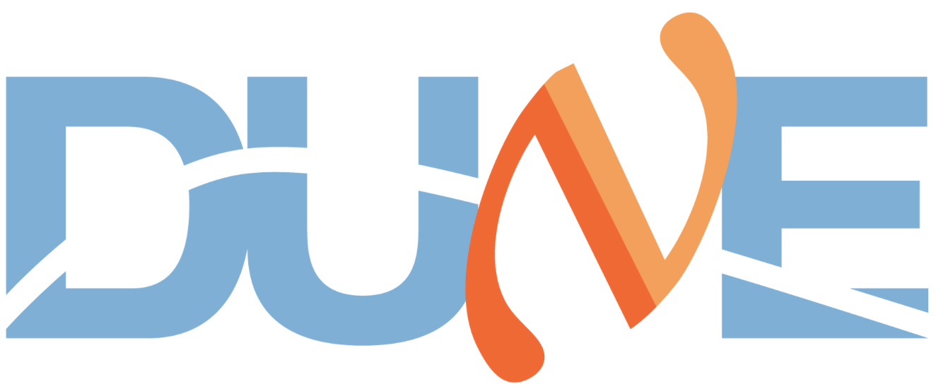
Core Collapse Supernovae
Raph Hix
Progenitor
Core Collapse
Shock & Breakout
Photosphere
Nebula
Remnant
Pre-solar grains
Hydrodynamics
Nucleosynthesis
Chemistry/Materials Physics
ν Transport
Photon Transport / Atomic Physics
GR
Plasma Physics
Nuclear EOS
Cosmic Rays

Slide 7
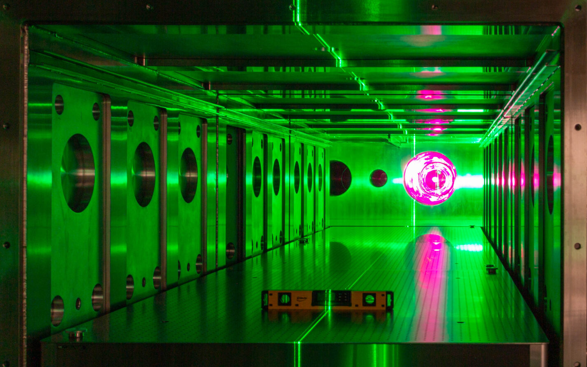

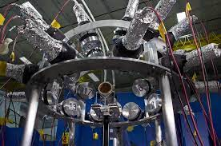

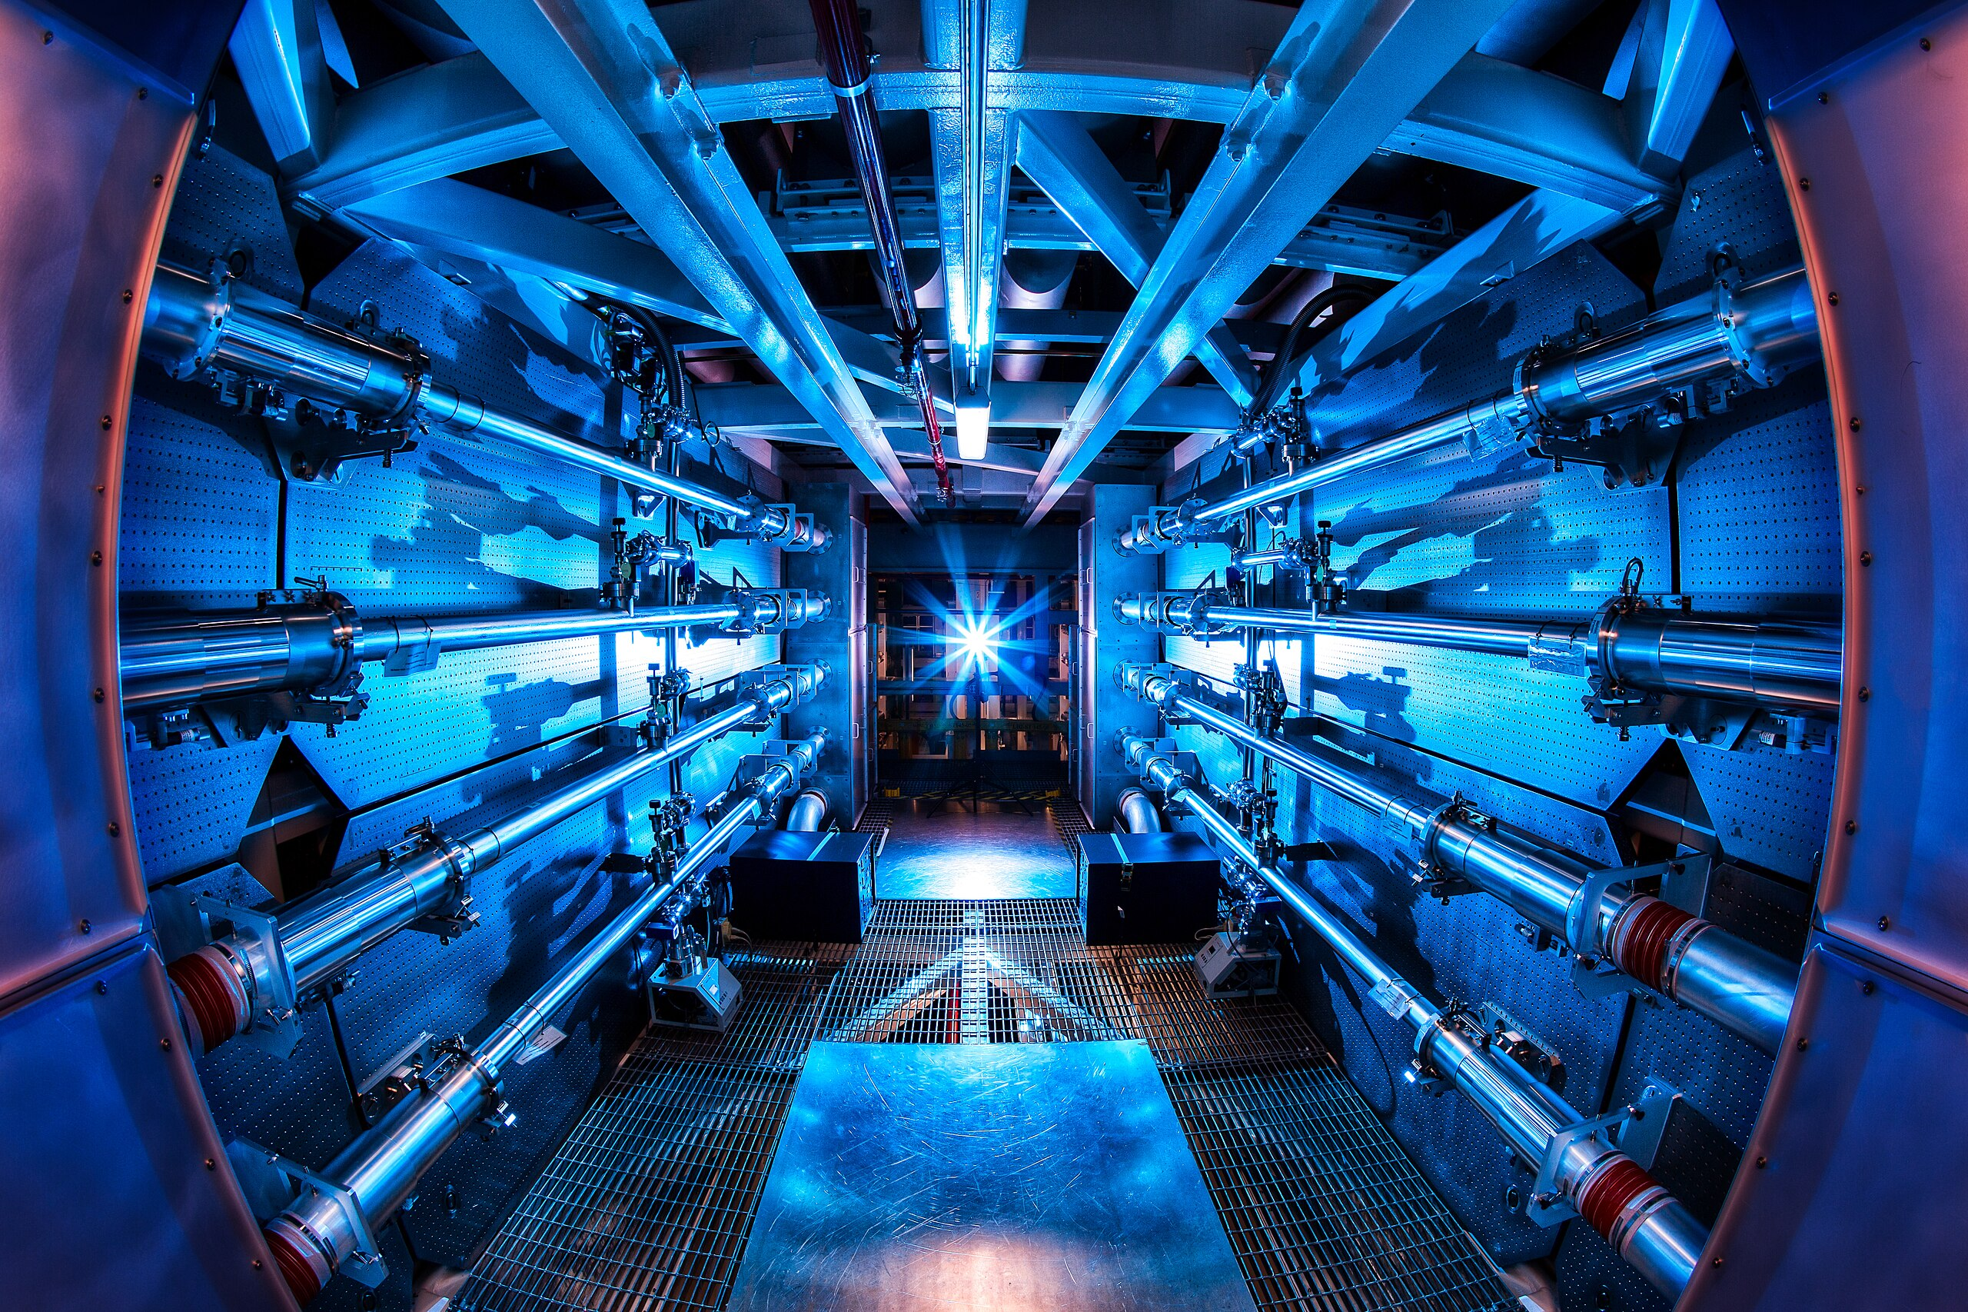
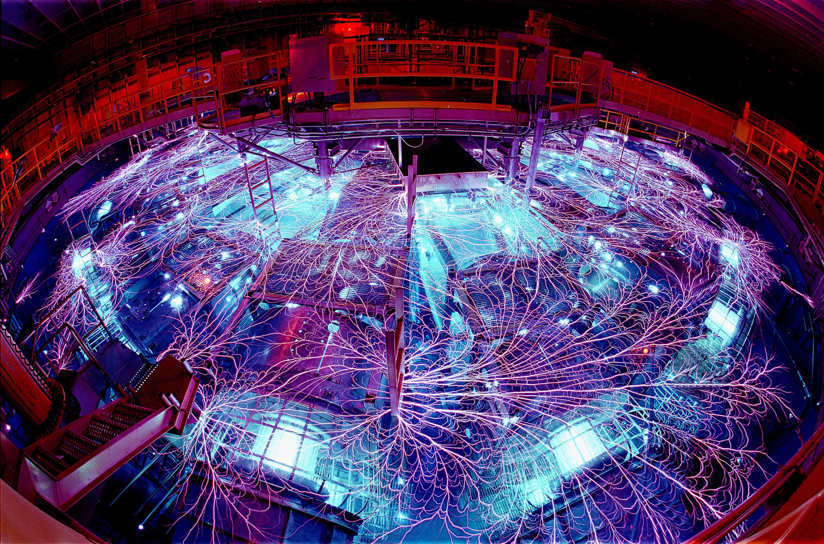


Core Collapse Supernovae
Raph Hix + Eric Burns
Progenitor
Core Collapse
Shock & Breakout
Photosphere
Nebula
Remnant
Pre-solar grains
Hydrodynamics
Nucleosynthesis
Chemistry/Materials Physics
ν Transport
Photon Transport / Atomic Physics
GR
Plasma Physics
Nuclear EOS
Cosmic Rays

Slide 8
X-rays, Infrared and Gamma-Rays
The puzzle of the Cassiopeia A Supernova remnant:
Shock heated silicon features reminiscent of a jet (Huang et al. 2004). But this emission can be affected by the circumstellar media
⁴⁴Ti decay photons confirm the convective engine (Grefenstette et al. 2014)
Milisavljevic is leading a JWST team to probe unshocked material (first results out – Milisavljevic et al. 2024). Combining γ-ray and IR will solve outstanding yield questions.

Slide 9
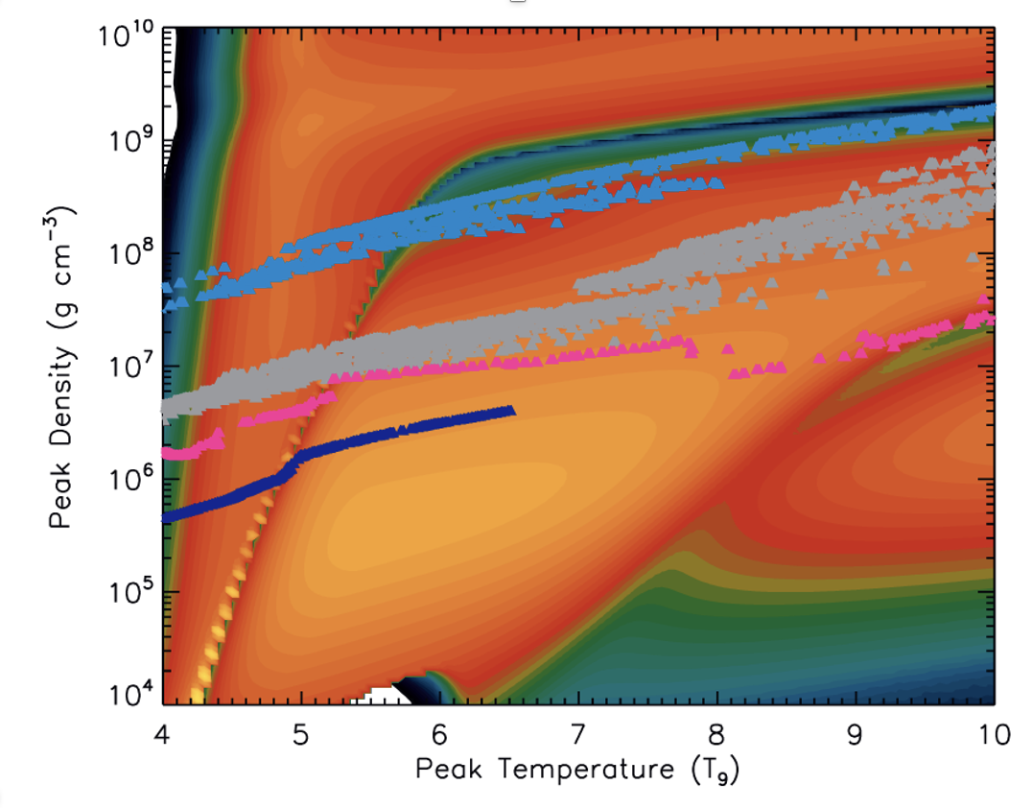
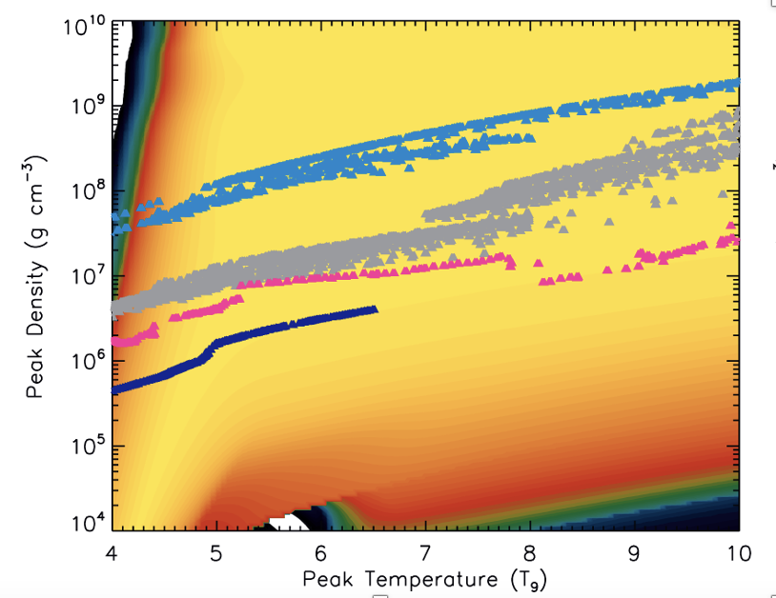
Studying Supernova Nucleosynthesis (γ-ray detectors, e.g. NuSTAR, COSI): Nuclear Physics
⁵⁶Ni
⁴⁴Ti
Magkotsios et al. 2010

Slide 10
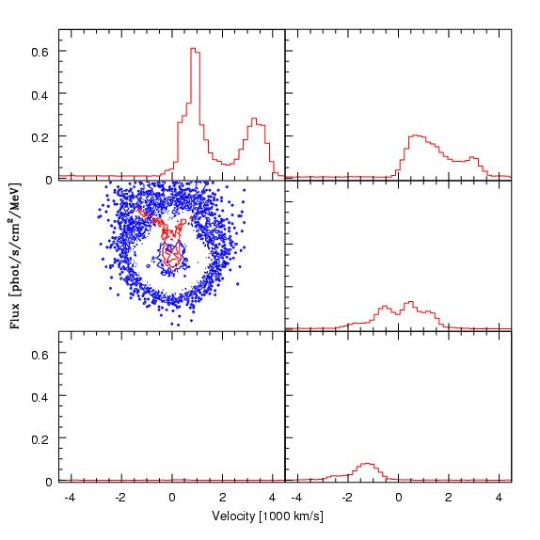
Probes of the Central Engine Morphology: ⁵⁶Ni Gamma-Rays
Hungerford et al. 2003
The convective engine produces asymmetric explosions.
With mild rotation, the convection is aligned with the rotation axis (the angular momentum gradient prevents convection on the equator).
Based on the convective engine, 3-dimensional SN calculations coupled with 3D gamma-ray transport calculations demonstrated how this engine could explain the features in SN 1987A.
Clumpy explosions (from low-mode convection) is critical.

Slide 11
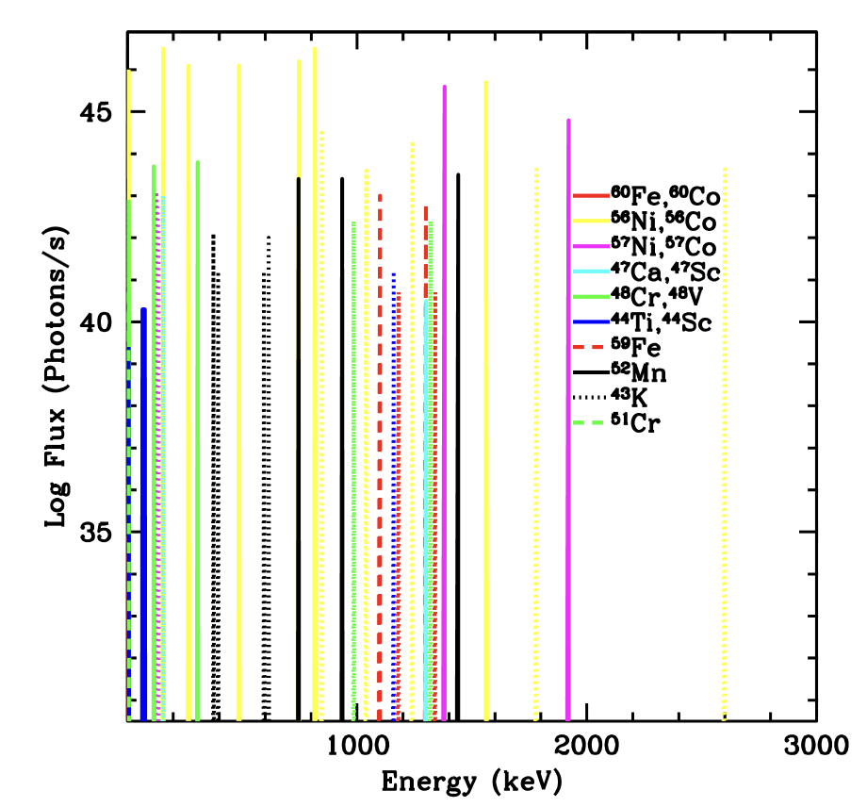
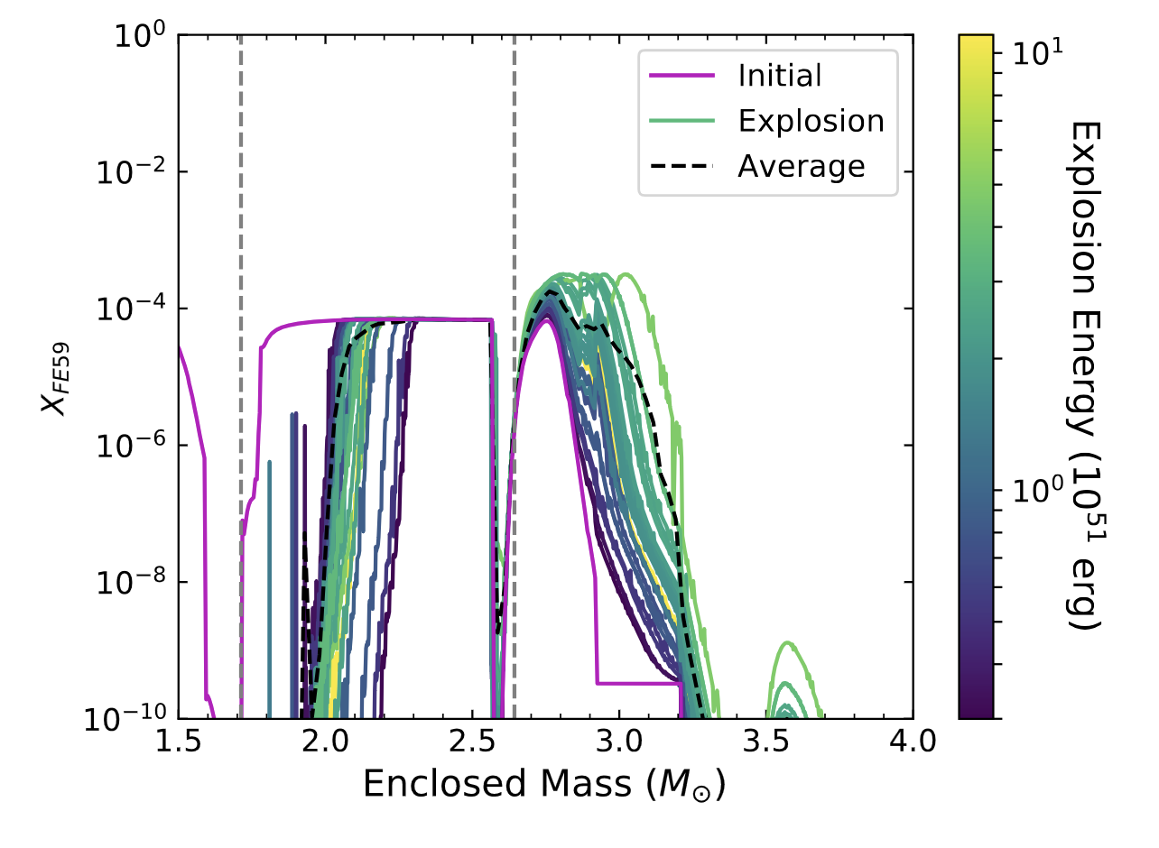
Galactic SN
Andrews et al. 2020
With the COmpton Spectrometer and Imager or next generation gamma-ray detector, we will be able to detect a broad set of lines.

Slide 12
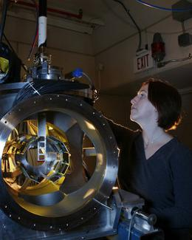
Production pipeline
Measuring cross sections
Coupling with theory to get full reaction rates
Understanding ejecta trajectories
Calculating the γ-ray signal
Implementation into Networks
K. Chipps
Measuring the ⁴⁴Ti(α,p)⁴⁷V

Slide 13
Production pipeline
Measuring cross sections
Coupling with theory to get full reaction rates
Understanding ejecta trajectories
Calculating the γ-ray signal
Implementation into Networks
Model Uncertainties for unmeasured rates have ~ order of magnitude uncertainties. Laboratory measurements can constrain these, but typically in a limited energy regime.
Rate study from joint JINA-CeNAM-INT-CNLS-ASC workshop (R. Longland)
23Na(α,p)
Measuring the ⁴⁴Ti(α,p)⁴⁷V

Slide 14
Production pipeline
Measuring cross sections
Coupling with theory to get full reaction rates
Understanding ejecta trajectories
Calculating the γ-ray signal
Implementation into Networks
Network Comparisons from joint JINA-CeNAM-INT-CNLS-ASC workshop (S. Jones)
Measuring the ⁴⁴Ti(α,p)⁴⁷V
At 30% for many shell trajectories, these uncertainties are among the smallest, but a better understanding of the differences can reduce these significantly.

Slide 15
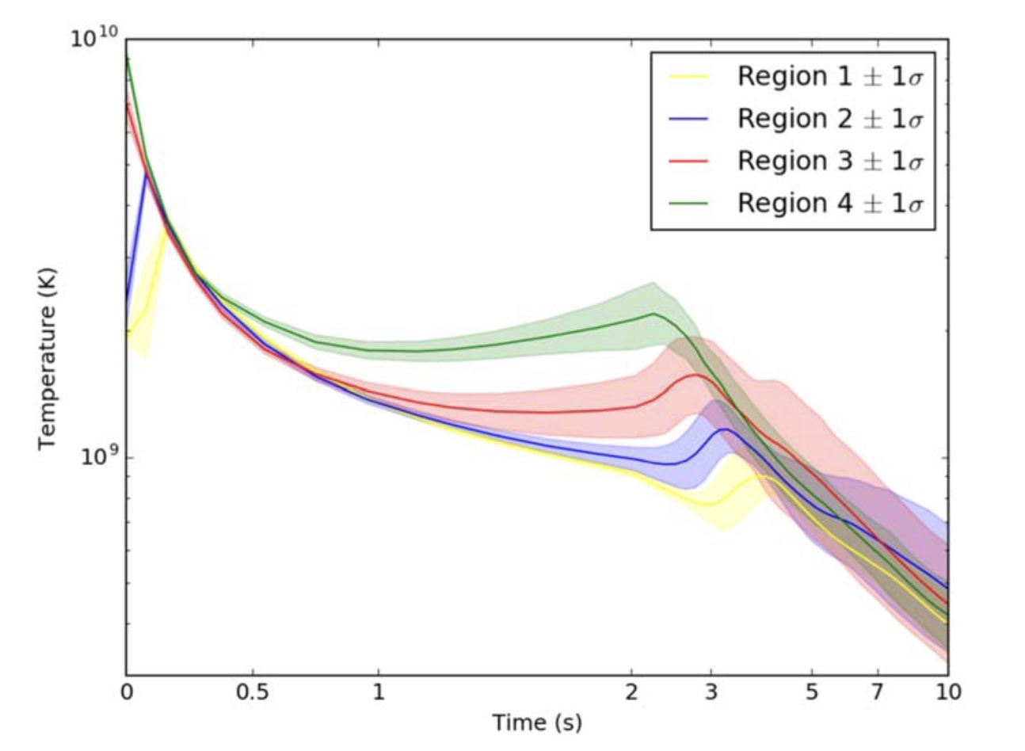
Production pipeline
Measuring cross sections
Coupling with theory to get full reaction rates
Understanding ejecta trajectories
Calculating the γ-ray signal
Implementation into Networks
Accurate trajectories require combining understanding gained from analytica studies and 1-,2-,3-D simulations
Vance et al. 2020
Measuring the ⁴⁴Ti(α,p)⁴⁷V

Slide 16
Production pipeline
Measuring cross sections
Coupling with theory to get full reaction rates
Understanding ejecta trajectories
Calculating the γ-ray signal
Implementation into Networks
Hungerford et al. 2003
Measuring the ⁴⁴Ti(α,p)⁴⁷V

Slide 17
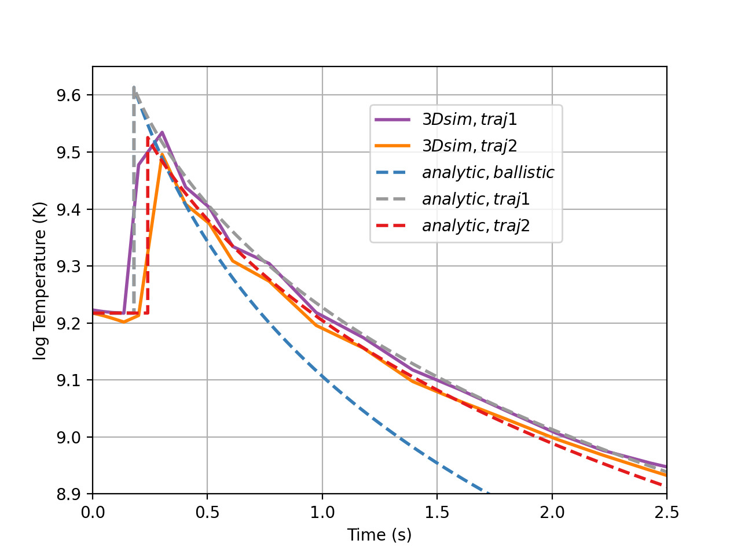
Factors in a trajectory
Power law vs. deceleration
Continuous explosion – this causes reheating in the trajectory (requires multi-dimensions)
Re-implosion of material (multi-d)
Auxiliary shocks (e.g. asymmetries in star, requires multi-dimensions)
Capturing the strong shock: Multi-dimensional models typically can’t capture the shock heating
Any approach requires a full understanding of the trajectories (combining 1-,2-,3-d simulations with analytic solutions)

Slide 18
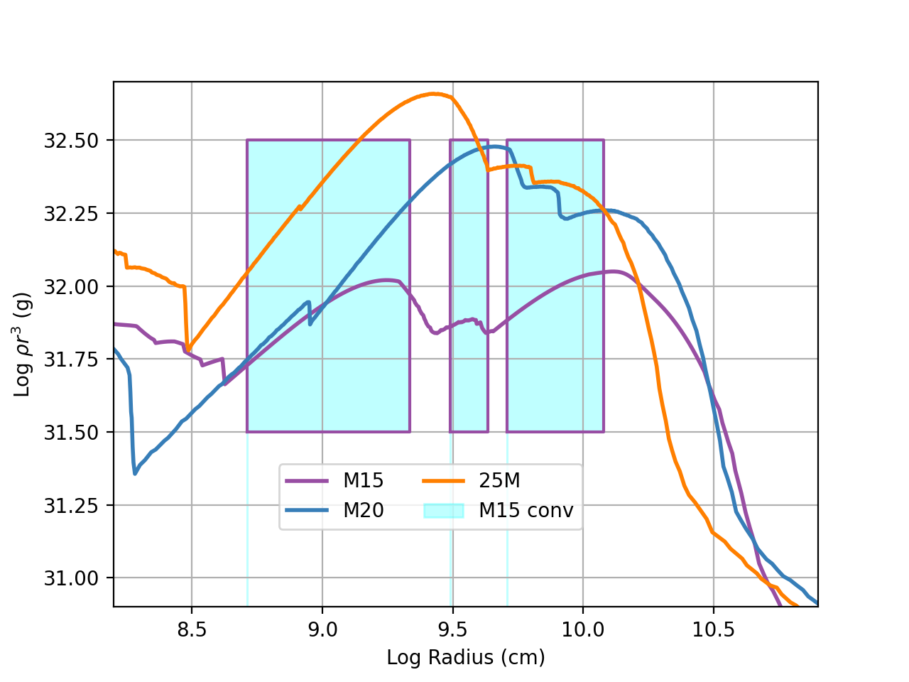
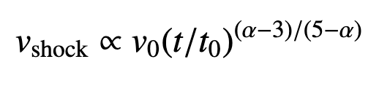
Factors in a trajectory
Power law vs. deceleration
Continuous explosion – this causes reheating in the trajectory (requires multi-dimensions)
Re-implosion of material (multi-d)
Auxiliary shocks (e.g. asymmetries in star, requires multi-dimensions)
Capturing the strong shock: Multi-dimensional models typically can’t capture the shock heating
Any approach requires a full understanding of the trajectories (combining 1-,2-,3-d simulations with analytic solutions)
where ρ ∼ ρ^{−α}

Slide 19
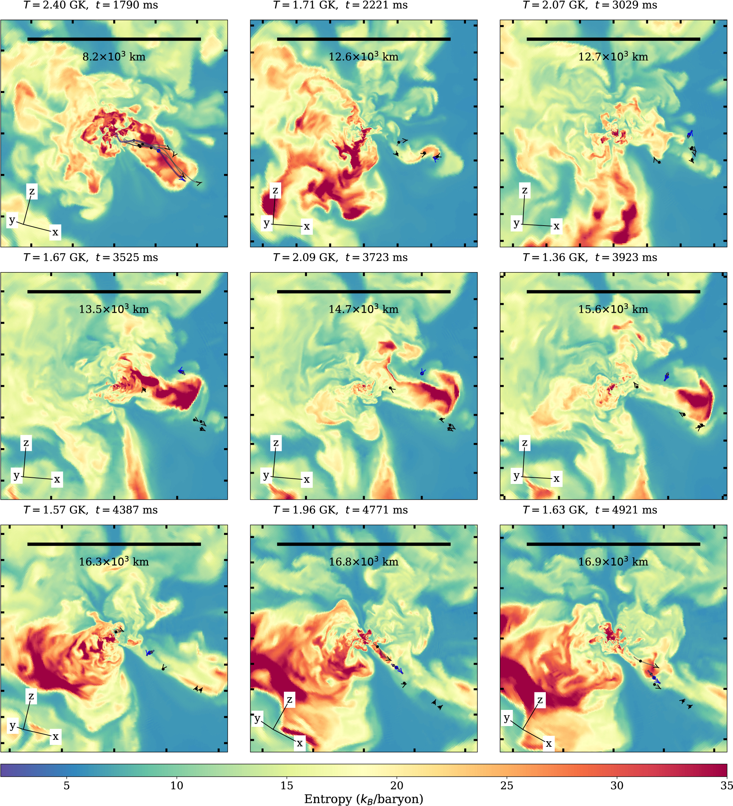
Factors in a trajectory
Power law vs. deceleration
Continuous explosion – this causes reheating in the trajectory (requires multi-dimensions)
Re-implosion of material (multi-d)
Auxiliary shocks (e.g. asymmetries in star, requires multi-dimensions)
Capturing the strong shock: Multi-dimensional models typically can’t capture the shock heating
Any approach requires a full understanding of the trajectories (combining 1-,2-,3-d simulations with analytic solutions)
Sieverding et al. 2023

Slide 20
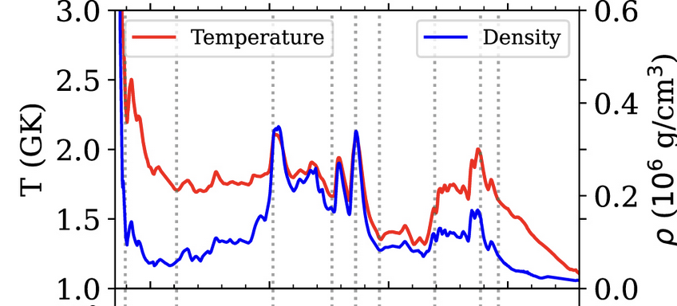

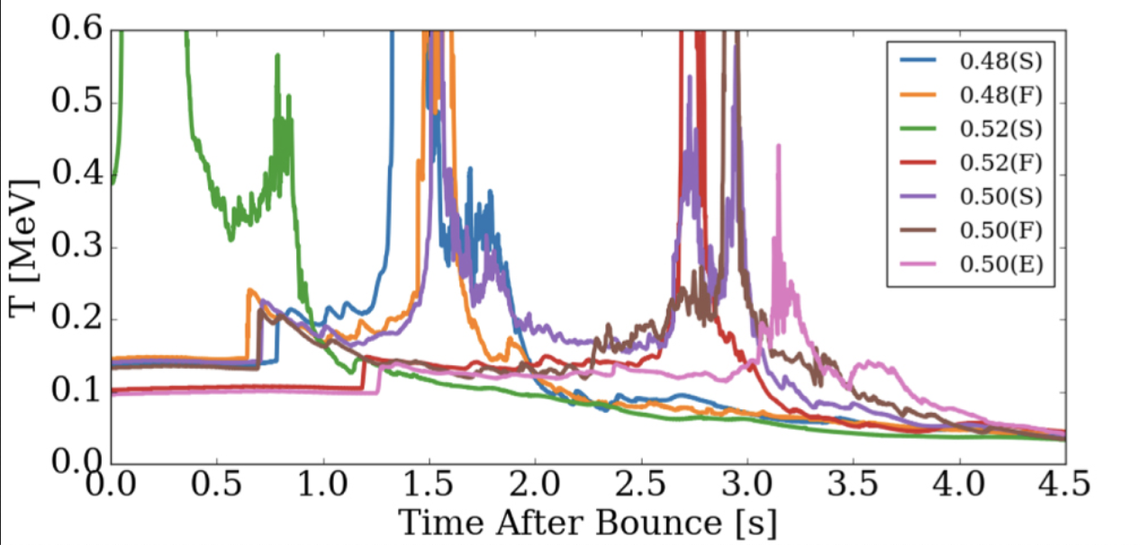
Factors in a trajectory
Sieverding et al. 2023
Power law vs. deceleration
Continuous explosion – this causes reheating in the trajectory (requires multi-dimensions)
Re-implosion of material (multi-d)
Auxiliary shocks (e.g. asymmetries in star, requires multi-dimensions)
Capturing the strong shock: Multi-dimensional models typically can’t capture the shock heating
Any approach requires a full understanding of the trajectories (combining 1-,2-,3-d simulations with analytic solutions)
Wang & Burrows 2024

Slide 21
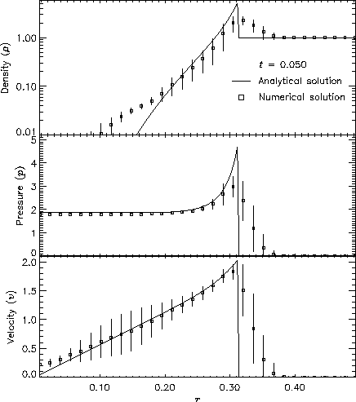
Factors in a trajectory
FLASH Sedov test calculation
Power law vs. deceleration
Continuous explosion – this causes reheating in the trajectory (requires multi-dimensions)
Re-implosion of material (multi-d)
Auxiliary shocks (e.g. asymmetries in star, requires multi-dimensions)
Capturing the strong shock: Multi-dimensional models typically can’t capture the shock heating
Any approach requires a full understanding of the trajectories (combining 1-,2-,3-d simulations with analytic solutions)

Slide 22
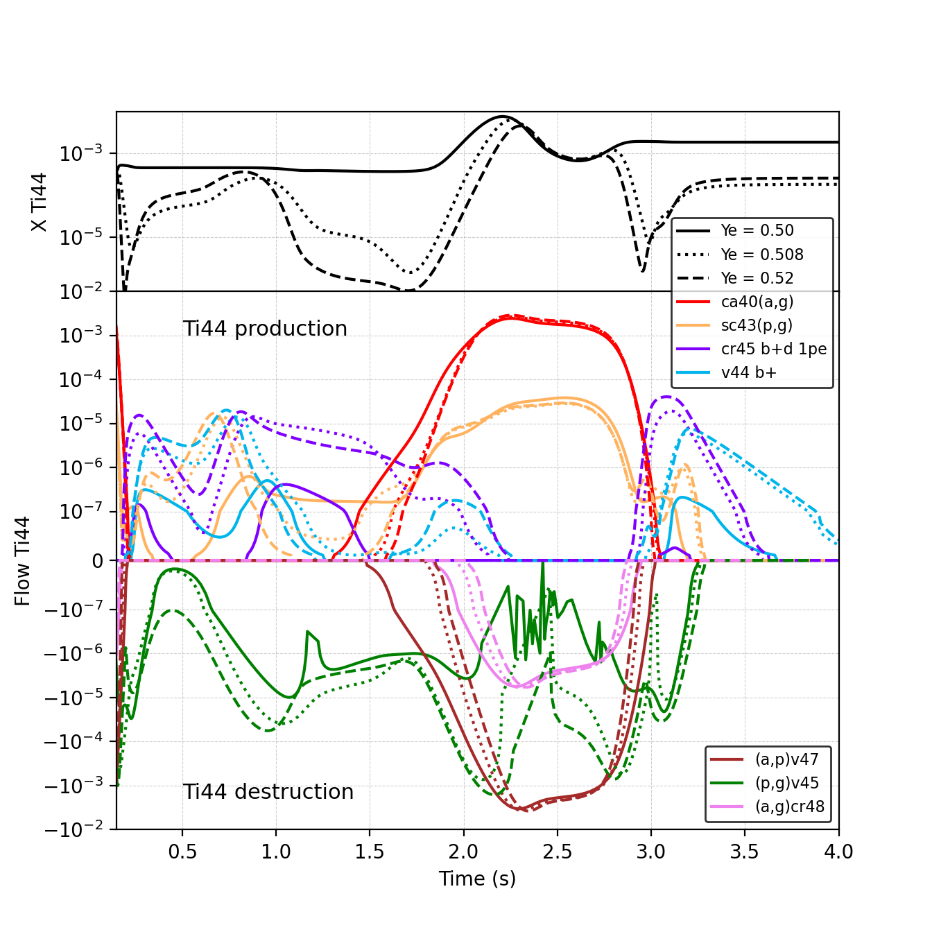
Neutrinos and the Electron Fraction
⁴⁴Ti is made in a flow from lighter elements up to the iron peak and, as such, it is sensitive to alterations in the follow.
Both p- and α- capture reactions are critical in determining the flow.
Changing the electron fraction can have a drastic effect on the free proton fraction and proton capture can alter the flow dramatically.
Advanced neutrino physics (e.g. neutrino oscillations) can alter the electron fraction. If we reduce the other uncertainties, we can use 44Ti measurements to probe this neutrino physics.

Slide 23
Nuclear Physics Uncertainties
⁴⁴Ti is produced and destroyed many different ways (depending on the exact conditions of the explosion.
Magkotsios et al. 2010 found that the most critical reaction rates depend on the conditions of the trajectory.
From the α-rich trajectory incorporating multi-dimensional effects in our joint JINA-CeNAM-INT-CNLS-ASC workshop, current uncertainties in the rates lead to order of magnitude uncertainties (R. Longland).
But focused efforts can reduce these significantly before the development of next-generation detectors.

Slide 24

Conclusions
We have a broad set of multi-messenger data: gravitational waves, neutrinos, and a broad wavelength range of photons.
Given the astrophysical uncertainties, multi-diagnostics can provide much needed confirmation. A broad set of observations can be used for the same diagnostics (e.g. compact remnant properties).
EM studies are typically indirect requiring coupling experimental and theoretical physics and simulation (e.g. our nuclear physics example). We will have to improve all of these to beat down the errors.
Gamma-Rays: Help guide the next generation of gamma-ray telescopes by working with FIGSAG

Slide 25
Indirect Observations require tying to a broad range of physics
Chris Fryer (LANL)
What we learn from SN Light-Curves and Shock Breakout
Constraints on the Engine and the Progenitor
But we have a lot of work ahead of us.

Slide 26
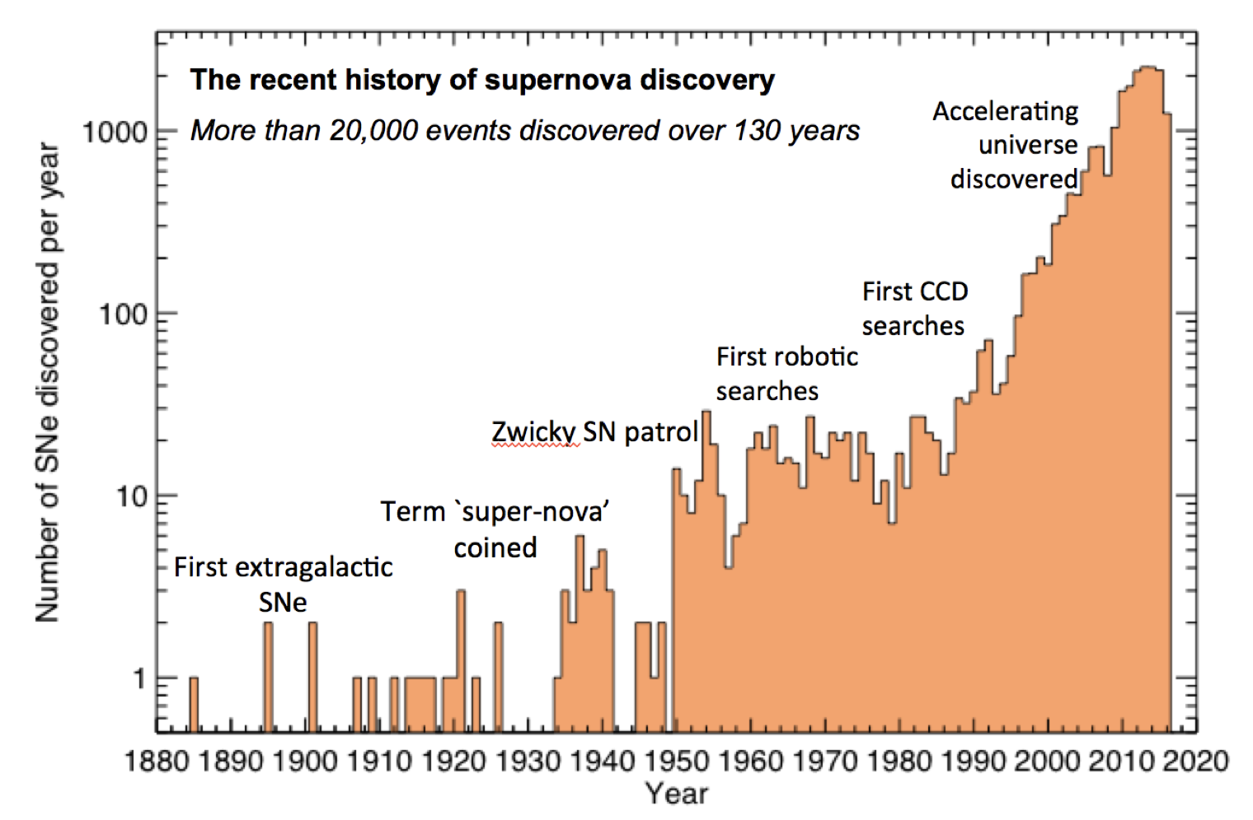
Supernova Light Curves
Most of our data comes from supernova lightcurves and spectra (by 2015, we were detecting over 1000 supernovae per year).
This number will increase by over 100-fold with LSST.
But what can we constrain with this data.
There are many degenerate characteristics of the SN light-curve.
SN light-curves depend on a lot of uncertain physics.
M. Sullivan

Slide 27
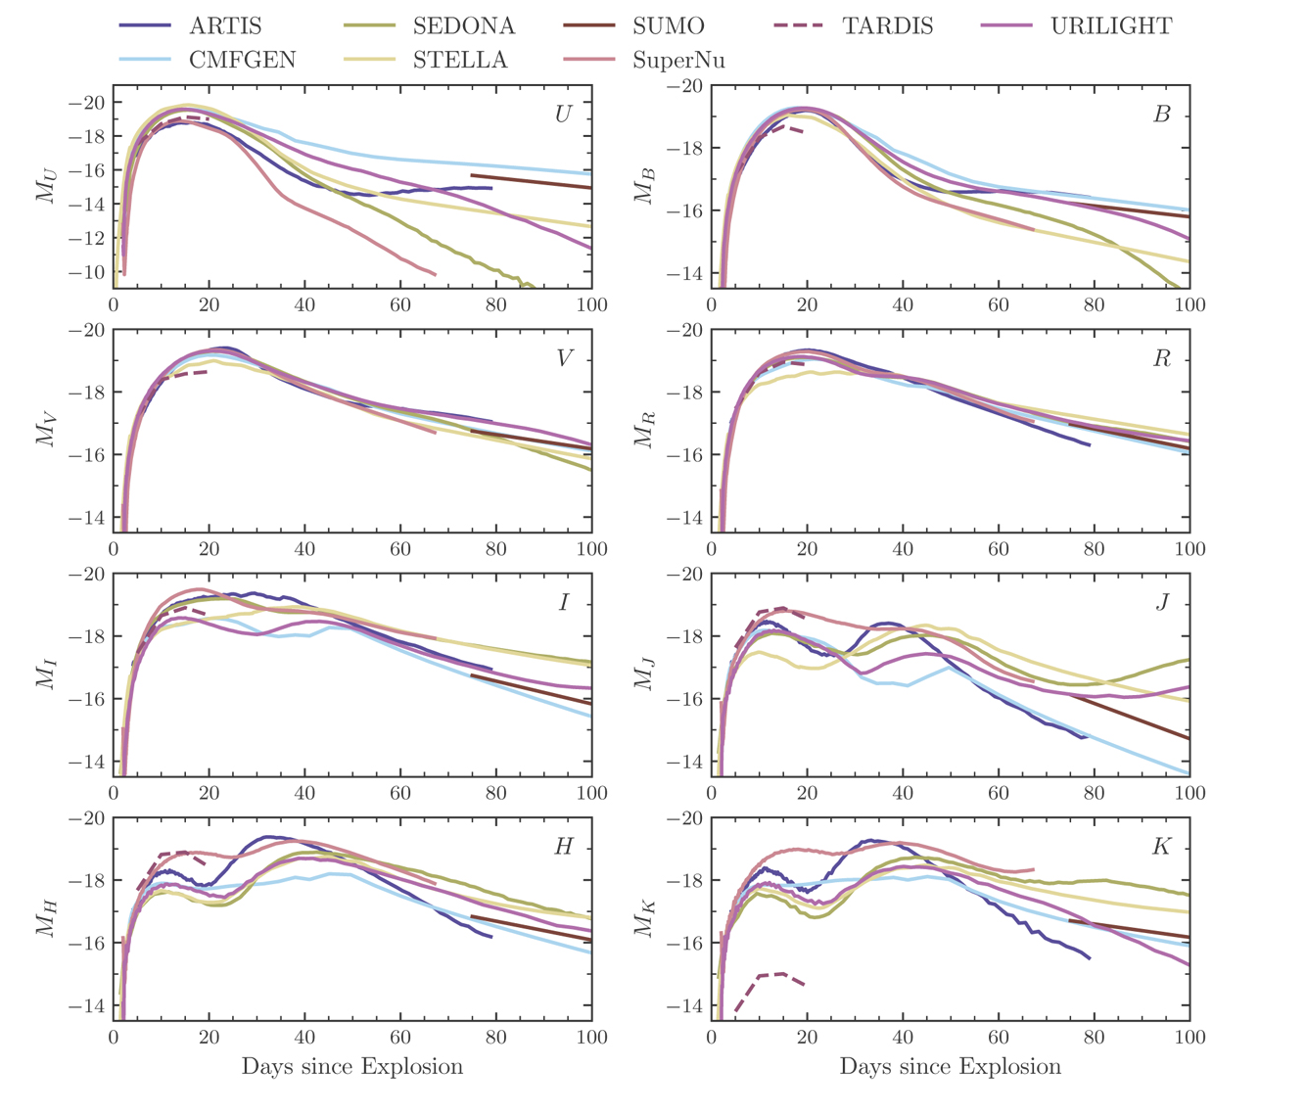
Light-Curves are Difficult
Even when we fix the the initial conditions and the physics, the codes do not reach great agreement.
NLTE effects are plaguing us (lots of things are not in equilibrium)
But, in general for CCSN, we don’t know the initial conditions:
Ejecta mass
Explosion energy
v(m)
Dominant power sources (radioactive decay, shocks, compact sources), the amount of power and their location
Composition (opacities)
Blondin et al. 2022

Slide 28
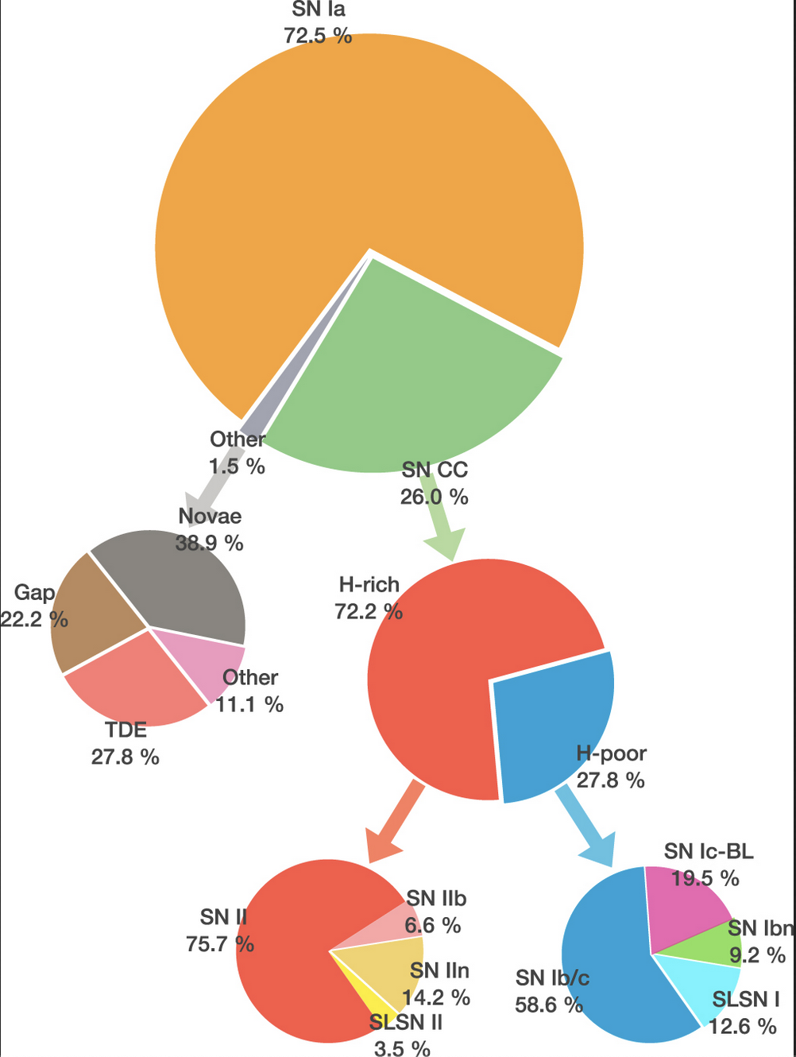
Broad Line Supernovae
Perley 2020
Properties:
Seen as type Ic (no H, no He) SNe, (H/He masses are low
Even the BL-Ic SNe not associated with GRBs tend to be low metallicity (same as the GRB metallicity distribution).
In ZTF, BL Ic are 20% of all type I, 5% of all SNe.
These may require specific progenitors (many invoke BHAD models), e.g.:
Rotation-induced mixing, Yoon & Langer 2005
Tight binaries - Fryer et al. 2025 (but then something is wrong with our stellar models)

Slide 29
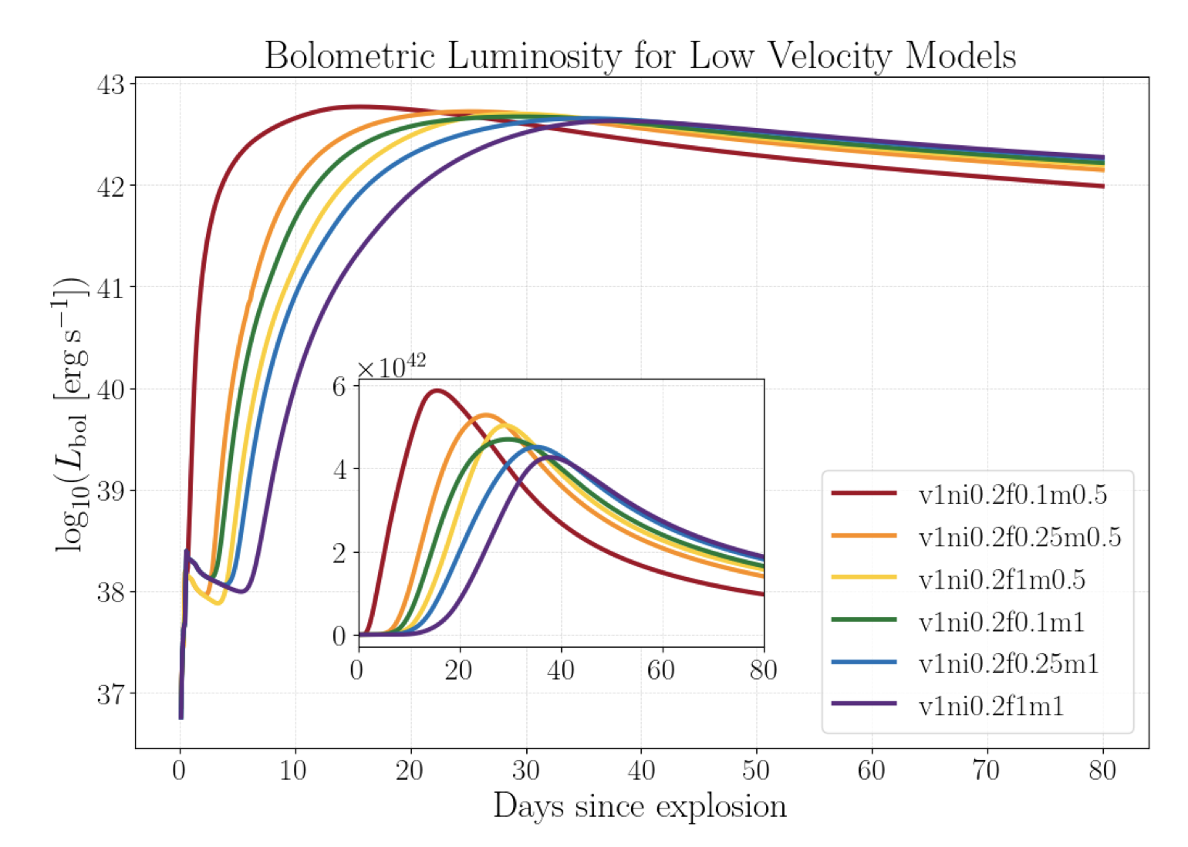
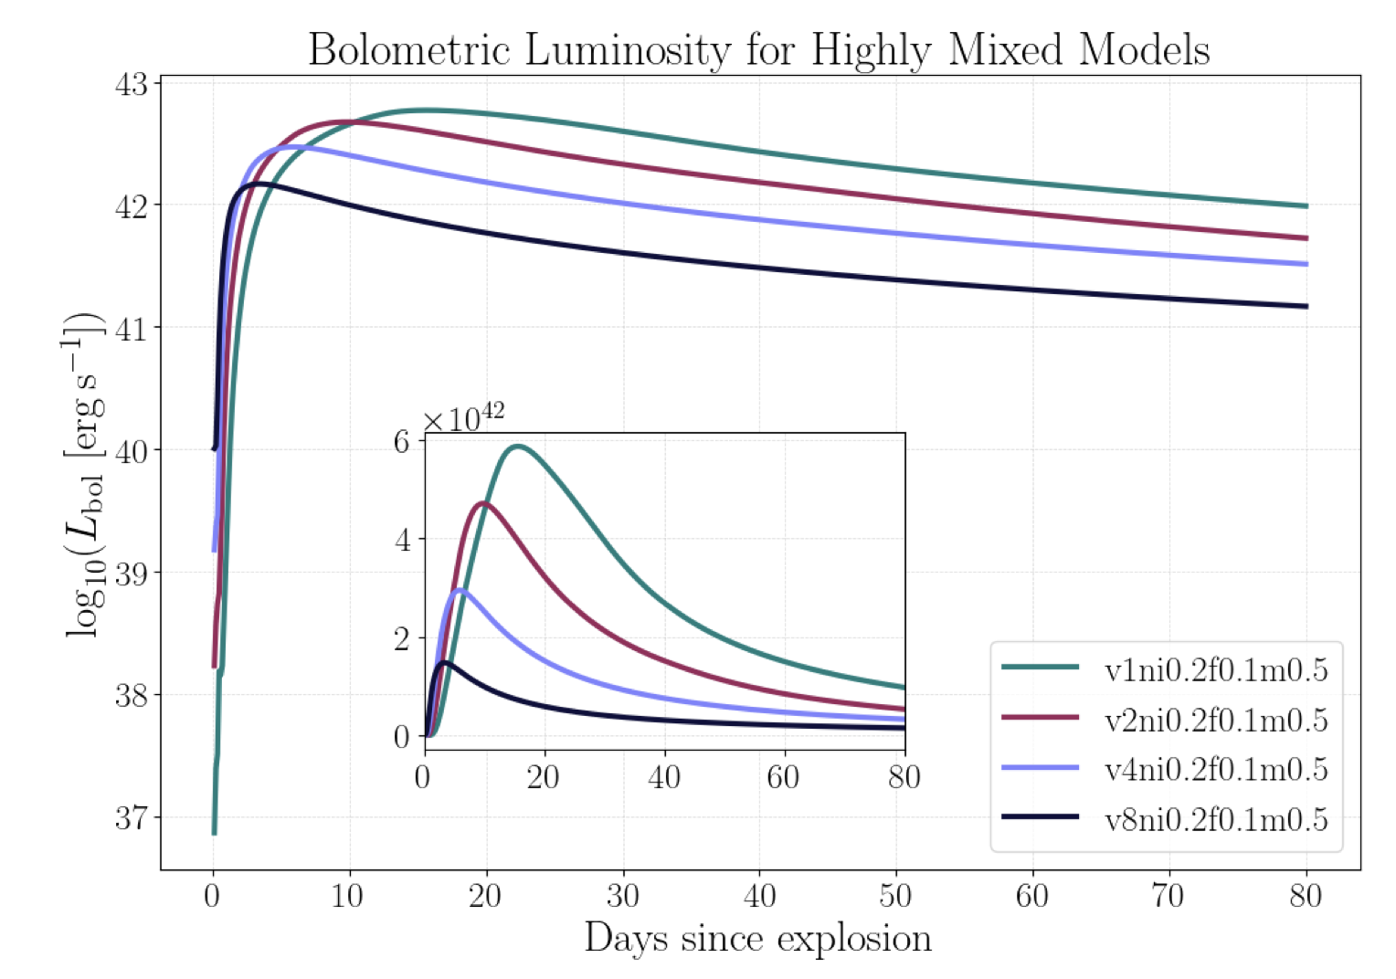
Lightcurve Sensitives
For nickel-powered light-curves, the observed supernova light-curve depends on ejecta mass, ejecta energy, nickel mass, distribution of the nickel (mixing – e.g. from asymmetric explosions), …
Niblett et al. 2025

Slide 30
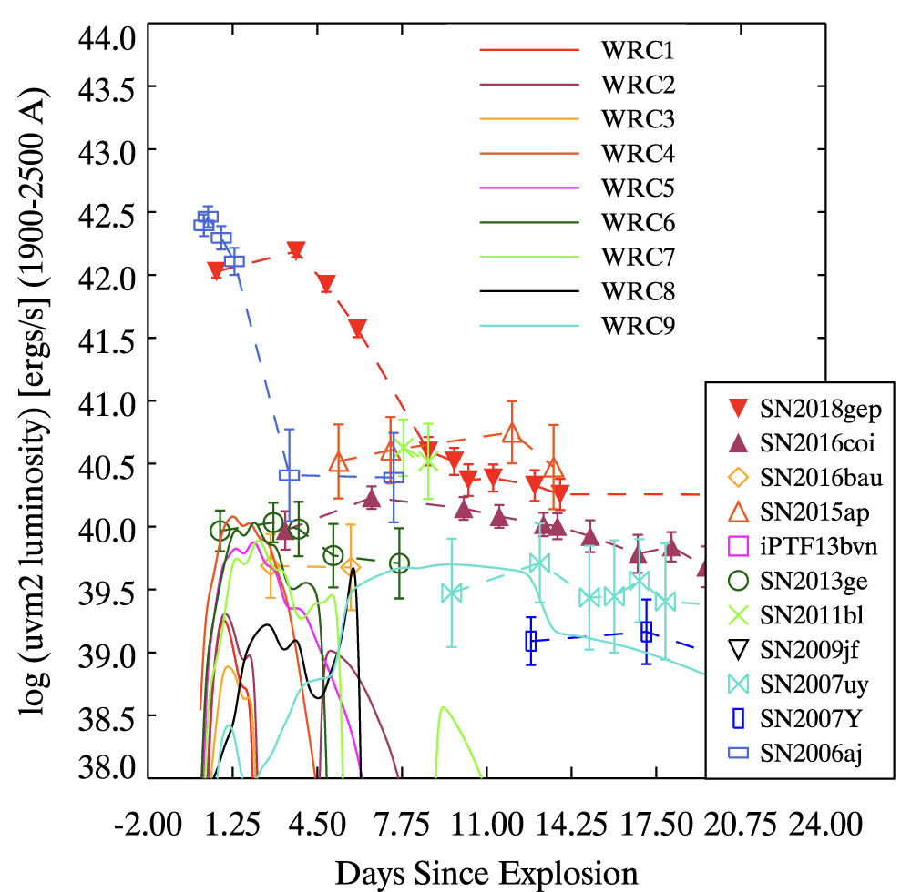
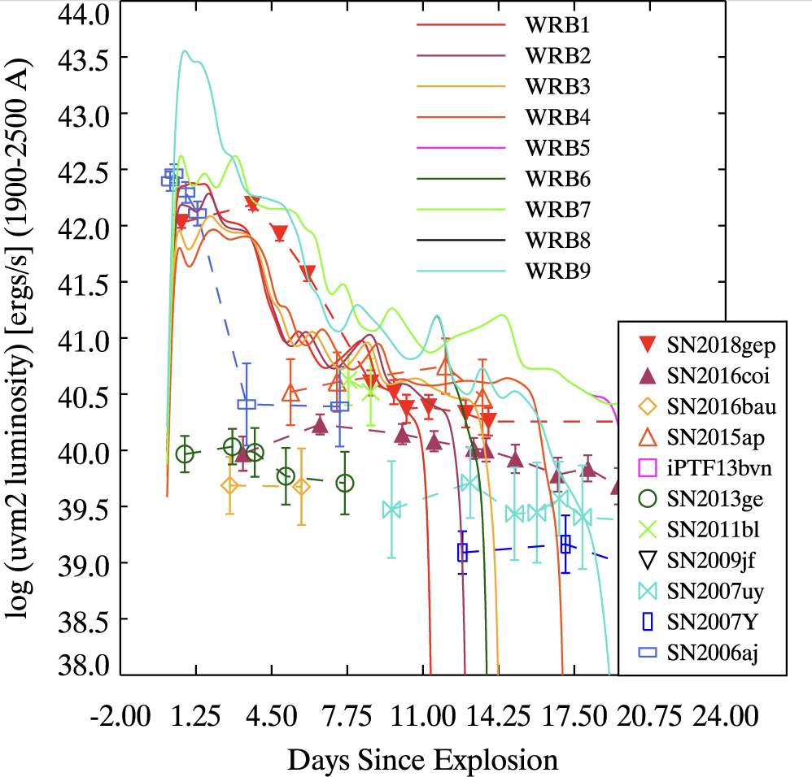
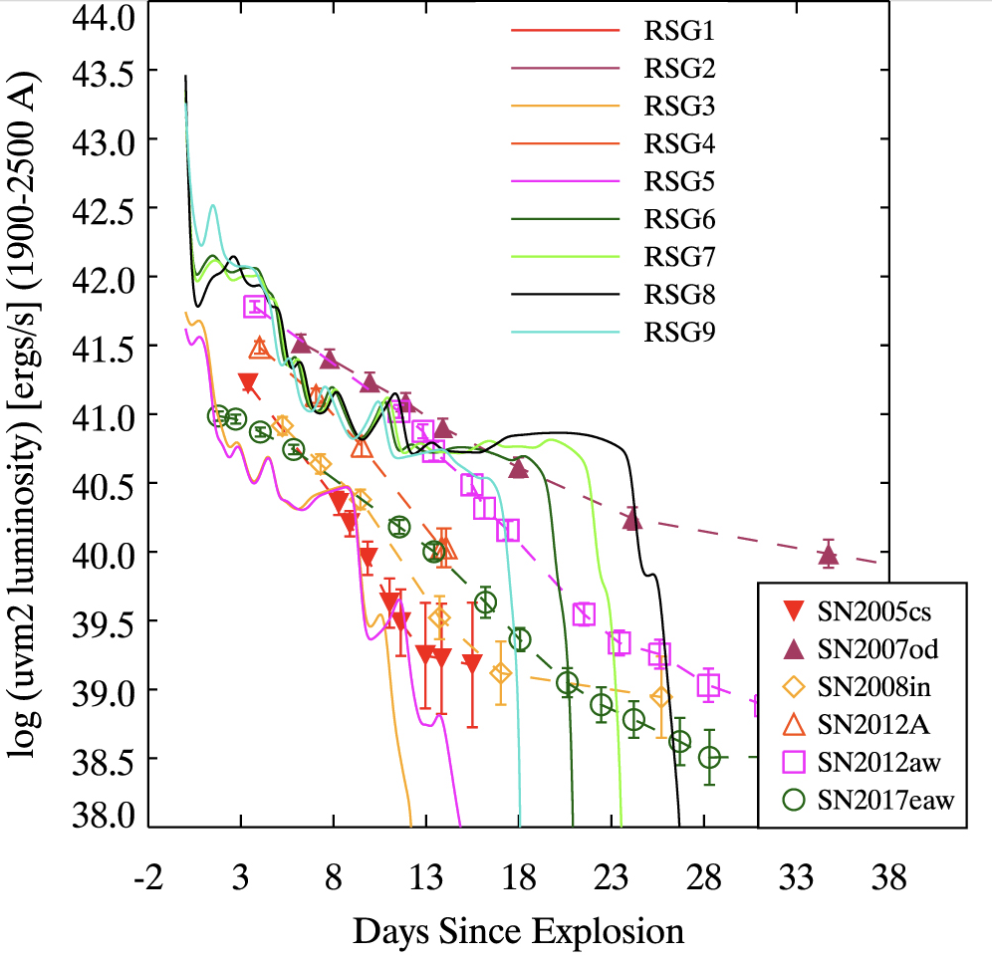
Swift UV observation of SNe require CSM shock interactions
Ultraviolet emission for most supernovae are higher than those predicted by standard SN models. These observations either require extensive outward mixing of ⁵⁶Ni or shocks in the circumstellar medium.
Weak shock interactions
Strong shock interactions
Shocks in type II
Bayless et al 2022, observations from Swift database (e.g. Brown et al. 2014)

Slide 31
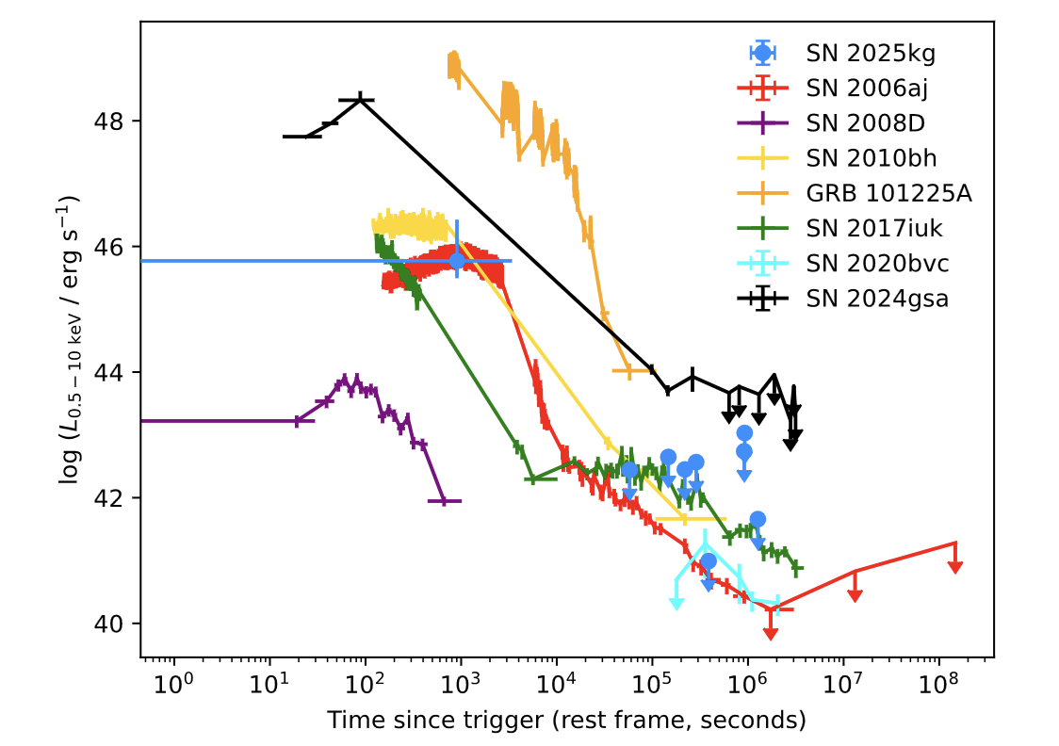
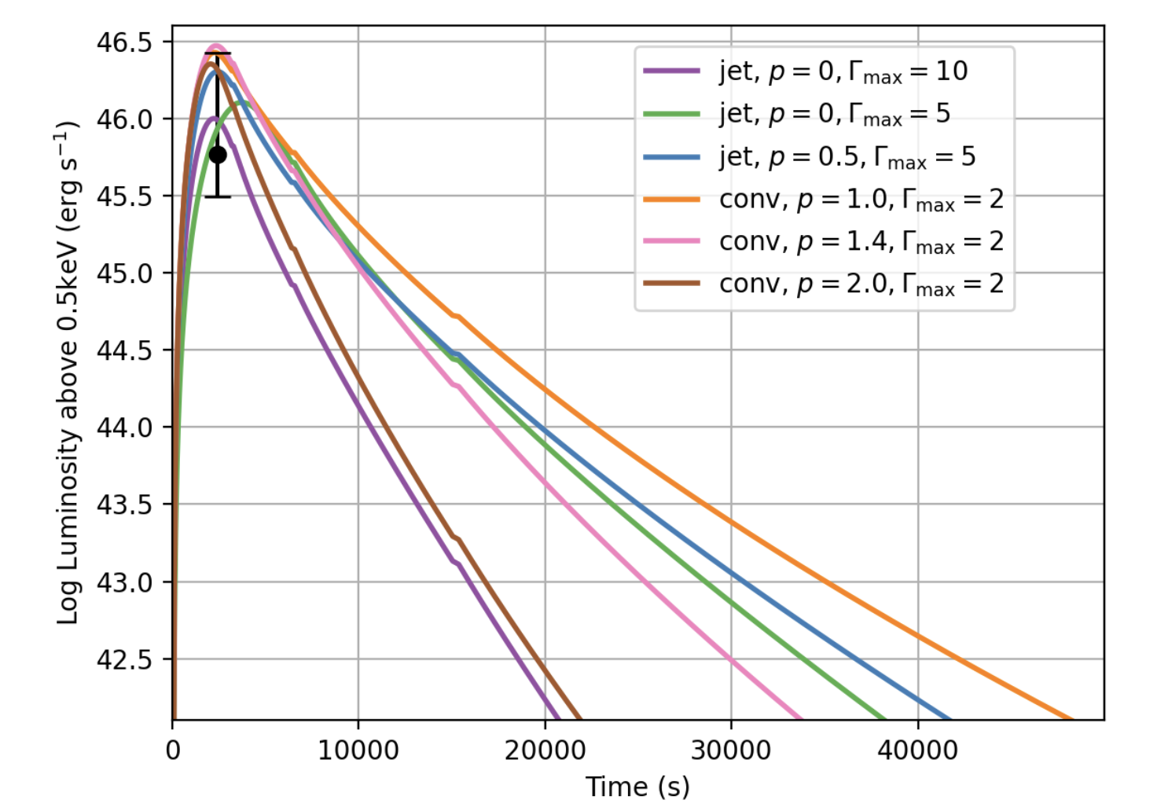
X-rays are needed but also non-trivial
X-ray signals focused on only the highest-temperature shocks.
This emission is shorter-duration than UV but it is still difficult to differentiate shock breakout from shock interactions (Eyles-Ferris et al. 2025)
Could measure shock acceleration propagating through the edge of the star but data is limited.

Slide 32
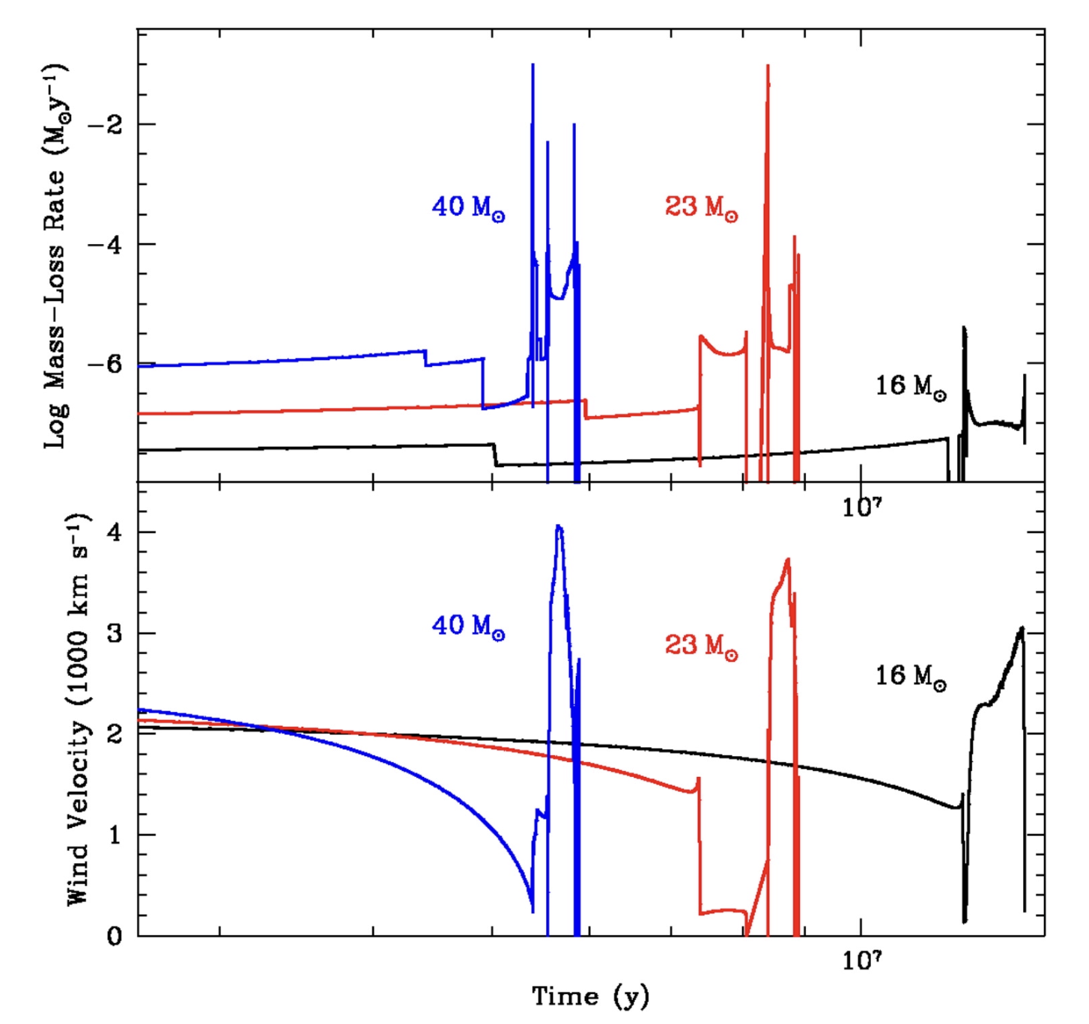
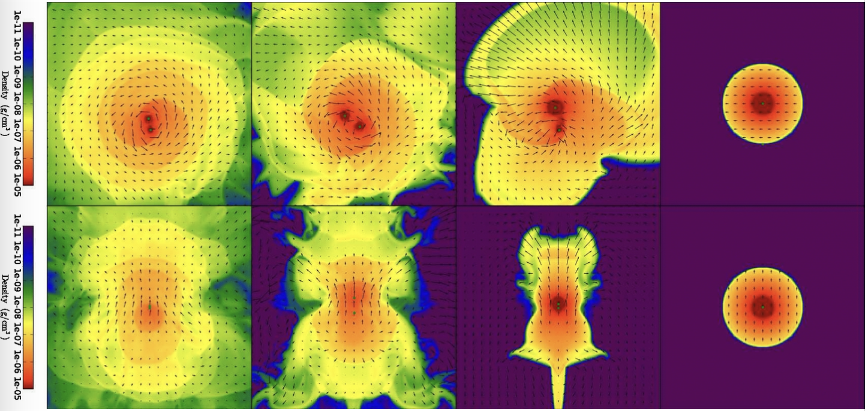
Mass Ejection is Messy
Mass ejection occurs from:
Explosive Burning
Driven waves (e.g. g-modes)
Opacity Inversions
Common Envelope ejection
This can be messy, allowing us freedom in incorporating this physics.

Slide 33
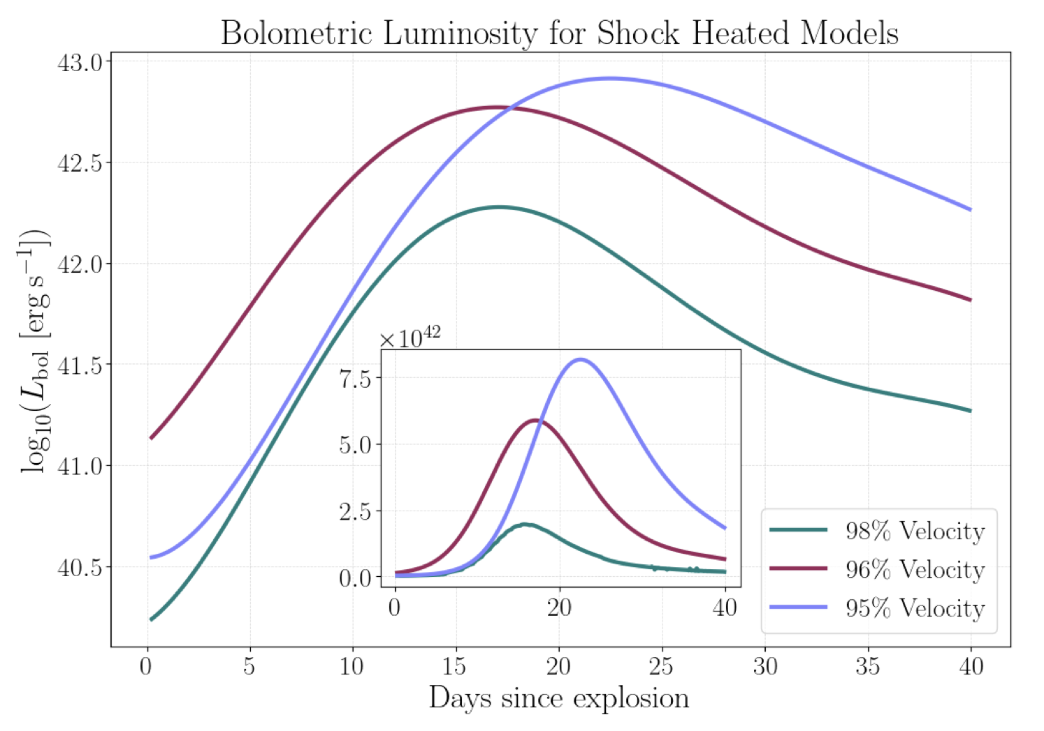
Shock Heating
Niblett et al. 2025
Shock heating can play a dominant role in the the light-curve.
Without improving our understanding of the circumstellar medium, it will be difficult to distinguish shock heating from outwardly-mixed ⁵⁶Ni.

Slide 34
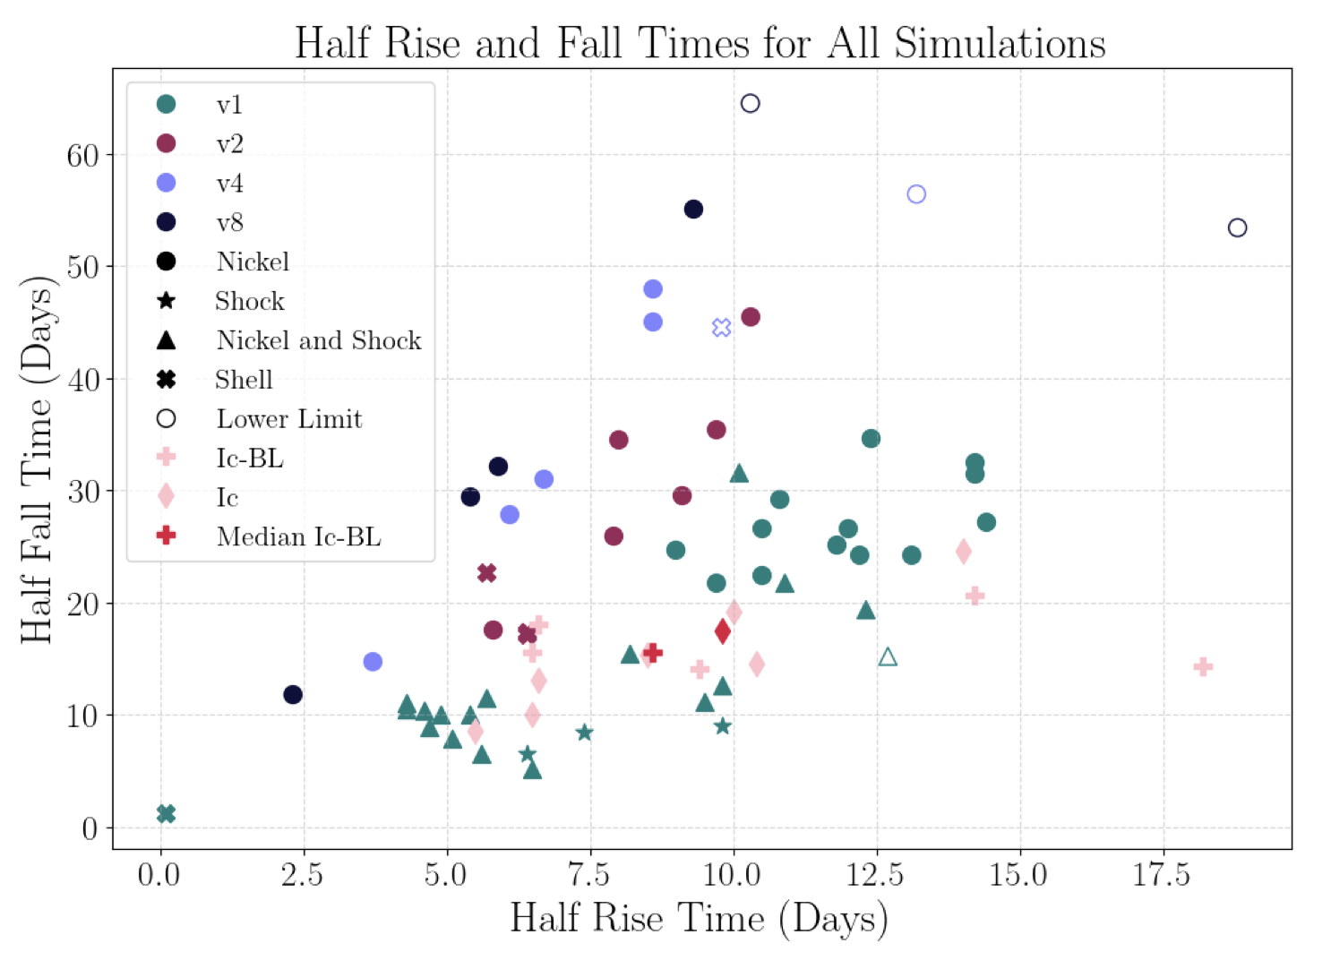
Rise/Fall Times
Niblett et al. 2025
A broad range of light-curves can be explained with our basic models.
It might be more educational to determine what the models can’t produce (⁵⁶Ni-powered models could not produce the rapid fall times of the light-curve)
These models are simplified (is the issue caused by the approximate physics?)

Slide 35

Perhaps Shock Breakout Can Help
In the first models of prompt emission, scientists focused on the energy stored in spherically symmetric shocks as they exited their progenitor stars (for a review, see Waxman and Katz 2017). These studies showed a direct correlation between stellar radii/shock speeds and the breakout emission.
New studies include asymmetry effects (Irwin et al. 2021). These asymmetries complicate the picture. Recall D. Vartanyan’s talk.
But the simple forward-shock picture does not capture the complete picture of the sources of prompt emission.
Irwin et al. 2021

Slide 36

Asymmetries in the Star
The “shock breakout” emission is powered by shock heating as the supernova blast wave bursts out of the star.
Shock heating occurs in:
Convective cycles in the stellar envelope
Shocks accelerated in the transition region between the envelope and the wind
Shocks in wind inhomogeneities
The asymmetric explosion plows through the star, shocking against the convective instabilities.
For type II SNe (giants/supergiants), the “edge” of the star is difficult to determine (Goldberg et al. 2022)

Slide 37

Shock Interaction 101
Shocks don’t just “Break Out”, i.e. the shock doesn’t transition promptly from trapped to free-streaming.
The radiation will begin to lead the shock, depositing momentum and energy into the stellar wind just above it, causing it to accelerate.
This physics is not in most shock breakout or SN light-curve models (most important at early times).

Slide 38




Shells
A simple shell can be understood from strong shocks:

Slide 39



Clumps
The picture with a clumpy medium becomes more complex.

Slide 40





Transport through a Stochastic Medium
LANL is building on these experiments to test radiation flow (and the resulting shocks, etc.) in an inhomogeneous medium.
Density
Temperature
Composition
Target

Slide 41






Experiments (e.g. NIF, Omega, z-pinch, …)
Observations (broad energy coverage for ground- and space-based observations, polarization, gravitational waves to get initial conditions, neutrinos…)
Multi-Physics, macroscopic calculations (e.g. radiation-hydrodynamics, turbulence, atomic physics, equation of state)
Physics (e.g. radiation hydrodynamicsturbulence)
Identify new observations
Scale Bridging + Multi-Physics Methods (e.g. PIML)
Algorithms (e.g.
radiation-hydrodynamics or radiation-opacity coupling schemes, subgrid turbulence models)
Theory Models
Instrument design:
UV, X-ray (e.g. UltraSAT,, UVEX)?
Identify physics probed by new observations
Different Calculations are more amenable to different architectures including GPU centric, CPU centric, and Quantum resources

Slide 42


TDAMM workshops
1st TDAMM workshop: focus on sources
2nd TDAMM workshop: focus on instrumentation and observing infrastructure
3rd TDAMM workshop: focus on the physics disciplines and modeling efforts needed to span from fundamental physics to observed phenomena.
4th TDAMM workshop: planning the EM follow-up to transient discoveries (Oct. 27-30, Huntsville)

Slide 43

Conclusions
The transient emission (from shock breakout to late-time evolution) requires broad band light curves and spectra (from IR to γ-ray) provide clues to help us understand both the progenitor and the engine.
Combined with observations of nucleosynthetic yields (nebular-phase spectra, SN remnants, Galactic Chemical Evolution), compact remnants (e.g. spin, mass), these observations can bolster what we learn from GWs and neutrinos about the SN engine and its progenitor.
For EM studies, we will need to combine experimental and theoretical physics with multi-physics calculations. We need to broaden our ties to the different physics & engineering communities.
We should do this as a community. Please join our team and evolve this discussion!

Slide 44



Compact Remnant Properties
Comparison to data requires understanding data systematics, analysis uncertainties (X-ray binaries, merging binaries), …
Coupling Stellar Models (also constrained by SN ejecta remnants, …), Supernova Engine and Explosion calculations with physical understanding.
Folding our knowledge of stellar evolution and supernovae with a knowledge of Binary Stars (e.g. stellar observations), physics of binary interactions (e.g. Luminous Red Novae, …).
Fryer et al. 2022
Ho, Ming-Feng, et al. 2024
Also see rates – Neha Singh’s talk
Olejak et al. 2022

Slide 45
Angular Momentum in Stars Depends upon Coupling
Different models produce different angular momentum profiles based on the recipe for their coupling:
Dotted: Meynet – no magnetic coupling
Solid: Heger – Tayler-Spruit Dynamo
Dashed: MESA
The red line shows the angular momentum required to make a 1000km disk.
Magnetar and NS accretion disks need special progenitors (probably limited to a small subset of massive collapse)

Slide 46

BH spins and GW probes of SN and GRB Engines
One of the big uncertainties in stellar evolution is understanding the coupling between burning layers (with implications on BH spins, collapsar GRB models, magnetar explosions, …
Gravitational wave data will ultimately be able to provide insight into this problem (already it suggests magnetars and NSAD engines are rare)
Belczynski et al. 2020

Slide 47

Studying Supernova Nucleosynthesis (γ-ray detectors, e.g. NuSTAR, COSI): Nuclear Physics
⁴⁴Ti
Yields probe both the supernova progenitor and the explosion properties.
Radioactive Isotopes are the best probes of supernova engines. ⁵⁶Ni and ⁴⁴Ti probe the innermost ejecta. ⁵⁶Ni has been observed in nearby supernova explosions (e.g. SN 1987A). With its longer half life, ⁴⁴Ti can be used to probe supernova remnants.
Laboratory experiments (e.g. at TRIUMF, ATLAS) constrain these yields.
Detailed yields also require accurate simulations to determine the:
Progenitor structures
3D explosion evolution
⁵⁶Ni
Magkotsios et al. 2010
Vance et al. 2020

Slide 48
What is Time Domain and Multi-Messenger Astronomy?
Time-Domain, a.k.a. transients. From the first TDAMM meeting: supernovae, novae (including dwarf and luminous red varieties), fast blue optical transients (FBOTS), flares in active galactic nuclei, pulsars, x-ray bursts, gamma-ray bursts, kilonovae, tidal disruption events (TDEs), and extreme mass ratio inspirals (EMRIs), …
Multi-messenger: Initially many wanted multi-messenger to refer only to phenomena where there are concurrent observations using different particles. This was neither the intent nor is it ideal to advance science.
Concurrent events are rare and there is a wealth of data we can use to understand events if we take in all of the observations, not just those done concurrently. But this requires a theoretical understanding.
Photons of different energies probe different aspects of a phenomenon (nuclear decay, thermal emission, synchrotron emission, dust scattering, …). We need broad-band photon coverage to probe many events. Again, a good theory understanding would make this clear.
Just because it is a different “messenger” arising from an event doesn’t mean it helps us understand that event. For example, in supernovae, gravitational waves, neutrinos, gamma-rays from radioactive decay, shock breakout, etc. all probe the engine. Cosmic rays, high energy gamma-rays and, in some cases, light-curves, are better probes of the circumstellar medium.

