Slide 1
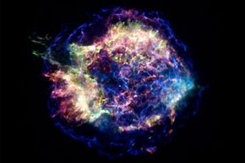


Detection of Gravitational Waves from Core-Collapse Supernovae:
Challenges and Limitations
Cassiopeia A
SN in MW 350 y ago
Sergey Klimenko
University of Florida

Slide 2
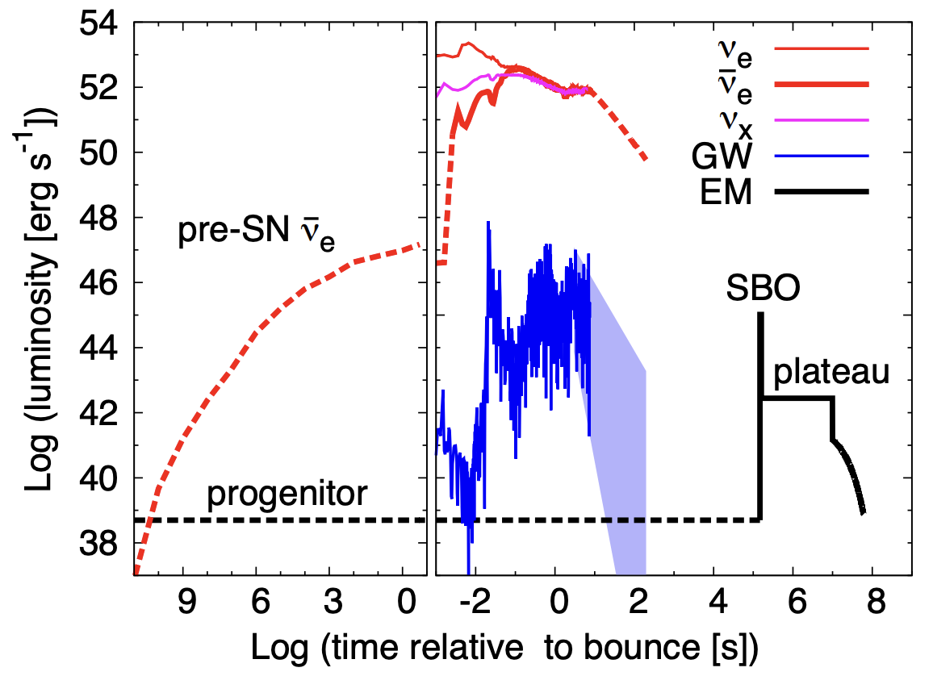
SN messengers
  Intense ν emission in the first second(s), energy ~ 10⁵¹ -10⁵³ erg
  Possible GW emission with energy 10⁴⁴ - 10⁴⁸ erg, depending on the model
  This is followed by the Shock Breakout when SN becomes optically visible at cosmological distances by telescopes.
  GW and ν are key to SN science
J. Beacom’s talk
GW Detection
now: LIGO
2028-: LIGO
upgrades
2035 Cosmic Explorer
Einstein Telescope
Detection
range is
mode/search dependent
1 pc ~ 3 ly
Detection
SN1987A (LMC 53kpc)
Kamiokande (3t) - 11 ν
now: SuperK (50t)
2027- HyperK (250t)
also IceCube and JUNO
Expected signal from
MW SN >10000 ν
Detectable out to
<1 Mpc with HyperK
few kpc
with HyperK
Ko Nakamura et.al 2016
Notes:
GW detectors are complex and GW search algorithms are mysterious

Slide 3
Prospects of GW detection from nearby SN
for the existing detector and data analysis methodology
BBH
O4 run
  Test a fraction of Galactic models
  Test ALL models for Beetlgeuise
O5 run
  Expect x2 better energy limits
  Start to test bar models
  Test a good fraction of Galactic SN models
3G detectors
  Expect x100 better energy limits due to strain sensitivity
  Can’t miss Galactic SN
  Fair chance of detection out to LMC for optimistic models
BNS
enthusiastic
optimistic
realistic
Szczepanczyk 2024
Notes:
2

Slide 4
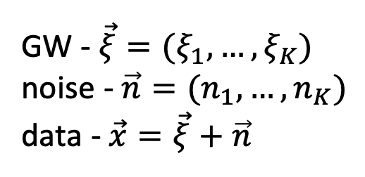
Detector Response FxH
← network data sample
network event →
Noise scaled network antenna patterns
  in general time-frequency dependent
  calculated for each data sample i characterized by noise PSD estimator S[i]
Dominant polarization wave frame:
_{NULL (K-2)}
network plane
x
ξ
n
GW - $\vec{ξ}=(ξ_{1},…,ξ_{K})$
noise - $\vec{n}=(n_{1},…,n_{K})$
data - $\vec{x}=\vec{ξ}+\vec{n}$
Klimenko et al, 2005
Notes:
2

Slide 5
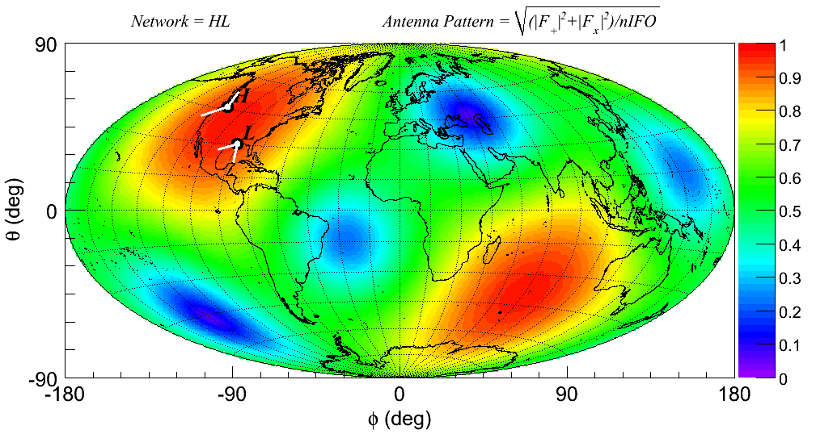
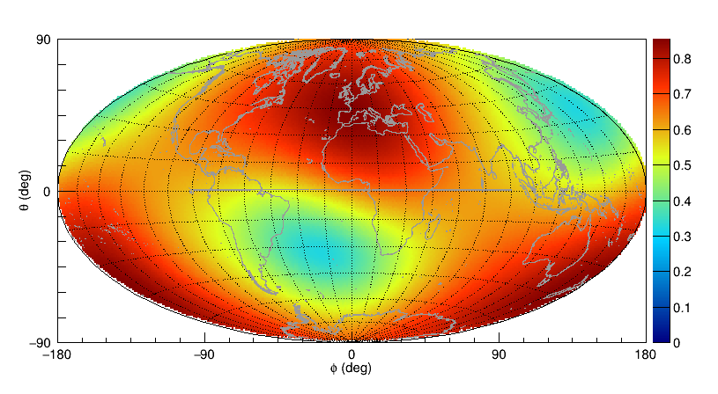
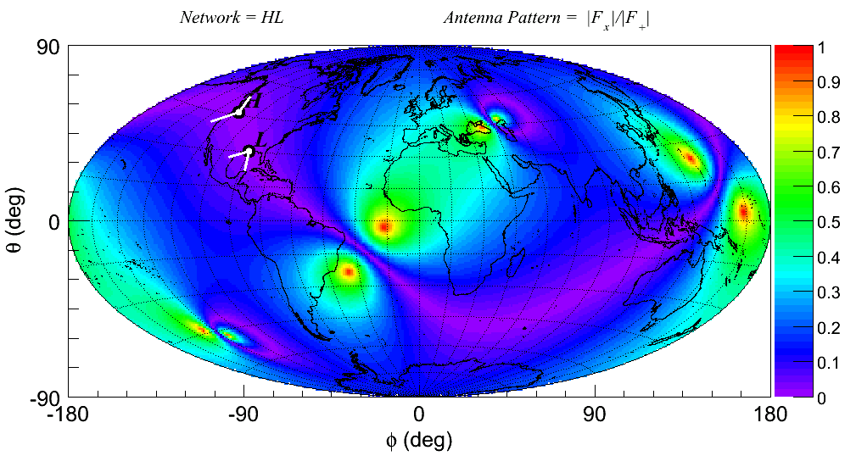
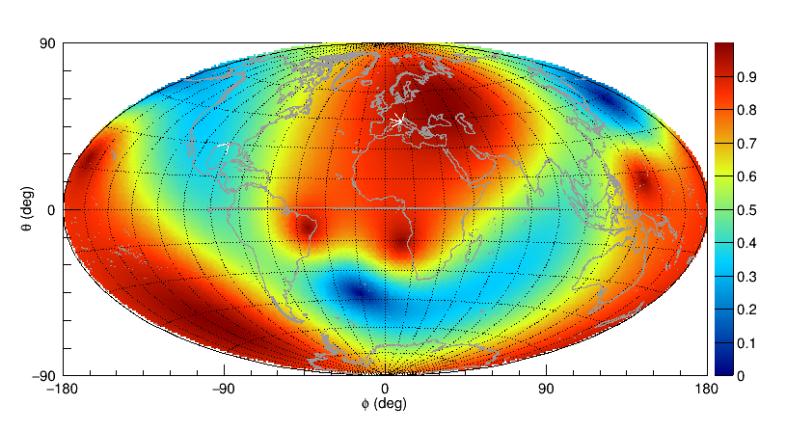



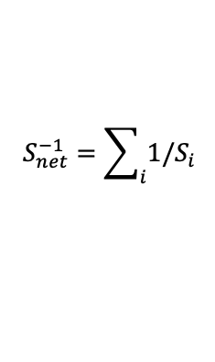



Network Sensitivity
Acceptance: - sensitivity wrt omnidirectional detectors
Alignment: - fraction of SNR in the h_{x} polarization wrt h₊
$$S_{net}^{−1}=\sum_{i}{1/S_{i}}$$
$$F$$
CE-ET
$$F$$
HL
$$\overline{F}=0.5$$
$$\overline{F}=0.62$$
HL
$$A$$
CE-ET
$$A$$
The CE-ET network may improve GW energy limits by a factor of ~100 due to strain sensitivity and increase the number of detectable events due to the network configuration.
Notes:
1

Slide 6
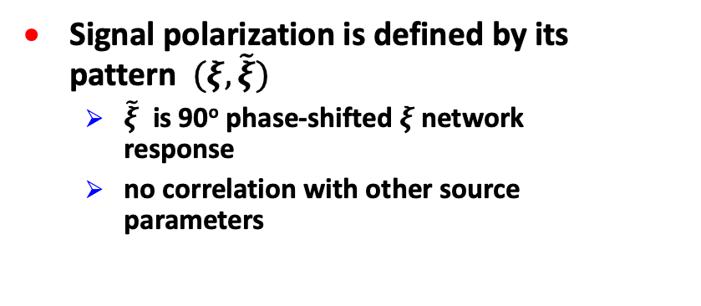
GW polarizations
Signal polarization is defined by its pattern $(ξ,\tilde{ξ})$
  $\tilde{ξ}$ is 90º phase-shifted $ξ$network response
  no correlation with other source parameters
NULL space
Klimenko et al, 2016
ψ
linear
random
circular
elliptical
ψ
ψ
The unique polarization pattern may be distorted by
  noise - results in the pattern dispersion
  network – results in the pattern bias
Notes:
2

Slide 7
Capturing GW polarizations
HL
Example: elliptical wave patterns
For A~0 network can not distinguish the polarization state of the incoming wave
  Full alignment coverage is required for the reconstruction of gravitational wave polarizations.
  It is a gamble to detect a linearly polarized CCSN signal.
Notes:
1

Slide 8
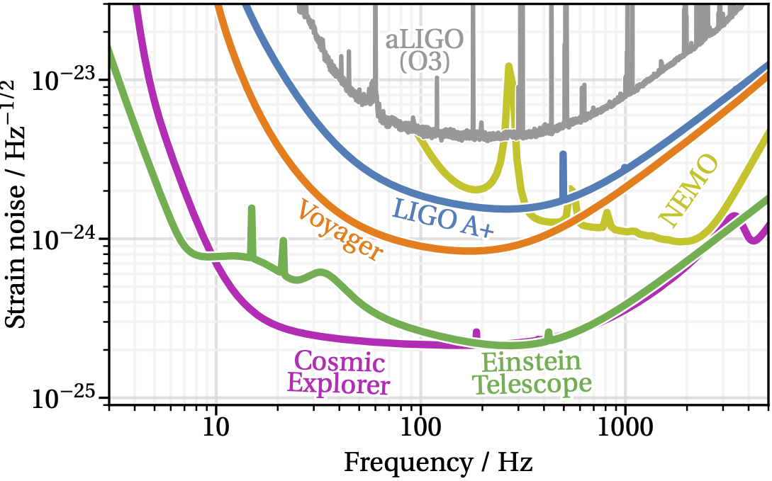
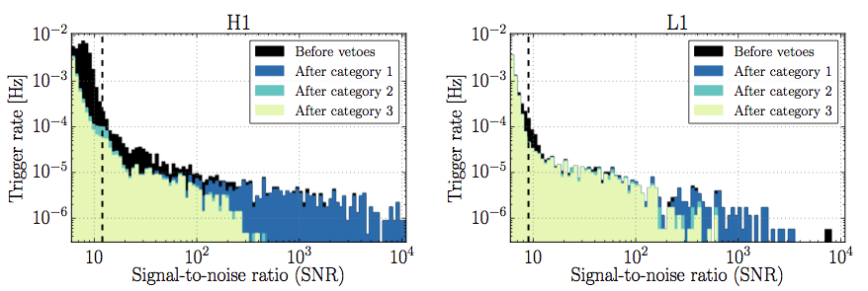
Detector noise
https://cosmicexplorer.org/sensitivity.html
NULL
glitch
fundamental
noises
glitch
Strain
sensitivity
  Glitches – need more than one detector for confident detection
CQC, v33, n13, 2016
Notes:
2

Slide 9
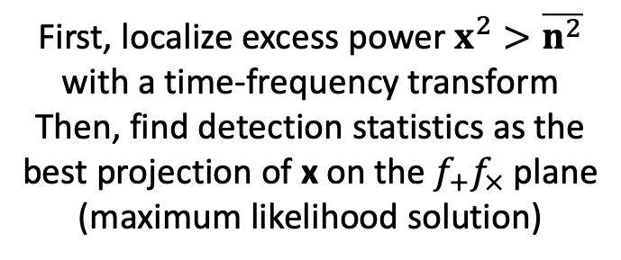
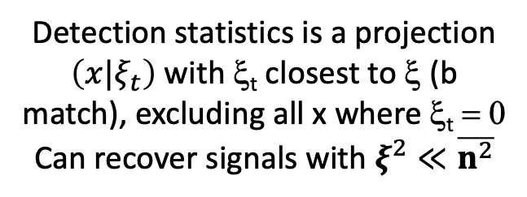
Signal Identification
Matched filter
Model-agnostic search
NULL
NULL
x=ξ+n
noise n
x=ξ+n
noise n
ξ
ξ_{t}
ξ_{p}
ξ
true response
template response
true response
Detection statistics is a projection $\left(x|ξ_{t}\right)$ with ξ_{t} closest to ξ (b match), excluding all x where ξ_{t} = 0
Can recover signals with $ξ^{2}≪\overline{n^{2}}$
First, localize excess power $x^{2}>\overline{n^{2}}$ with a time-frequency transform
Then, find detection statistics as the best projection of x on the $f_{+}f_{×}$ plane
(maximum likelihood solution)
Notes:
2

Slide 10
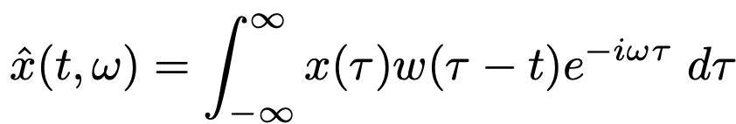
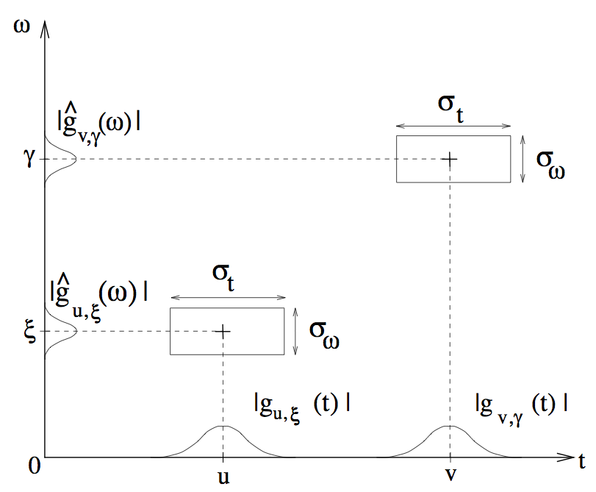
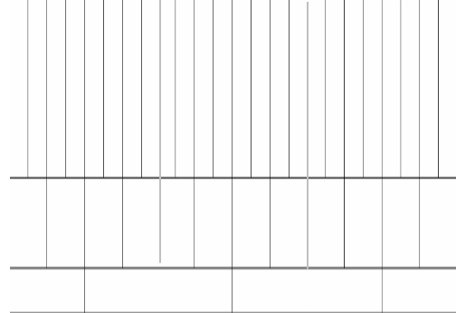
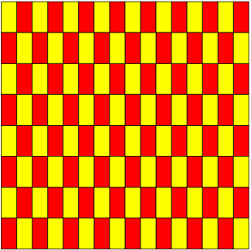
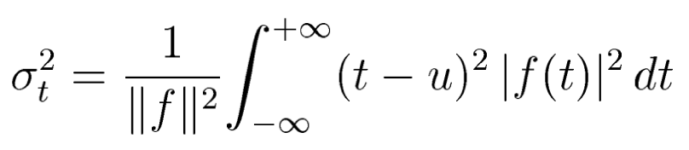

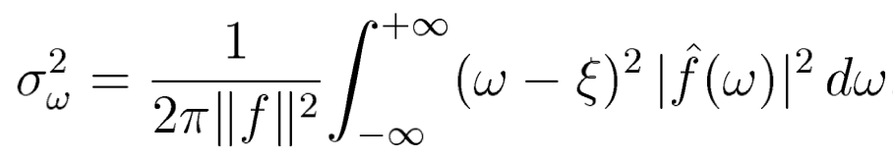




Time-frequency analysis
Describe data as a superposition of atomic waveforms (wavelets) with “minimal” TF spread to capture the TF varying spectrum – a large variety of wavelets available
Gabor atoms, 1946 → Short Time (windowed) Fourier Transform (STFT)
Organize wavelets in bases, frames, or libraries – a set of wavelets populating the TF plane in a grid with a time/frequency step Δt / Δω.
Gabor wavelets
uncertainty principle
w(t)-window
classical wavelet
WDM transform
σ_{t}σ_{ω}=0.5 for Gaussian window
f$(t)$ = w(t)cos(ωt)
$\tilde{f}(t)$ = w(t)sin(ωt)
=w(
σ_{t,}σ_{ω} - intrinsic wavelet resolution
Δt,Δw – TF map resolution
w(
S.Klimenko, July 25, 2025, Warsaw

Slide 11
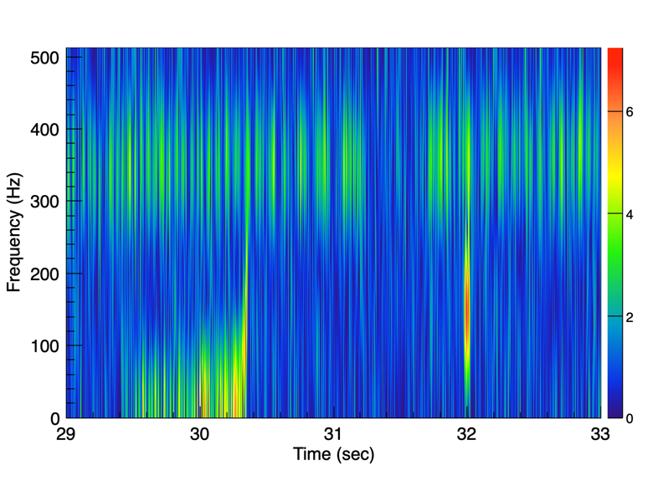
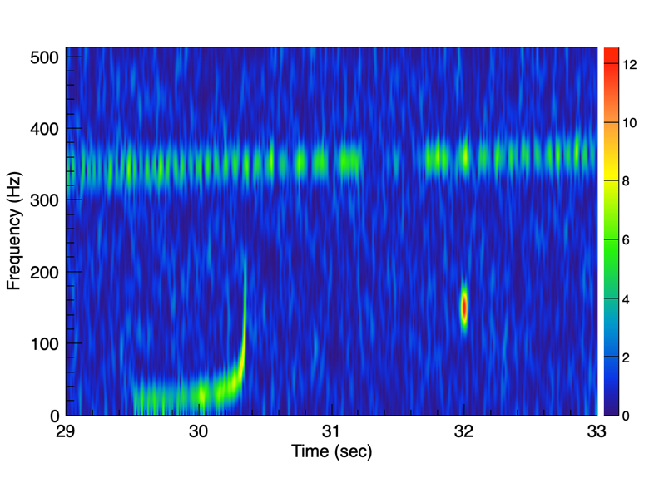
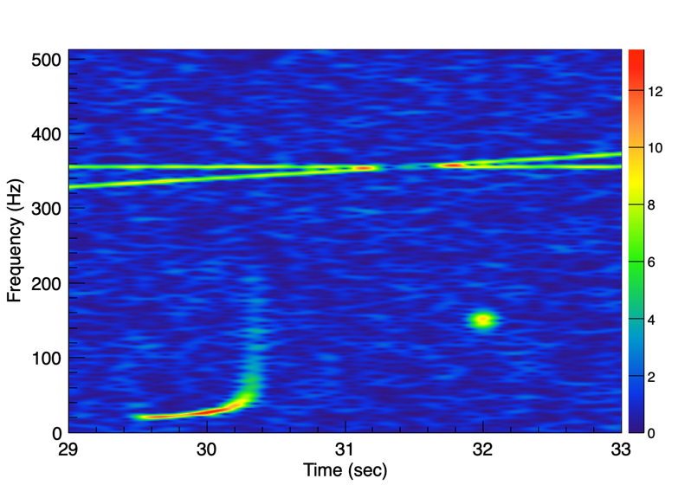

Time-Frequency Distribution $P\left(ω,t\right)={|\hat{x}(ω,t)|}^{2}$
Short Time Fourier Transform:
BBH
chirp
SG
T=0.016 s
T=0.064 s
sin(ωt)
linear chirp
T=0.256 s
T=1 s
No optimal localization of power for a single wavelet set (single Gabor window)
General question: How to find the optimal distribution $P(ω,t)$of the time-varying spectrum?

Slide 12
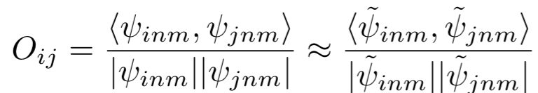
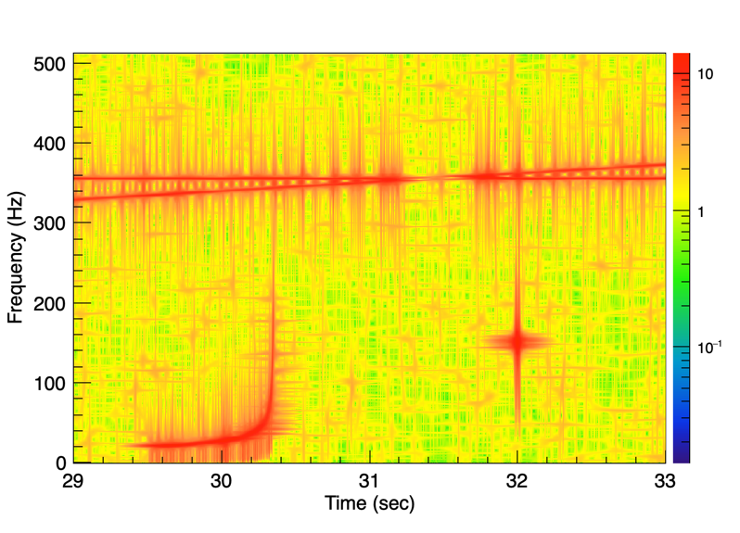
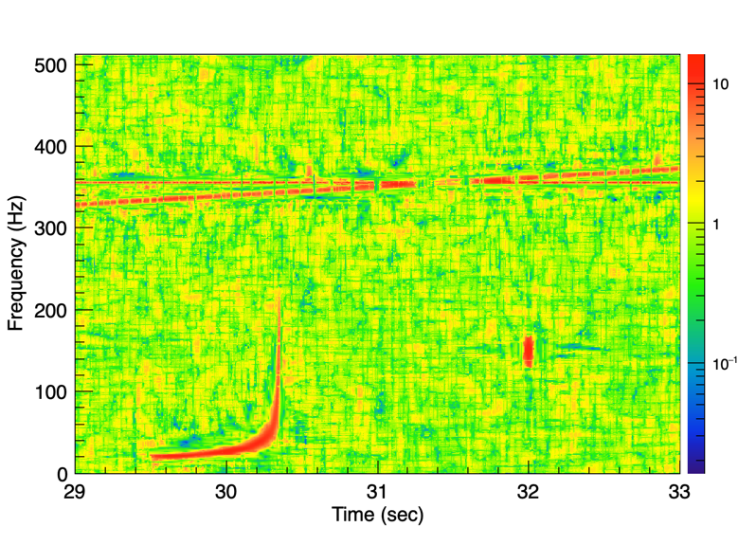

Wavescan Transform
New TF transform to address temporal and spectral leakage
  use several (6-8) STFTs with windows of different durations and the same sampling lattice (wavelet stacks)
  selecting optimal resolution by using the overlap O_{ij} between wavelets
  resolution of wavescan wavelets varies over the TF spectrogram
  efficiently remove spectral and temporal leakage
  recover both narrowband and broadband signals
Max Power
wavescan
$$\sqrt{{Max[P}_{n}(ω,t)]}$$
(Klimenko, 2022)
sin(ωt)
linear chirp
BBH
SG
12

Slide 13
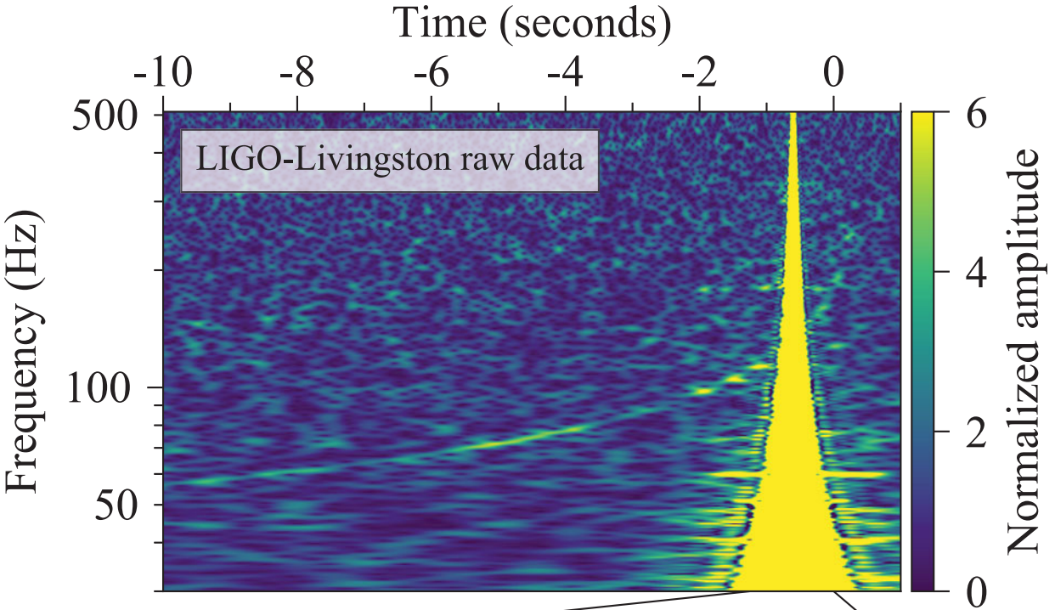
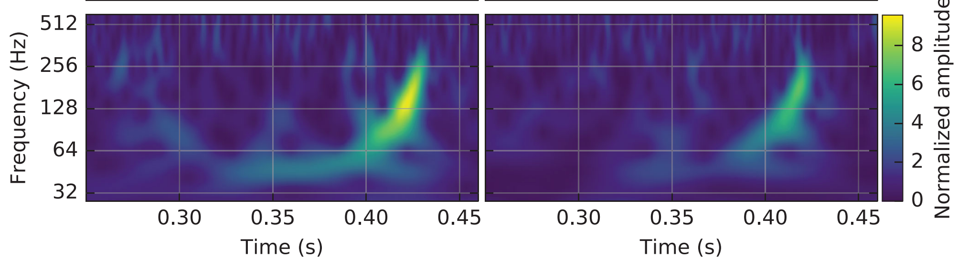
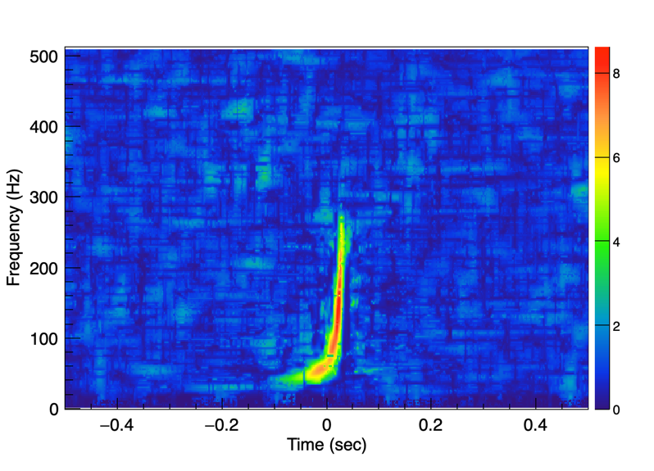
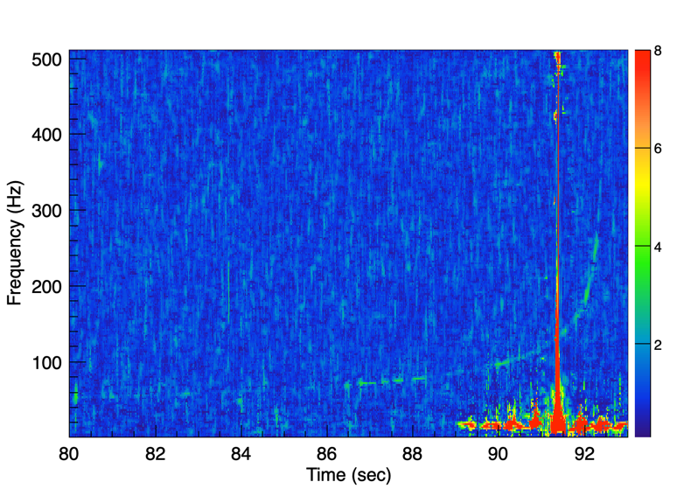
GW150914 and GW170817
Phys. Rev. Lett. 116, 061102 (2016)
Phys. Rev. Lett. 119, 161101 (2017)
H Q-scan
L Q-scan
H Q-scan
L Q-scan
Q-scan
H wavescan
L wavescan

Slide 14
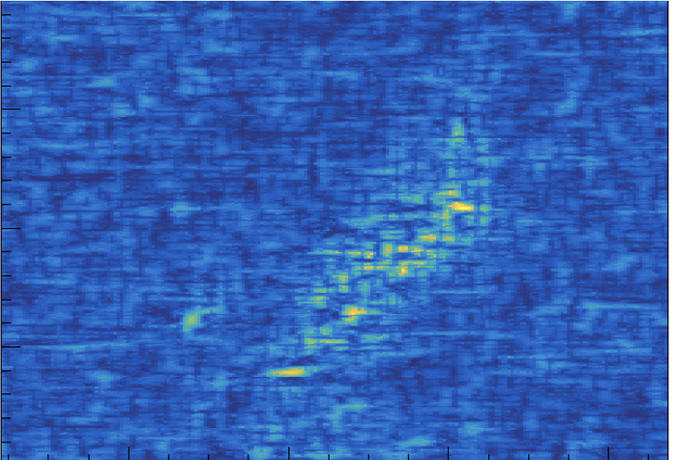
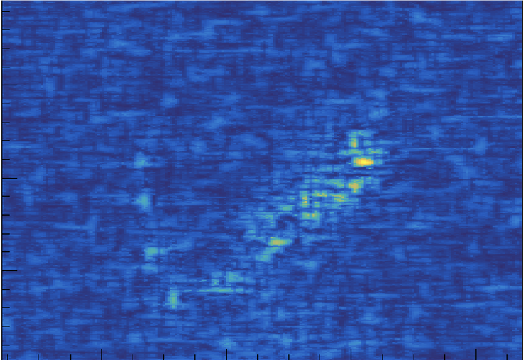
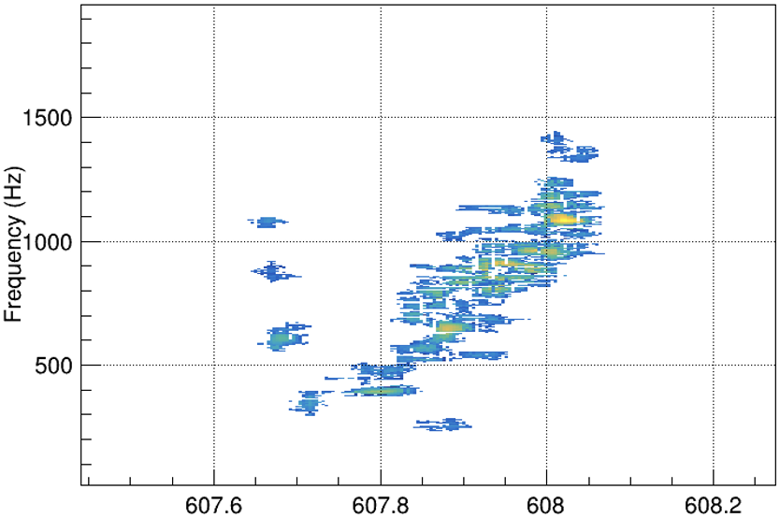
Search Algorithm
  Coherent WaveBurst: Identify correlated events in two (or more) detectors
  Combine the detector’s data into -excess-power TF map (cWB2G) -cross-power TF map (cWBXP) by accounting for ToF between the detectors
  Identify transient events by selecting excess-power and cross-power pixels above the noise fluctuations
  Use no assumptions on signal waveform: can search for un-modeled & unexpected sources
  used to “for detection of new GW species”, including the first GW detection, GW150914, and the first IMBH event, GW190521
Klimenko 2005, 2008, 2016, 2022
+
=
Time-delayed wavelet amplitudes
w_{k}(i,τ_{k}) need to be calculated for
each TF pixel and sky location
(~200000 sky locations)

Slide 15
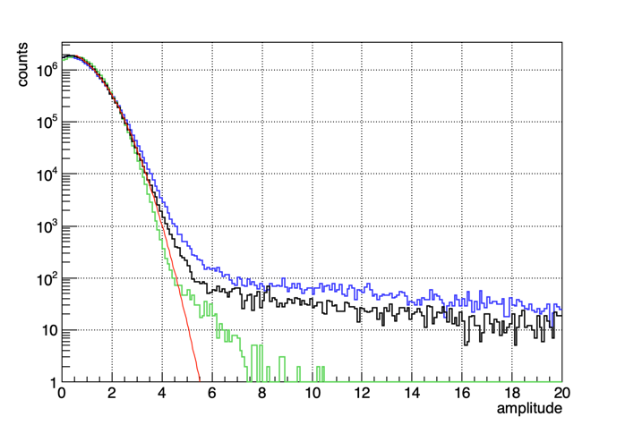
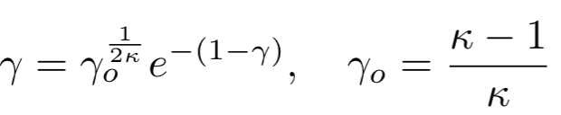
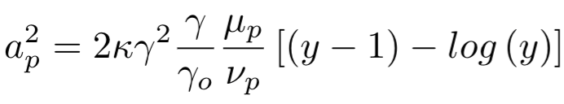

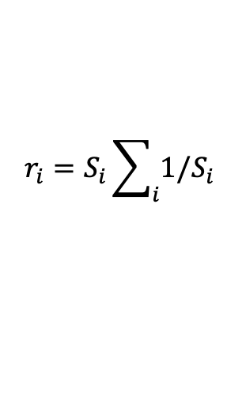
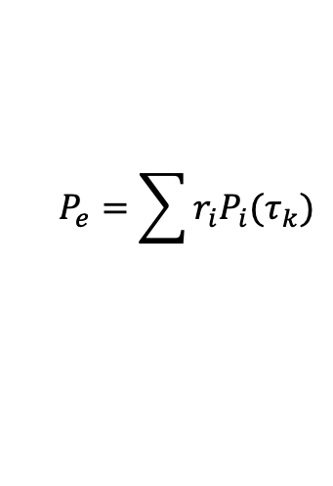
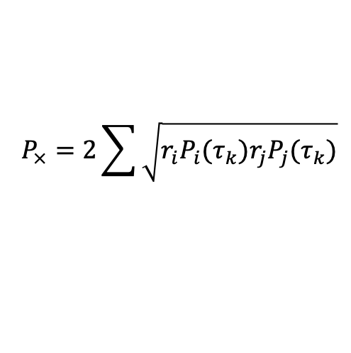


Identification of transient events
Identification of weak transient events in quasi-stationary noise starts with the selection of time-delayed ($τ_{k}$) pixels by using the excess/cross power statistics
excess-power cross-power
  S_{i} – power spectral density for detector i
universal pixel statistics
  transform Gamma $→$ half-normal
  κ – Gamma shape parameter
  $μ_{p}$ - mean of$P_{e}+P_{×}$ distribution
  $ν_{p}$ - median of $P_{e}+P_{×}$distribution
$$P_{e}=\sum{r_{i}P_{i}(τ_{k})}$$
$$r_{i}=S_{i}\sum_{i}{1/S_{i}}$$
$$P_{×}=2\sum{\sqrt{r_{i}P_{i}(τ_{k})r_{j}P_{j}(τ_{k})}}$$
Select pixels above
the threshold $a_{0}$
$a_{p}>a_{0}(2÷3$)
$${y=\frac{P_{e}+P_{×}}{γμ_{p}}}_{}$$

Slide 16
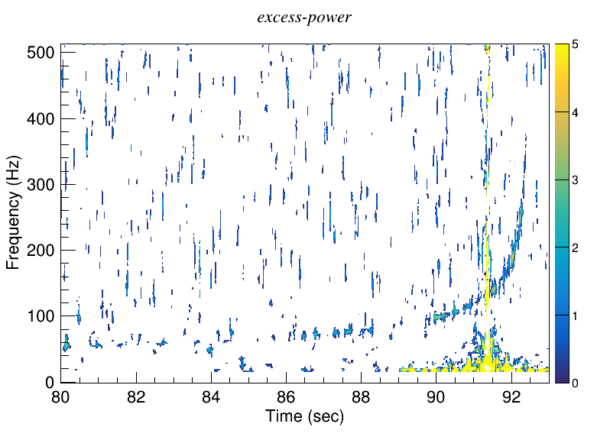
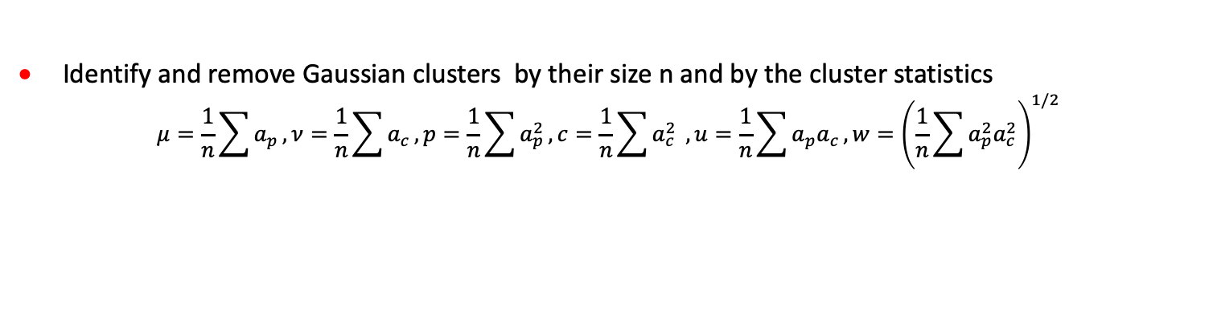
Initial cluster analysis
After the selection of cross-power (black) pixels, contiguous pixel groups are clustered – those are initial clusters. At this stage, the cluster rate is dominated by Gaussian noise.
Both a GW signal and glitches can be highly fragmented – split into two or more initial clusters. At this stage, the event defragmentation is not possible due to a high cluster rate
Identify and remove Gaussian clusters by their size n and by the cluster statistics
$$μ=\frac{1}{n}\sum{a_{p}},ν=\frac{1}{n}\sum{a_{c}},p=\frac{1}{n}\sum{a_{p}^{2}}, c=\frac{1}{n}\sum{a_{c}^{2}} , u=\frac{1}{n}\sum{a_{p}a_{c}}, w={\left(\frac{1}{n}\sum{a_{p}^{2}a_{c}^{2}}\right)}^{1/2}$$

Slide 17
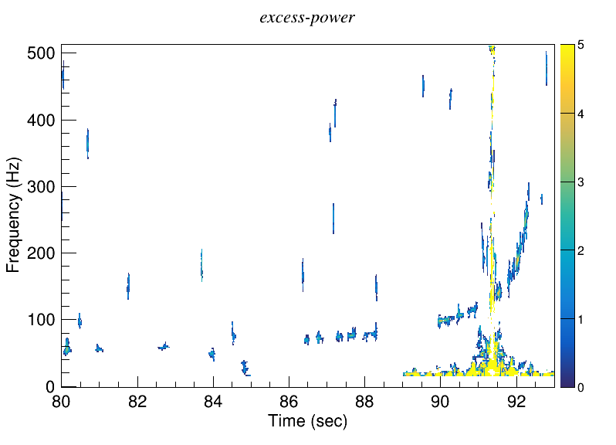
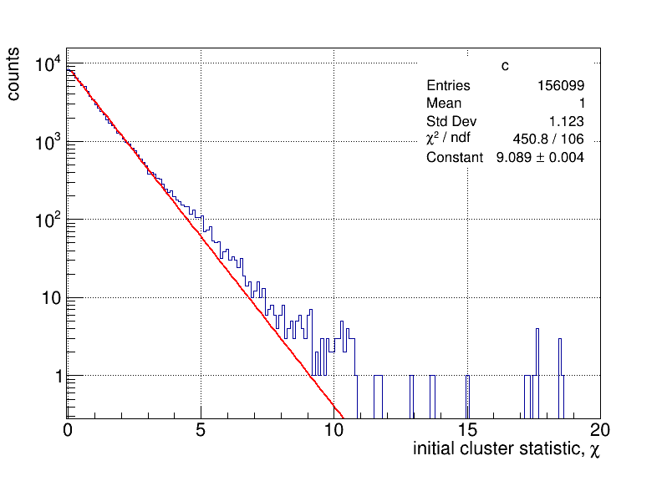
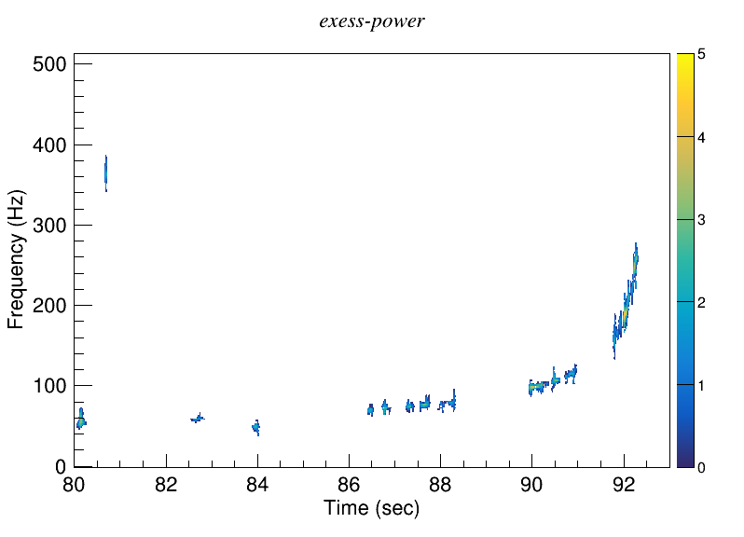
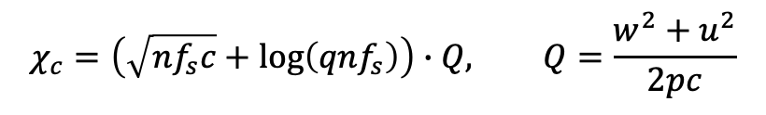



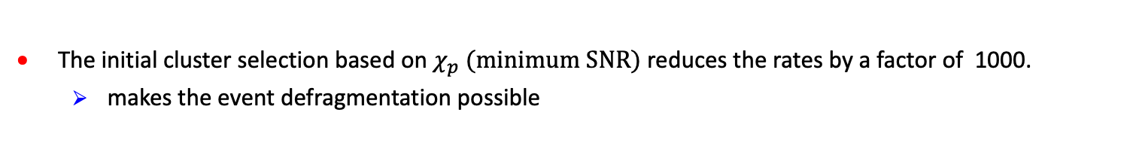
Initial Cluster Selection
For separation of clusters due to quasi-stationary detector noise from GW signals and glitches, the estimator of cluster coherent SNR is used
$χ_{p}=2\sqrt{2nf_{s}}\left(\sqrt{p}−a_{0}\right) +log⁡(2q\sqrt{nf_{s}}), q=\frac{w^{2}−u^{2}}{2pc}$
Where $f_{s}$is the wavescan oversampling factor and $a_{0}$ is the black pixel threshold. For Gaussian noise the statistic $χ_{p}$follows the exponential distribution (red line).
$$χ_{c}=\left(\sqrt{nf_{s}c}+\log\left(qnf_{s}\right)\right)∙Q, Q=\frac{w^{2}+u^{2}}{2pc}$$
cluster selection with $χ_{c}$
red
clusters selection with $χ_{p}$
cluster
threshold
The initial cluster selection based on $χ_{p} (minimum SNR)$ reduces the rates by a factor of 1000.
  makes the event defragmentation possible

Slide 18
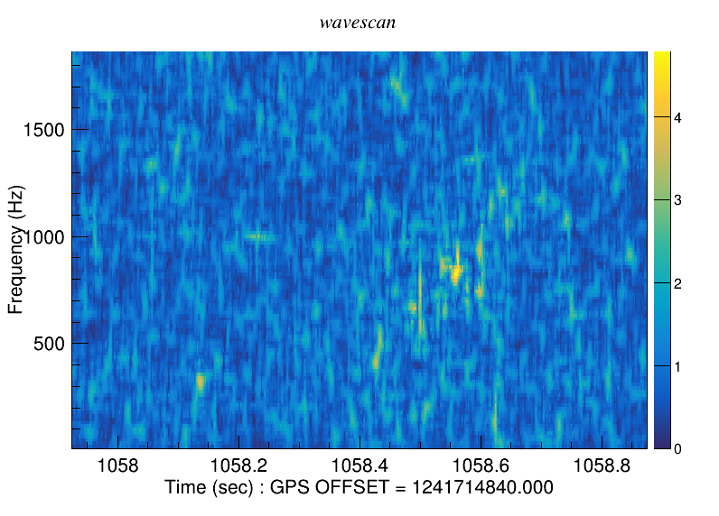



Event defragmentation
CCSN signals
  large TF volume – requires low threshold on pixel amplitudes ($a_{p}$) and cluster SNR ($χ_{p}$)
  could be highly fragmented – requires de-fragmentation to collect the signal’s power
Initial defragmentation
$δt=0.23 s, δf=64 Hz$
Final defragmentation
$δt=Tgap , δf=Fgap$
CCSN simulated signal
C15-3D: SNR=29
collected cross-power

Slide 19



Reconstruction
C15-3D simulation at 3.3 kpc
The impact of sky localization on CCSN detection confidence is
  moderate for an optical trigger due to poor timing localization of the core bounce
  significant for a neutrino trigger, narrowing the search interval down to a few seconds
It is better to have both triggers
GW190513
2G L1
XP L1
cWB with WDM and excess-power: collected SNR 11.5, IFAR~1 y
cWB with wavescan and cross-power: collected SNR 12.9, IFAR>1000 y

Slide 20





Factors limiting CCSN detection
iSNR=159
rSNR=139
range=0.5 kpc
iSNR=81
rSNR=62
range=1 kpc
C15-3D
iSNR=40
rSNR=27
range=5 kpc
iSNR=24
rSNR=9.3
range=3.3 kpc
O4 noise
For CCSN with a large TF volume (~500), the ratio of recovered/injected SNR (rSNR/iSNR) drops significantly for weaker signals
Main limitations
  pixel selection above Gaussian noise by the pixel cross-power statistic
  cluster selection for fragmented events
Red: small TF volume
Black: large TF volume

Slide 21


Enhancing CCSN detection
Can dig deeper into the detector noise with the cross-correlation integrated over a local group of n pixels
$$C=\sum_{ij}{\sqrt{r_{i}r_{j}\left(P_{ij}^{2}\left(τ_{k}\right)+Q_{ij}^{2}(τ_{k}\right)}}, P_{ij}=\sum_{n}{\left(x_{i}x_{j}+{\tilde{x}}_{i}{\tilde{x}}_{j}\right)}, Q_{ij}=\sum_{n}{\left(x_{i}{\tilde{x}}_{j}−{\tilde{x}}_{i}x_{j}\right)}$$
Increases the complexity of the CWB algorithm
CWB excess-power
-70 M pixels per detector map
-0.3 Tb of data manipulated
CWB cross-power
-315 M pixels per detector map
-6 Tb of data manipulated
CWB cross-correlation
~100 Tb of data manipulated
~ 10 times slower
iSNR=24
rSNR=9.3
range=3.3 kpc
O4 noise
iSNR=24
rSNR=25
range=3.3 kpc
CWB cross-power
-315 M pixels per detector map
-6 Tb of data manipulated

Slide 22





Pattern recognition
Identification of robust signal patterns can be used for reduction of false alarms due to glitches
  similar to the identification of the chirp patterns in cWB BBH searches
Low SNR signal patterns still can be informative, particularly in concurrence with ν signals.
range=2.0 kpc
glitch
range=3.3 kpc
random noise
range=5.0 kpc
705 706 707 708 709 710. 711
605 606 607 608 609 610. 611

Slide 23
Summary
Expect detections of CCSN signals like D15-3D out to
  ~3 kpc for the rest of the O4 run
  ~5 kpc (preliminary) with the cWB cross-correlation version
Preparation for O5 run
  Deploy a CCSN search targeting realistic signals (input from modelers).
  Run a low-latency CCSN search complementing a ν trigger alerts for telescopes.
Future GW detectors at 10 times better strain sensitivity and 1.5 times better sky coverage
  Detection and robust parameter estimation out to 30-50 kpc for D15
  Detection of optimistic models out to 1 Mpc

Slide 24


SN rates
468 $±$ 166 events per century out to 20 Mpc
1-2 events per century in MW
Galactic SN Cassiopeia A – 350 years ago
Closest extragalactic SN(53 kpc) SN1987A – 36 years ago
The closest SN 2023ixf on LIGO watch: May 19, 2023, 6.7 Mpc
Potential range of ν detectors
SN2023ixf
K. Gill et al, 2023
Notes:
Potential LIGO sources:

Slide 25
Detector response to a GW signal
Antenna patterns
Sampled GW signal
Sampled detector response
Wave frame
h+,hx
z
x
detector
frame
y
x
z
θ,ϕ
R_{z}(2ψ)
y
Direction to the source θ,ϕ, and polarization angle Ψ define the relative orientation of the detector and wave frames.
Rotation of the wave frame R_{z}(2Ψ) induces transformations both for F and h, but ξ is INVARIANT
In the analysis, we have the freedom to select any Ψ we like.
Notes:
2

Slide 26
Factors affecting CCSN detection
Detectors
  Fundamental detector noise (strain sensitivity)
  Non-stationary detector noise (glitches)
  Detector Network configuration
    Confident CCSN detection may not be possible with only one GW detector
Search algorithms
  Exclude data inconsistent with fundamental detector noise.
    Matched filters – identify statistically significant matches across the template bank for each detector
    Burst searches – time-frequency analysis to identify significant excess power, cross-power, or cross-correlation in the detector network
  Event reconstruction – use the maximum likelihood method to extract signal waveforms (parameters)
    Matched filters – best matching template
    Burst searches – superposition of atomic waveforms of limited duration (wavelets)
  Signal identification
    Matched filters – suppress glitches by requiring coincidence of templates across the network, and by the χ² statistics of the residual noise
    Burst searches – use ML statistics (including χ²) to find events coherent across the detector network.
Notes:
Potential LIGO sources: binary SBH are outside of the LIGO band, binary BH may exist, but never observed before, few binary pulsars (NS) observed in our Galaxy – primary LIGO source

Slide 27
Signal reconstruction
Likelihood ratio (global fit to the data)
Matched filter for bursts
  Noise model: usually multivariate Gaussian noise
  signal model (detector response)
  find best solution for Ω=(h₊,h_{x}) at maximum of Λ
    For un-modeled bursts, do variation of Λ over h₊,h_{x} amplitudes
    Use network and signal constraints
Find the signal sky location and waveforms
Flanagan, Hughes, PRD 57 4577 (1998)
Klimenko et al, PRD 72, 122002 (2005)
Klimenko et al, CQG 25, 114029, (2008)
Σ-noise covariance matrix
Notes:
2

