Slide 1


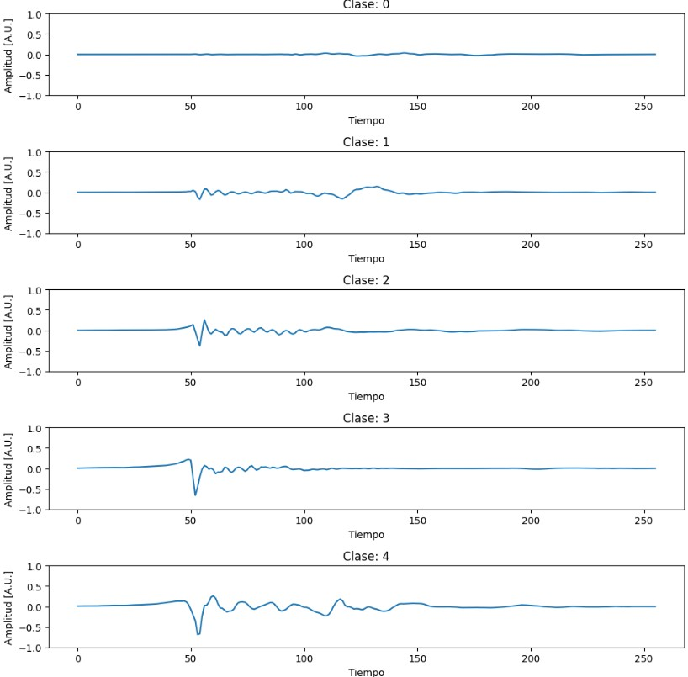
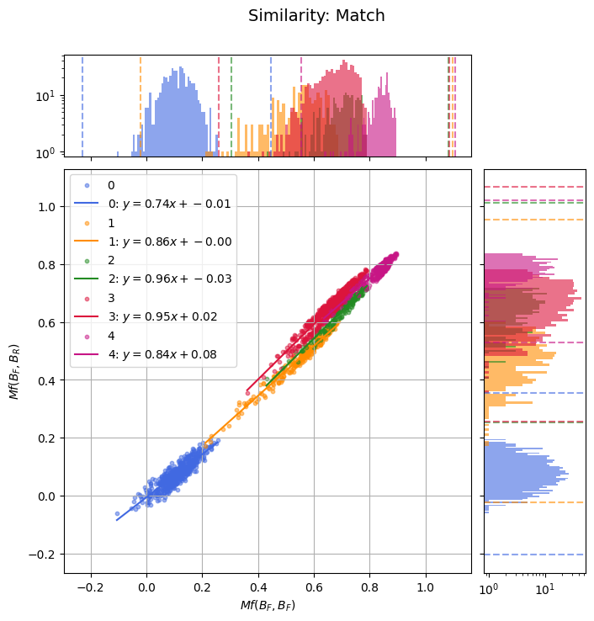
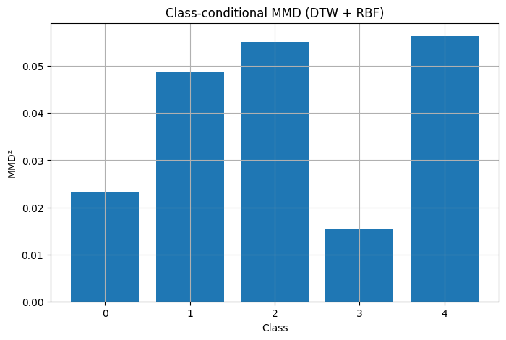
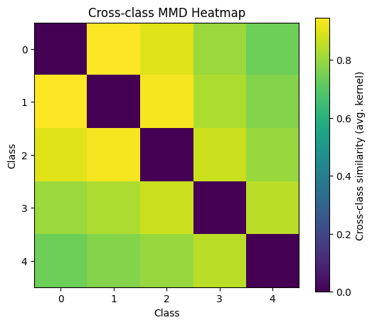
cDVGAN for Generating Gravitational Waves from Rotating Core-Collapse Supernovae
SN2025gw: First IGWN Symposium on Core Collapse Supernova Gravitational Wave Theory and Detection, Warsaw, Poland
Jossian A. Garcia, Vicente Sierra, Javier M. Antelis, Claudia Moreno
Tecnológico de Monterrey, School of Engineering and Sciences, Jalisco
Universidad de Guadalajara, Physics Department, CUCEI, Jalisco
Figure 1 shows high linear relations, which indicates highly similarities between real and fake generations
Class-conditional MMD results in figure 2 compare generated and training classes sets, indicating high similarities between signal class-distributions.
Cross-class MMD heatmap in figure 3 shows normalized values near to one, which depicts high separability between classes.
Figure 1: join and marginal distributions m(BF , BF ) and m(BR, BF ) as well as their best fit for each class
Figure 2: Class-conditional MMD results. Each generated signal is compared against its corresponding class training set
Figure 3: Cross-class MMD heatmap. Values near to one (yellow) depicts high separability between classes
Figure 4: Examples of generated signals per class.

