Slide 1
Neutrino Flavor Conversion in Supernovae:
Quantum Kinetics and Astrophysical Implications
Masamichi ZAIZEN
Postdoc, Univ. of Tokyo in Japan
Phys. Rev. D 107, 103022 (2023)
Phys. Rev. D 111, 103029 (2025)
SN2025gw: First IGWN Symposium on Core Collapse Supernova
Gravitational Wave Theory and Detection
University of Warsaw on Jul. 22, 2025

Slide 2

Roles of Neutrinos in CCSNe
Massive star $≳$ 8 M⦿
ν-trapping
Shock stalled
Shock revival
ν
ν
ν
ν
ν
ν
Fe
ν
PNS
PNS
Si
ν
ν
O
ν
C
He
ν
H
ν
Core collapse
Core bounce
Neutrino-heating
Neutrino-heating process:
Shock wave stalls due to accreting matter and fails to explode.
Neutrinos work as mediators because of their weakly-coupling nature with matter.
Neutrinos transfer their energy from the hotter core to the colder stalled shock.
Neutrino transport is essential in the theoretical studies/predictions.
→ One of the uncertainties is neutrino oscillation.

Slide 3
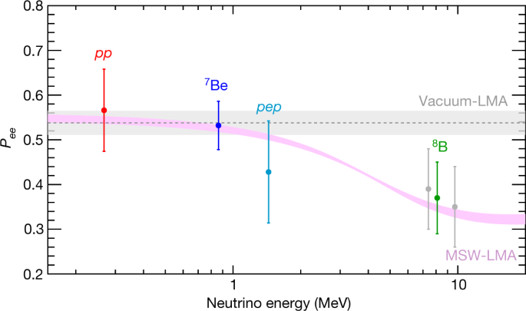
Solar Neutrino Problem
n
ν?
Propagating in matter
e
Potential
from Electrons
e
p
e
From pp-chain
MSW effects
ν_{e}
ν_{e}
Borexino ‘18
Fusion
Core

Slide 4
Sea of Leptons & Nucleons in CCSNe
n
Potential
from electrons
ν?
Propagating in matter
e
ν_{μ}
Potential
from Neutrinos
ν_{μ}
ν_{e}
p
Collisions w/ nucleons
e
ν_{e}
ν_{e}
Neutrino Transport with Quantum Kinetics:
PNS
R ~ 10 km
Collisions ∝ (G_{F}² n_{l})
Refractions ∝ (G_{F} n_{l}) ~ O(cm)!!

Slide 5
Possibility Search of Flavor Conversion
2D-CCSN
Rotating PNS Cooling
10¹⁰ g/cm³
PNS ~ 6 sec
10¹¹
10¹²
10¹³
PNS ~ 30 sec
10¹⁰ g/cm³
Akaho, MZ+ PRD ‘24
Barrio+ arXiv ‘25

Slide 6
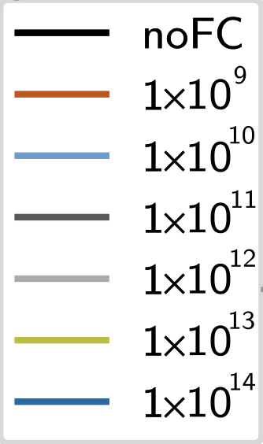
Phenomenological Approach in 1D/2D
enhance
Flavor conversion
11.2 M⦿
Equipartition
Simple prescriptions:
- Flavor equipartition
below ρ < ρ_{crit}.
This may over-/under-estimate the impact but can change the shock dynamics.
20 M⦿
(noFC = traditional moment transport)
Ehring+ PRD & PRL ‘23

Slide 7
Phenomenological Approach for GW
ρ_{crit} ~ 10¹³⁻¹⁴ g cm⁻³
ρ_{crit} ~ 10¹⁰⁻¹² g cm⁻³
2-D
3-D
Ehring+ arXiv ‘24
Mori+ PASJ ‘25

Slide 8
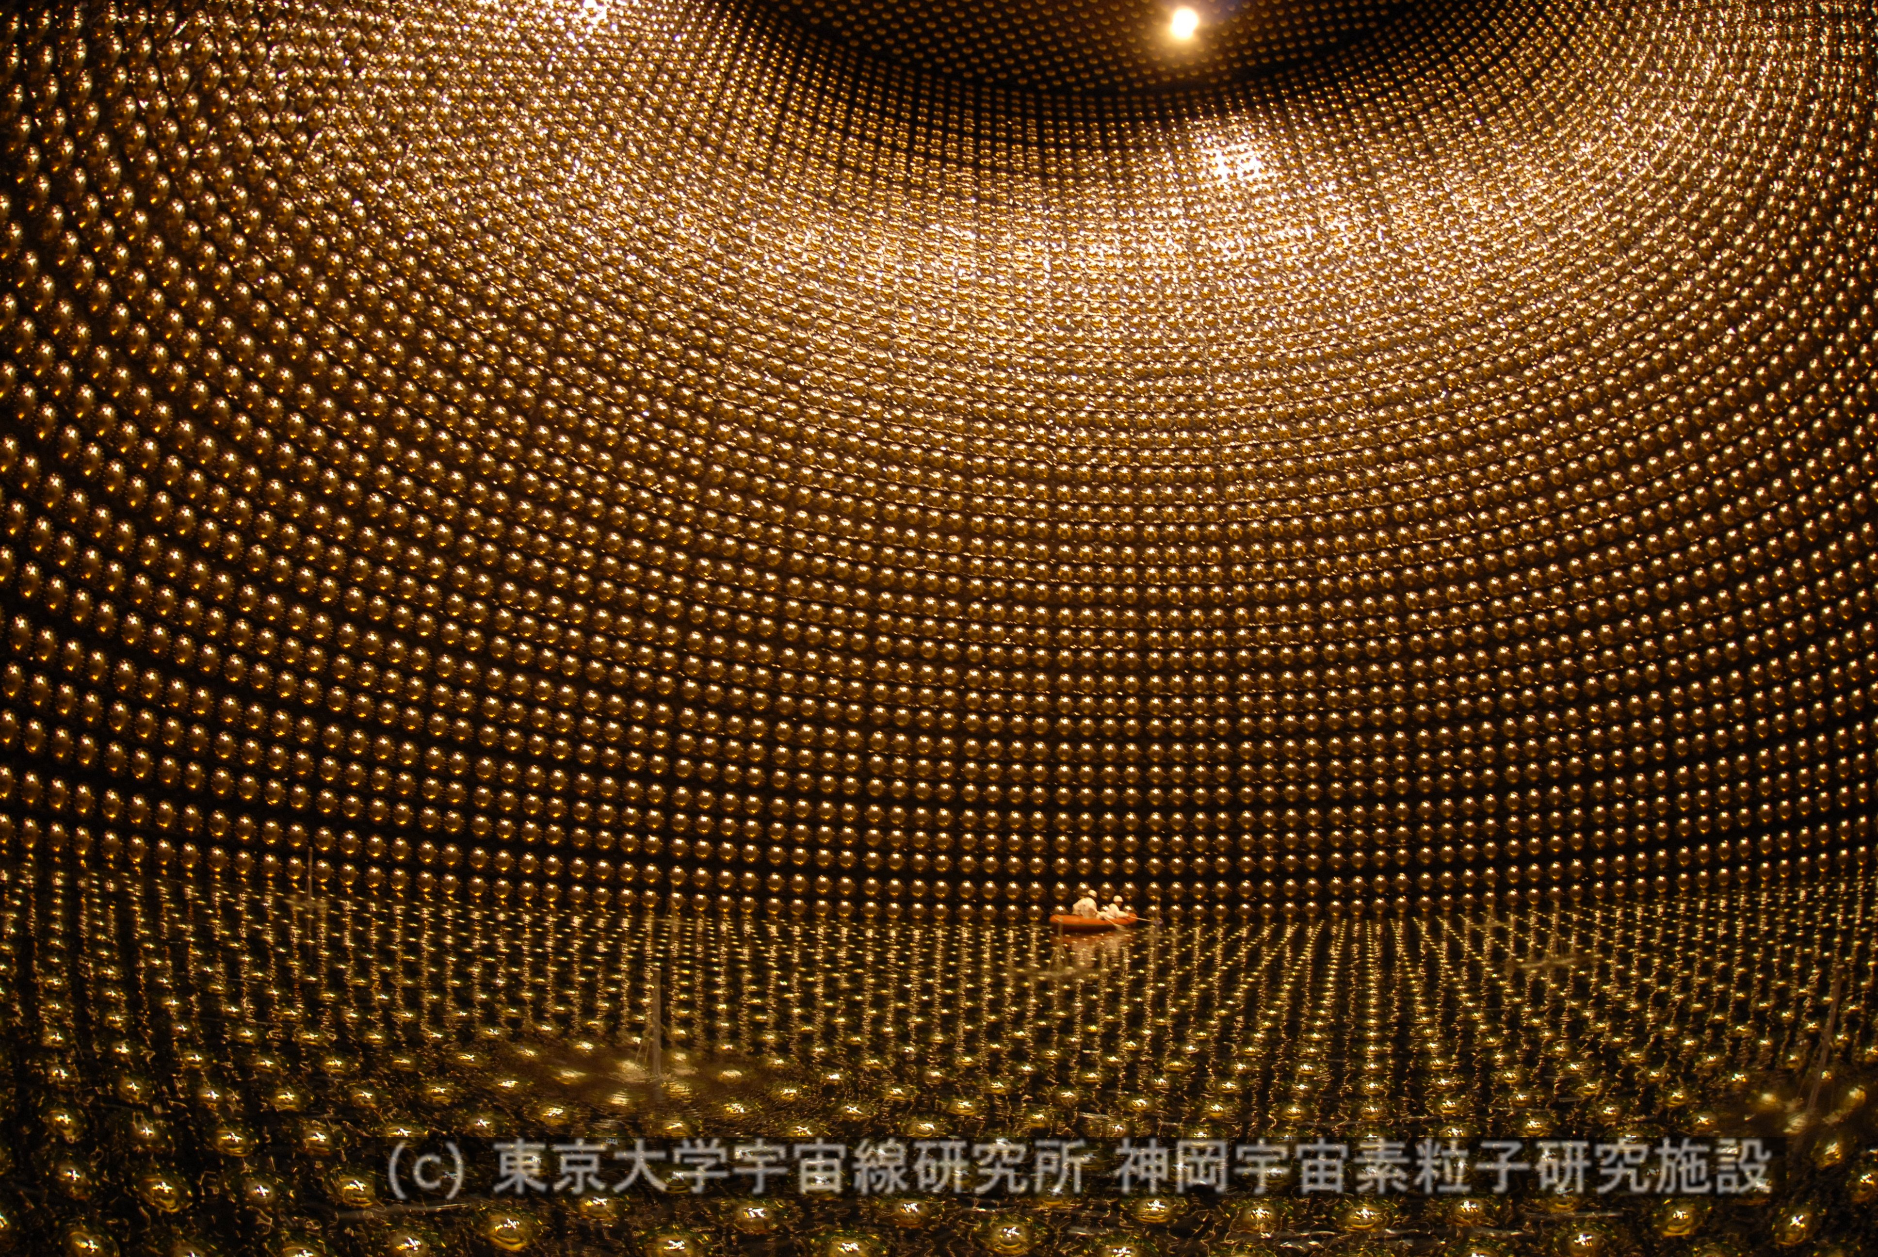
Quantum Kinetic Neutrino Transport
Observation
Neutrino heating
Absorption
n
ν_{e}
MSW resonance
(Matter + Vacuum osc.)
ν_{e}
n
Cooling
ν_{μ}
ν_{e}
Neutrino Flavor Conversion
l_{osc} ~ O(cm)
ν_{e}
PNS
R ~ 10 km
Stalled shock
r ~ 200 km
Envelope
r ~ O(1000) km
ν_{μ}

Slide 9
Asymmetry Triggering Flavor Instability
Quantum Kinetic Equation:
Self-interactions
Collisions
e.g., Duan+ ’06
Slow flavor instability (SFI)
Asymmetry in energy
e.g., Sawyer ’16
Fast flavor instability (FFI)
e.g., Johns ’23
Asymmetry in angle
Collisional flavor instability (CFI)
Asymmetry in collisions
~ 1 cm
Need separate understandings!!
Relatively longer scale

Slide 10
Possibility Search of Flavor Conversion
2D-CCSN
10¹⁰ g/cm³
10¹¹
10¹²
10¹³
Fast flavor instability (FFI)
Mechanism of instability:
・Asymmetry in angles
Neutrino distribution
・Outside decoupling regions
・Forward-peaked
→ Angular dist. is crucial.
FFI
10¹⁰ g/cm³
Akaho, MZ+ PRD ‘24

Slide 11




Asymmetry in Angular Distributions
ELN-XLN angular distribution:
= ELN － XLN
(Electron Lepton Number)
(Heavy-Leptonic one)
( = MuLN or TauLN)
Crossing
$\overline{ν}e$ excess
$νe$ excess
$νe$ excess
$\overline{ν}e$ excess

Slide 12
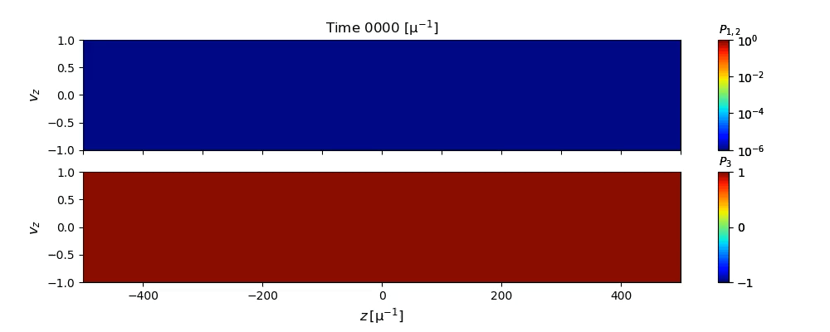
Local Simulation of Fast Instability
Flavor correlation
Flavor content
Conservation laws
Flavor equipartition is established.
( = stability condition, can be modelled)
ELN – XLN angular dist.
Asymptotic states
Rich angular structure!
Not just equipartition
MZ & Nagakura PRD ‘23

Slide 13
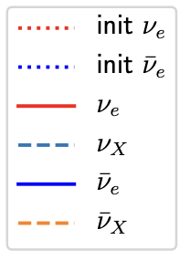



Note: Flavor Equipartition for Species?
Flavor Equipartition
ν_{e}
ν_{μ}
$\overline{\text{ν}}$_{e}
$$\overline{\text{ν}}\text{μ}$$
Asymptotic states
Non-zero XLN angular dist.
$$νX≠\overline{ν}X$$
Four- or Six-species
are necessary
in flavor conversion.
See Akaho’s talk
(1st day)
MZ & Nagakura PRD ‘23

Slide 14
Possibility Search of Flavor Conversion
2D-CCSN
10¹⁰ g/cm³
Mechanism of instability:
・Asymmetry in collisions
Neutrino distribution
・Inside/Outside PNS
・Close to isotropic
→ Energy dist. is crucial.
10¹¹
10¹²
CFI
10¹³
Collisional flavor instability (CFI)
10¹⁰ g/cm³
Akaho, MZ+ PRD ‘24

Slide 15
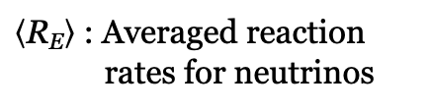
Local Simulation of Collisional Instability
Case 1:
Flavor swap
Same
Hierarchy
Beyond equipartition
$\left\langle \text{R}\text{E}\right\rangle$ : Averaged reaction
rates for neutrinos
Case 2:
Flavor equipartition
Twisted
Hierarchy
Rich spectral diversity!
Not just equipartition
MZ PRD ‘25

Slide 16
+ Classical β-Equilibrium (Feedback)
Case 2:
CFI can occur
near the neutrino sphere.
~ β-equilibrium with matter
Flavor Equipartition
P_{ex} ~ 0.5
Additional emission
of electron neutrinos
( = cooling)

Slide 17
Summary & Conclusions
Refractive effects from background matter can lead to non-negligible flavor conversion phenomena.
Neutrino flavor conversion can alter not only shock dynamics and neutrino signals but also GW signals from CCSN.
Direct computation of fast/collisional flavor conversion exhibits the angular / energy structure of the asymptotic states.
More accurate modeling of “Neutrino Flavor Conversion” into CCSN is running!!

Slide 18
Note
Back slides

Slide 19
Implementation of Quantum Kinetics
Quantum Kinetic Neutrino Transport
∝ (G_{F} n_{l})
Separately considered
among physical scales
∝ (G_{F}² n_{l})
~ O(cm)
~ O(km)
Quantum Kinetics
[Neutrino Self-interactions]
Classical Transport
[Boltzmann Equation]
Independently
investigated
Back into “classical” ν-transport
with relaxation
➔ BGK-Relaxation ν-Transport
Sub-grid modeling for
Slow Instability
Fast Instability
Collisional Instability
See Akaho’s talk
(1st day)

Slide 20
Beyond Phenomenological
BGK-Relaxation Transport
See Akaho’s talk
(1st day)
1D-CCSN in Akaho+ arXiv ‘25

Slide 21
Sub-grid Modeling for Fast Conversion
Full QKE:
Relaxation-
Time Approx.:
Analytical
Asymptotic states f ª
Time evolution of survival prob. of ν_{e}
Good Agreement!!
Low reso.
Nagakura, Johns, & MZ PRD ’24
21

Slide 22
Progress in CCSN Simulation
Dimensionality
Neutrino
transport
3D
Full-Boltzmann
2D
Moment method
1D
FLD, IDSA
Ideal model
Canonical
Newtonian
Pseudo-GR
Advanced
Gravity
Full-GR
Microphysics
(EoS+reactions)
22

Slide 23
Advanced Neutrino Transport
Beyond Boltzmann:
Quantum Kinetics
Dimensionality
Neutrino
transport
3D
Full-Boltzmann
2D
Moment method
1D
FLD, IDSA
Canonical
Newtonian
Pseudo-GR
Advanced
Gravity
Full-GR
Microphysics
(EoS+reactions)

Slide 24

Neutrino Oscillations by Background
Schrödinger equation in medium
Potential from matter (leptons)
Leptonic current
Distribution function of a lepton l
Background leptons:
・Solar case → electrons
・CCSN ? → electrons + neutrinos
c.f.,
Neutrino flux : N_{ν} ~ 10⁵⁸ (L ~ 10⁵³erg/s)
24

Slide 25
Neutrino Oscillations by Background
Schrödinger equation in medium
Potential from matter (leptons)
Neutrino self-interactions !!
→ Collective oscillation
25

Slide 26
Flavor Conversion in ν-Transport
Classical Boltzmann Equation
Quantum Kinetic Equation
(= Include correlations between flavors)
Refractive effect
= Oscillation term
Neutrino density matrix (for 2-flavor) :
ρ^{αα} : flavor content of α
  = same as f_{α}
ρ^{αβ} : flavor correlation
between α and β
Notes:
In CCSNe, there are three types of neutrino oscillations.
Vacuum and matter oscillations are linear effects and well-known by many experimental efforts, while collective neutrino oscillation is nonlinear effect induced by the neutrino-neutrino interactions.

Slide 27
Flavor Conversion in ν-Transport
Neutrino density matrix (for 2-flavor) :
ρ^{αα} : flavor content of α
  = same as f_{α}
ρ^{αβ} : flavor correlation
between α and β
Via mixing angles,
Flavor correlation becomes perturbative.
(Less dependent on mass ordering)
Self-interactions amplify it.
Linear stability analysis
→ Flavor instability
Significant flavor conversion
Notes:
In CCSNe, there are three types of neutrino oscillations.
Vacuum and matter oscillations are linear effects and well-known by many experimental efforts, while collective neutrino oscillation is nonlinear effect induced by the neutrino-neutrino interactions.

Slide 28
Phenomenological Approach in 2D+GW
ρ_{crit} ~ 10¹³⁻¹⁴ g cm⁻³
11.2 M⦿
Ehring+ arXiv ‘24

Slide 29
Phenomenological Approach in 3D+GW
ρ_{crit} ~ 10¹⁰⁻¹² g cm⁻³
11.2 M⦿
enhance
Mori+ PASJ ‘25

Slide 30
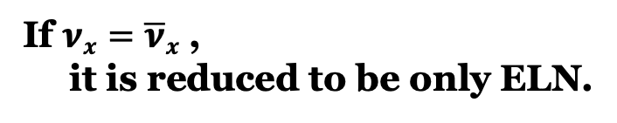

Fast Flavor Conversion
ELN-XLN angular distribution:
= ELN － XLN
(Electron Lepton Number)
(Heavy-Leptonic one)
( = MuLN or TauLN)
Crossing
$\overline{ν}e$ excess
If $νx=\overline{ν}x$ ,
it is reduced to be only ELN.
$νe$ excess
(reasonable in CCSNe)

Slide 31
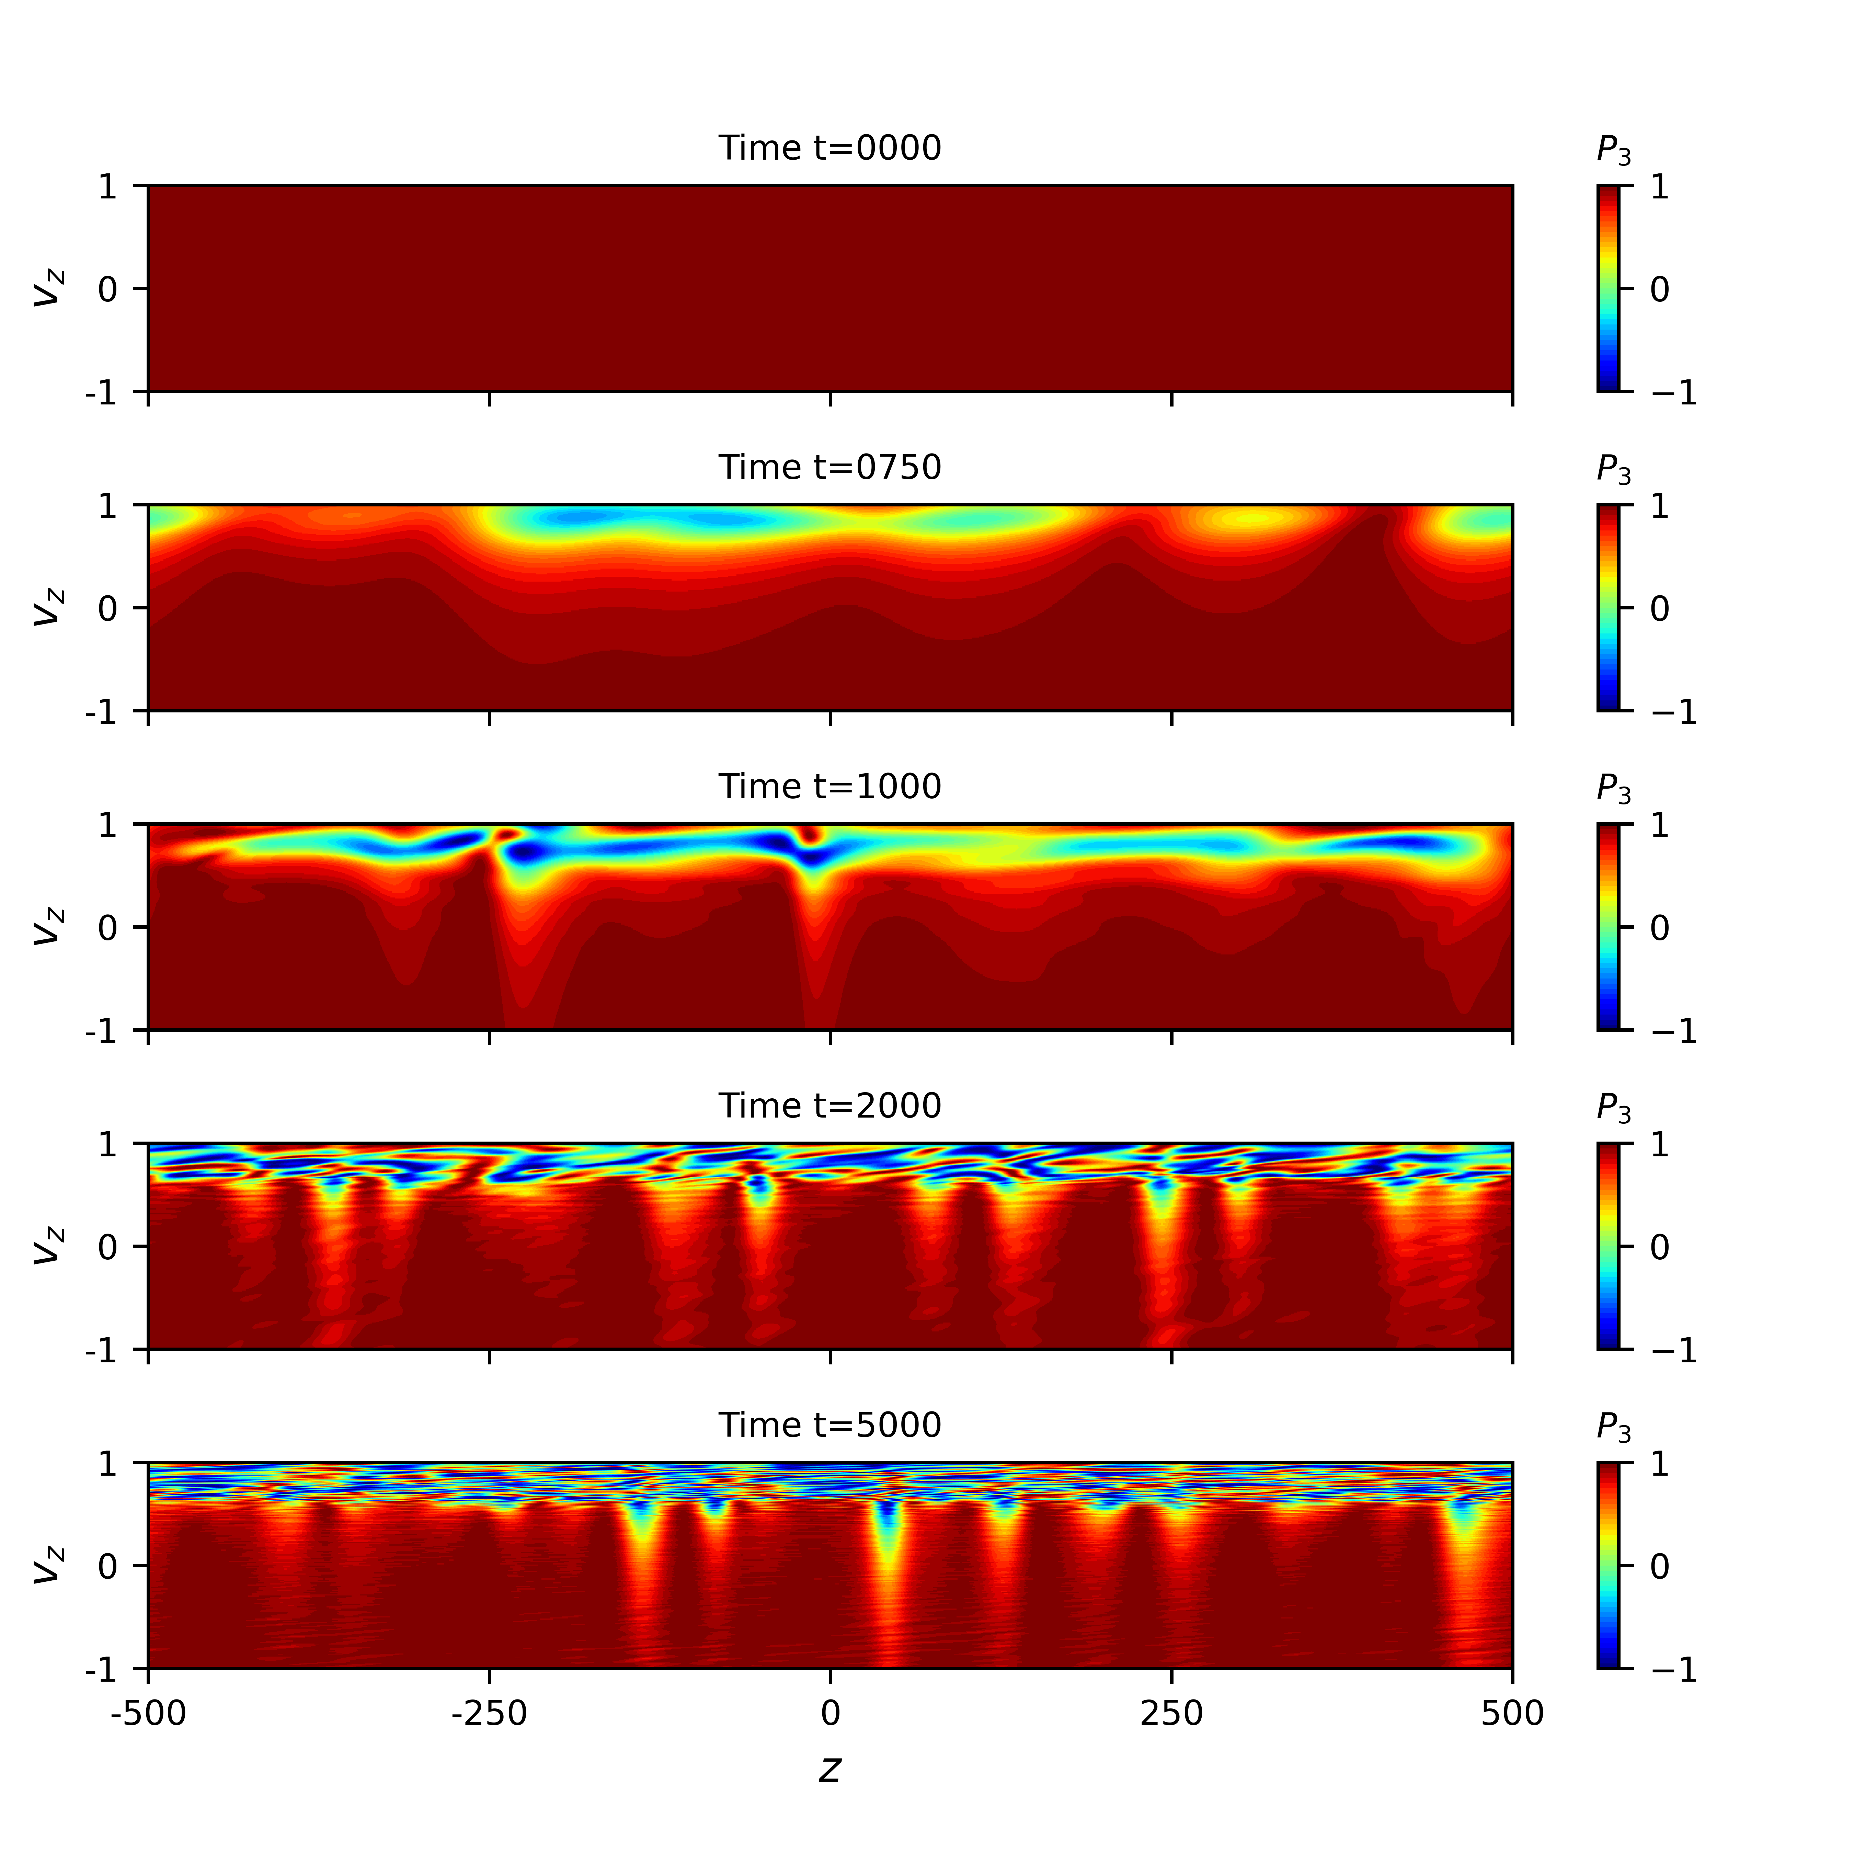
Spatial Structure
Flavor evolution
ν_{e}
=
ν_{μ}
Flavor equipartition
is established.
Asymptotic states
MZ & Nagakura PRD ‘23

Slide 32
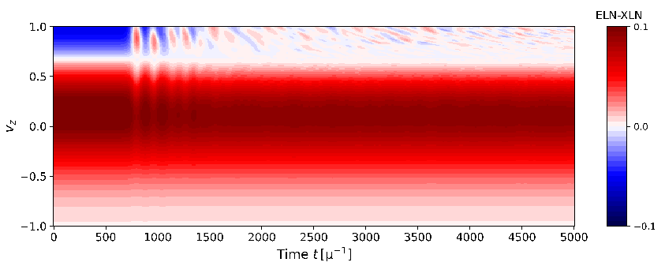
Spatial-Averaged Structure
Spatial-averaged ELN-XLN.
Crossing
Time evolution
Disappearance of crossing
Quasi-steady
Nonlinear saturation
FFC works to eliminate the crossings.
MZ & Nagakura PRD ‘23

Slide 33
Modeling of Asymptotic State
Asymptotic behaviors:
Stability
  - Flavor equipartition
  - (Disappearance of crossing)
Conservation laws
  - (Periodic boundary)
50%
Flavor equipartition
Simplest model
For B > A
MZ & Nagakura PRD ‘23

Slide 34
Collisions in Quantum Regime
e.g., Emission & Absorption processes are matrix-formed:
Quantum contributions (off-diagonal parts)
・Flavor-decohering collisions
Collisional Flavor Instability (CFI) is triggered.
Classical collisions (diagonal parts)
・Changing the numbers/momenta of (anti-)neutrinos.

Slide 35
Collisional Flavor Instability
Self-interactions:
Couplings
When the entire system has the disparity in collision rates between neutrinos and antineutrinos, flavor instability can appear.
Johns PRL ’23
Flavor correlation can grow!!
(But relatively slower)

Slide 36
Collisionally Unstable Modes
minus mode
plus mode
Growth rate
In linear stability analysis
plus mode
MZ arXiv:2502.09260
minus mode

Slide 37
Eigenvector of Unstable Modes
Grows
or Damps
or Oscillates
Plane-wave ansatz in linear stability analysis:
Amplitude
= Spectral structure
Iso-energetic
Low-energy
Peak
MZ arXiv:2502.09260

Slide 38
Local Simulation of Collisional Instability
Twisted
Hierarchy
Flavor equipartition P_{ex} ~ 0.5
ν_{e}
=
ν_{μ}
Equipartition
Energy-dependent flavor evolution.
Collision decoheres the system.
→ Neutrino reaches a steady state.
Linear growth
Decay
= Decoherence
MZ PRD ‘25

Slide 39
Evolution of Plus Mode
Same
Hierarchy
Flavor swap P_{ex} ~ 1
Beyond equipartition
ν_{e}
↔︎
ν_{μ}
Swap
Linear growth
Rich spectral diversity!
Not just equipartition
MZ PRD ‘25

Slide 40
Eigenvector of Unstable Modes
Iso-energetic
Iso-energetic
Low-energy
Peak
Energy dependence
MZ arXiv:2502.09260

Slide 41
Collisional Decoherence
Degree of collisional decoherence with energy dependency
Weak decoherence
Strong decoherence
MZ arXiv:2502.09260

Slide 42
Flavor Evolution
Strong decoherence
Less decoherence
Decay
= Decoherence
MZ arXiv:2502.09260

Slide 43

Local Simulation of CFI
Case 1:
Twisted
Hierarchy
$\left\langle \text{R}\text{E}\right\rangle$ : Averaged reaction rates
Flavor equipartition
ν_{e}
=
ν_{μ}
Equipartition
Rich spectral diversity!
Not just equipartition
MZ PRD ‘25

Slide 44
Local Simulation of CFI
Case 2:
Same
Hierarchy
$\left\langle \text{R}\text{E}\right\rangle$ : Averaged reaction rates
Flavor swap
ν_{e}
↔︎
ν_{μ}
Swap
Beyond equipartition
Rich spectral diversity!
Not just equipartition
MZ PRD ‘25

Slide 45
+ Classical β-Equilibrium (Feedback)
Case 2:
Flavor Swap
P_{ex} ~ 1.0
Additional
emission ( = cooling)
of electron neutrinos
MZ PRD ‘25

Slide 46
+ Classical β-Equilibrium (Feedback)
Case 2:
Flavor Swap
P_{ex} ~ 1.0
Additional
emission ( = cooling)
of electron neutrinos
MZ PRD ‘25

Slide 47
Back to Classical Transport
Relaxation-Time
Approximation
c.f., Nagakura, MZ+ PRD ’24
Supply the number density.
For all
flavor instabilities
Growth rate
Modeling of
Asymptotic states
We’ll obtain more accurate ν-transport implementing Quantum Kinetics w/o direct computation.

Slide 48
Mean-Field Approximation
Neutrino flux : N_{ν} ~ 10⁵⁸ (L ~ 10⁵³erg/s)
→ Highly non-linear many-body problem.
Momentum exchange
Size : 3^{N}
(e.g., Balantekin+ ’06)
Mean-Field (MF) Approximation
(e.g., Volpe+ ’13)
Size : 3N
Two-body problem to a one-body.
Treatable.
Mean field is our Friends!!
One-body ν-interaction
48

Slide 49
Collisional Flavor Instability (CFI)
Quantum Kinetic Equation:
Collision decoheres neutrinos.
→ Usually suppress flavor instability
Shalgar+ ‘21, Kato+ ’21, Sasaki+ ‘22
Martin+ ‘21, Sigl ‘22, Johns+ ‘22
Off-diagonal components:
differential effect between $ν$ and $\overline{ν}$
Flavor instability
(Relatively slower scale)
Johns ‘21 & PRL ‘23

Slide 50
Go Back to Stability Analysis
Governing equation for the off-diagonal components.
Convolution between s_{v} & S_{v}
in nonlinear regime.
Assumptions:
- |S| << s ~ 1.
- Ignore mode couplings.
= Linearization
Main obstacles
in fully nonlinear stability analysis.

