Slide 1



Rarita-Schwinger Fields and Cosmology
Sep 22 – 25, 2025
University of Warsaw, Faculty of Physics
Rocky Kolb

Slide 2
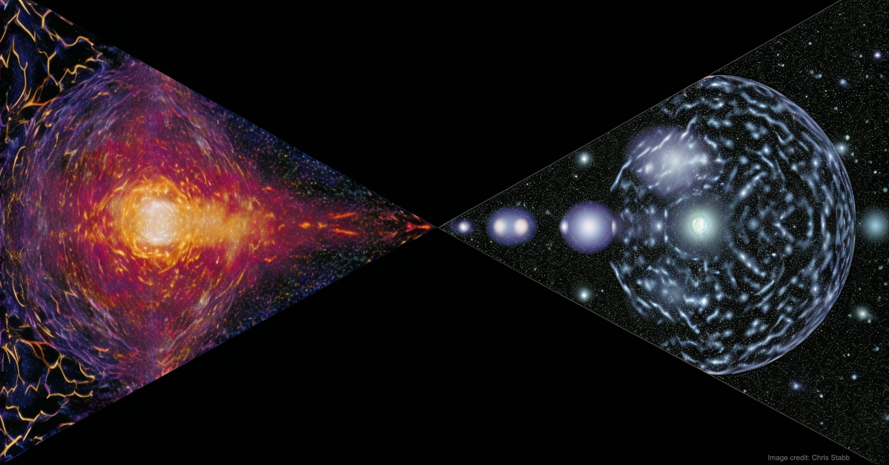
Inner Space/Outer Space Interface
Cosmological limits on particle properties:
1. neutrinos
2. axions
3. magnetic monopoles
4. all sorts of BSM particles (e.g., SUSY)
    5. cosmological defects
    6. Kaluza-Klein modes
    7. String theorists suggest a lot of unseen things … difficult to get rid of them
Usually assume LTE
I will consider limits from “cosmological gravitational particle production (CGPP)”
CGPP can populate hidden sectors & produce DM w/ only gravitational interactions

Slide 3
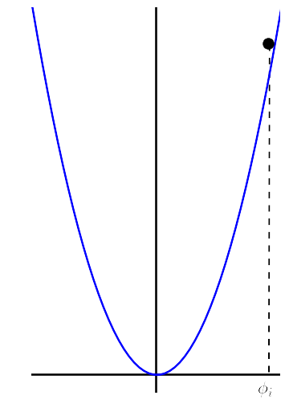

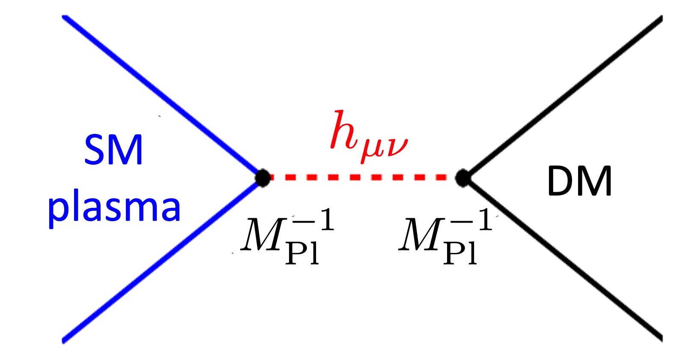
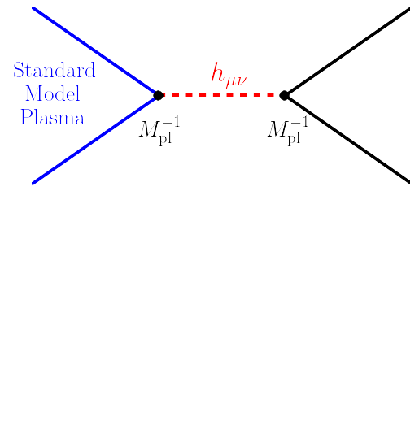
Ideas for gravitational particle production
Misalignment
Hawking radiation from primordial black holes
Hooper, Krnjaic, & McDermott
Superhorizon quantum fluctuations during inflation
After inflation, field frozen by “Hubble drag” until H drops below mass
Then energy density in oscillating field
Most familiar example is the axion
PBH seeds from inflation
PBHs evaporate in early universe
DM mass ∼ 10¹¹ GeV (WIMPzilla)
φ
φ_{i}
From primordial plasma via graviton exchange
From inflaton field after inflation via graviton exchange
Ema, Nakayama, Tang; Mambrini & Olive
Garny, Sandora, & Sloth
“Boltzmann” approach not complete treatment (Kaneta, Lee, Oda; Basso, Chung, EWK, Long).
Underestimates particle production: must include Schrödinger Effect (production during quasi-de Sitter era).
Reheating produces SM plasma
DM mass ∼ 10¹³ GeV (WIMPzilla)
Assumes m < T_{RH}
cold
inflaton
condensate
DM

Slide 4
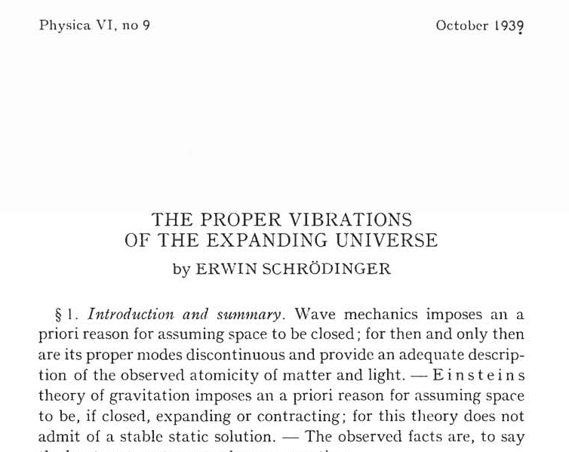
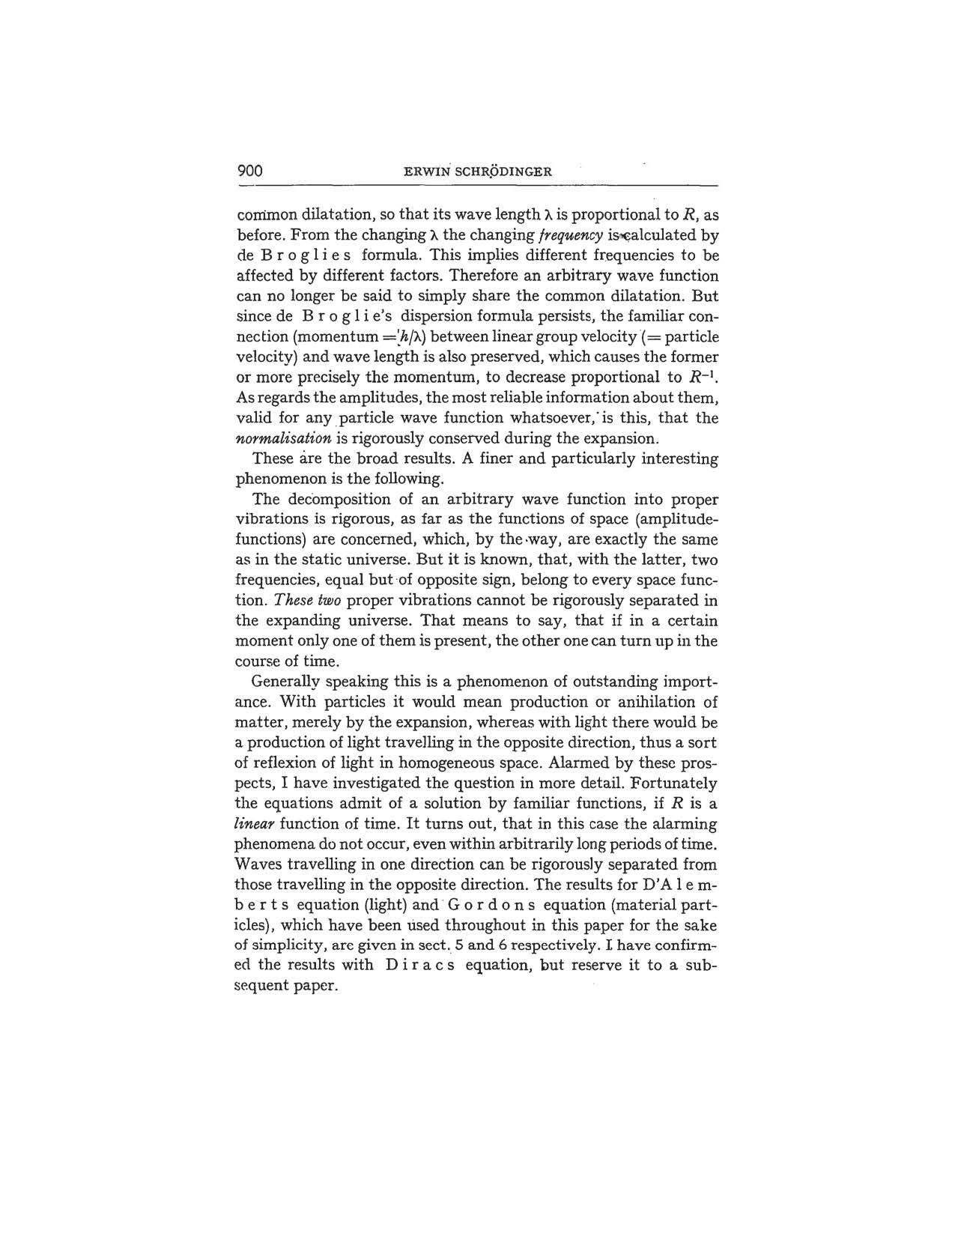
Ideas for gravitational particle production
Cosmological Gravitational Particle Production (CGPP) through the Schrödinger Effect
Physics of “Schrödinger Effect” in the spirit of the “Schwinger Effect”

Slide 5
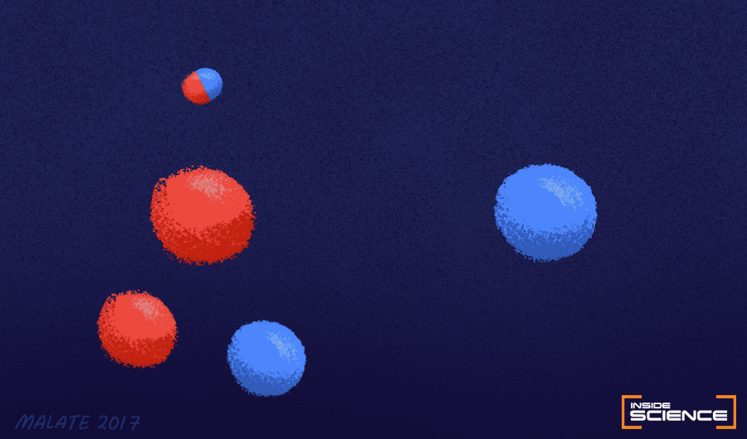
The Schwinger Effect
Electric field
Particle creation
Quantum
Vacuum
Seething Sea of Uncertainty
Image: Malate 2017 (AIP)
Turn on field
Particle creation from the vacuum if energy gained in acceleration from field over a Compton wavelength exceeds the particle’s rest mass.
Sauter (1931); Heisenberg & Euler (1935); Weisskopf (1936); Schwinger (1951)
Notes:
I = 10^30 W cm^2, B = 5X10^13 G
Non perturbative. quantum

Slide 6
The Schrödinger Effect
Expanding space
Particle creation
Quantum
Vacuum
Seething Sea of Uncertainty
Image: Malate 2017 (AIP)
Turn on expansion
expansion
Particle creation from the vacuum if energy gained in acceleration from expansion over a Compton wavelength exceeds the particle’s rest mass.
Hubble’s law
Schrödinger (1939)

Slide 8
Cosmological Gravitational Particle Production (CGPP)
through the Schrödinger mechanism
Chung, EWK, Riotto (1998); Kuzmin & Tkachev (1999)
My collaborators:
      Ivone Albuquerque
      Edward Basso
      Christian Capanelli
      Tammi Chowdhury
      Daniel Chung
      Patrick Crotty
      Michael Fedderke
      Gian Giudice
      Lam Hui
      Leah Jenks
      Siyang Ling
      Andrew Long
      Evan McDonough
      Guillaume Payeur
      Toni Riotto
      Rachel Rosen
      Leo Senatore
      Alexei Starobinski
      Keyer Thyme
      Igor Tkachev
      Jingyuan Wang
      Mark Wyman

Slide 9
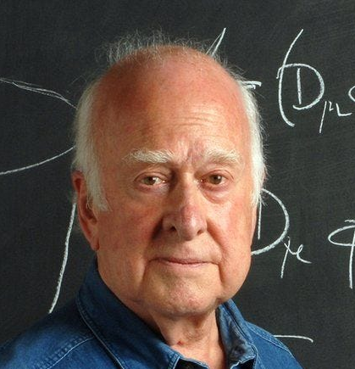
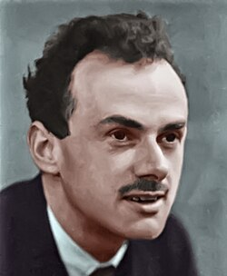
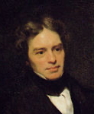
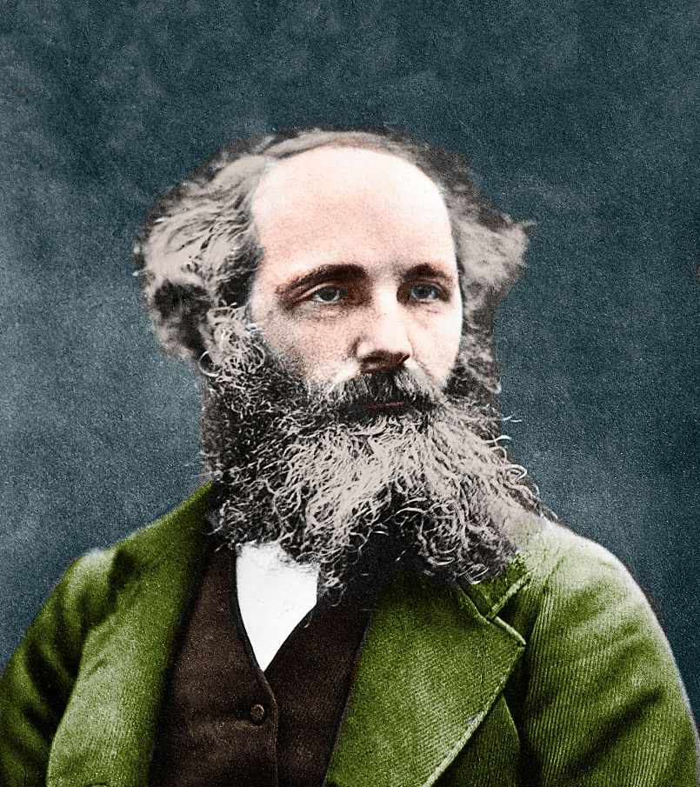
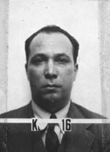
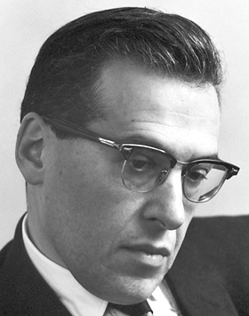
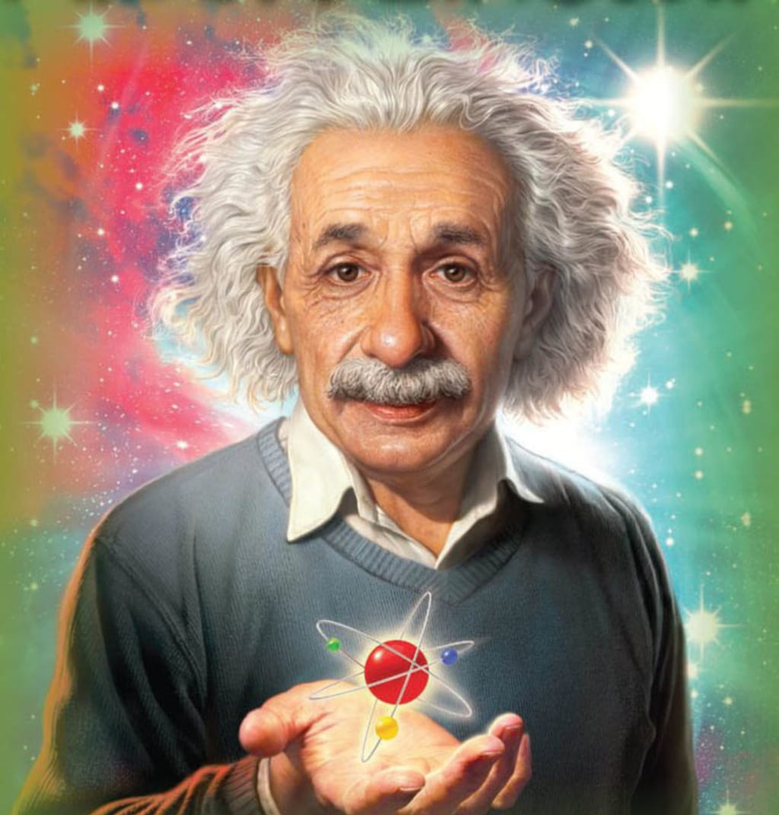
What are Rarita-Schwinger fields?
Standard Model of Particle Physics
?
Gravity
Spin 0
Spin 1/2
Spin 1
Spin 3/2
Spin 2
Higgs Boson
Leptons & Quarks
Gauge Bosons
Rarita-Schwinger (R-S)
Graviton
R-S fields do not appear in the standard model of particle physics, but are a legitimate subject as a quantum field theory.
Massless R-S fields consistent only if coupled to a conserved current as in supersymmetry (Haag–Lopuszanski–Sohnius theorem).
R-S field Ψ_{μ} is a “vector-spinor” arising from the direct product of vector and Dirac spinor reps. of the Lorentz group.
Reducible representation RS field.
can be decomposed into irreps. corresponding to and helicity states.

Slide 10
Why study Rarita-Schwinger fields?
Standard Model of Particle Physics
?
Supergravity
Gravity
Spin 2
Spin 3/2
Spin 2
Spin 0
Spin 1/2
Spin 1
Spin 3/2
Higgs Boson
Leptons & Quarks
Gauge Bosons
Rarita-Schwinger (R-S)
Graviton
Graviton
In Supergravity (SUGRA), the spin 3/2 R-S field is the superpartner of the graviton, the gravitino.
Gravitino difficult to detect at LHC because of feeble gravitational coupling to SM fields, but …
“Gravitino production leads to important constraints on early universe cosmology.” (Supergravity, Freedman and Van Proeyen).
“Early universe cosmology (may) lead to important constraints on Supergravity model building.” (EWK, Long, McDonough, PRD 2021 & PRL 2021; EWK, Long, McDonough, Wang 2025).
This is a work in progress with Andrew Long, Evan McDonough, and Jingyuan Wang.

Slide 11
Why study CGPP of Rarita-Schwinger fields?
through the Schrödinger mechanism
I’ve studied CGPP of minimally-coupled scalars, conformally-coupled scalars, Dirac fermions, de Broglie-Proca fields, Kalb-Ramond fields, Fierz-Pauli fields, in one-field inflation models, rapid-turn inflation models, inflation models with non-canonical kinetic terms, Higgs-inflation models, …
Aren’t you tired of it? Don’t you have anything better to do?
What could possibly be new with Rarita-Schwinger fields? Two answers:
1. possibility of vanishing sound speed,
2. in SUGRA models, generally RS field (the gravitino) has a dynamical mass.
Our (EWK, Long, McDonough, Wang) project goal is to calculate CGPP of gravitinos.
First step is to understand CGPP of “simple” R-S fields.
This is a progress report.

Slide 12
Rarita-Schwinger field in FRW background
Covariant action for R-S field: vector-spinor
Kallosh, Kofman, Linde, Van Proeyen (1999)
Giudice, Riotto, Tkachev (1999)
EWK, Long, McDonough (2021)
Specialize to FRW and define new field for canonical kinetic term
Impose constraints from field equations
Fourier decomposition
Remove non-dynamical DOFs and decompose into helicity states: and
Mode equations become
C_{A} and C_{B} are functions
of

Slide 13
Rarita-Schwinger field in FRW background
Parameterize spinor wavefunctions in terms of helicity eigenspinors with mode functions
which satisfy
Helicity-3/2 mode equation is just like Dirac field
Helicity-1/2 mode equation is more “interesting”
Eigenvalues of 1/2 mode equation are
c_{s} is complex sound speed
c_{s} = C_{A} + i C_{B}
Vanishes for R-S fields, but
can be nonzero for gravitinos

Slide 14
Sound speed can vanish
New feature (or is it a bug?): sound speed can vanish!
in dS ( )
when
0.4
0.01
avoided
occurs
EWK, Long, McDonough (2021)

Slide 15
Vanishing sound speed enhances GCPP
c_{s} varies for helicity-1/2 mode
If |c_{s}| > 0, proportional to k², and CGPP suppressed for high-k modes
If |c_{s}| = 0, independent of k², and CGPP unsuppressed for high-k modes
a³n_{p} is the comoving
spectral density
a³n is the comoving
number density
If a³n_{p} peaked,
a³n ≈ peak of a³n_{p}
Even if |c_{s}| doesn’t vanish, GPP can be enhanced by a large factor (50 in this case)
EWK, Long, McDonough (2021)

Slide 16
Vanishing sound speed enhances GCPP
Unresolved high-p behavior
p⁰, p¹, p², p³ ?
Call it a “raritron” (Kaneta, Ke, Mambrini, Olive, Verner 2023)
Low mass raritron: catastrophic production for ½ helicity
Dashed lines are
Boltzmann
calculation à la
Kaneta et al.
EWK, Long, McDonough, Wang (2025)

Slide 17
Vanishing sound speed enhances GCPP
Call it a “raritron” (Kaneta, Ke, Mambrini, Olive, Verner 2023)
High mass raritron: no catastrophic production for ½ helicity, but n_{k} larger
Dashed lines are
Boltzmann
calculation à la
Kaneta et al.
Dashed lines are
Boltzmann
calculation à la
Kaneta et al.
EWK, Long, McDonough, Wang (2025)

Slide 18
Rarita-Schwinger field can be dark matter
For high-mass raritrons (m/H_{e} ≳ 0.4):
  Helicity ½ dominates, esp. for m ≲ 1.5 H_{e}.
  n_{k} decreases at large k, n and Ω finite.
  Could be dark matter for m ≲ 10 H_{e}.
For low-mass raritrons (m/H_{e} ≲ 0.4):
  Helicity ½ dominates.
  n_{k} unbounded at large k, so must either
  introduce cutoff, or have (SUGRA?)
  Could be dark matter
EWK, Long, McDonough, Wang (2025)

Slide 19
Rarita-Schwinger field can be dark matter
For low-mass raritrons (m_{3/2} /H_{e} ≲ 0.1):
  For helicity 1/2, T_{RH} scales as (m_{3/2}/H_{e})⁻¹ to obtain Ωh² = 0.12
  For Λ/a_{e}H_{e} = 10, if T_{RH} = 10¹⁵ GeV, Ωh² = 0.12 for m_{3/2}/H_{e} = 10⁻¹⁰
  Can have very light raritron be dark matter
  If cutoff Λ > 10 a_{e}H_{e}, even lighter raritron possible for Ωh² = 0.12
  Similar conclusion in Kaneta et al., but different calculation
EWK, Long, McDonough, Wang (2025)

Slide 20
Varying R-S mass?
Varying rarirton mass to remove catastrophic helicity ½ production
Sound speed is complex
Now just focus on and consider
R = Ricci scalar
N = ln(a/a_{e})
Ambiguity in choice of sign.
When dm/dN = 0, can change sign.
dm/dN = 0 when or when m = 0 and .

Slide 21
Varying R-S mass?
|c_{s}| = 1 to remove catastrophic helicity ½ production. Require . BUT WHY?
What fixes initial value of m?
at late time. Not acceptable.
Note: for fermion sign of m doesn’t matter.
What fixes initial value of m?
Sign of dm/dN changes every time goes through 0.
Nice m behavior at late time, but WHY change sign?
Answers must lie with Supergravity

Slide 22
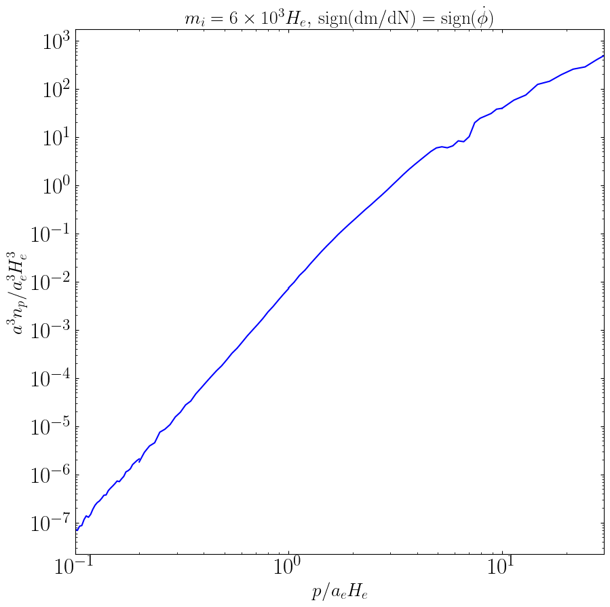
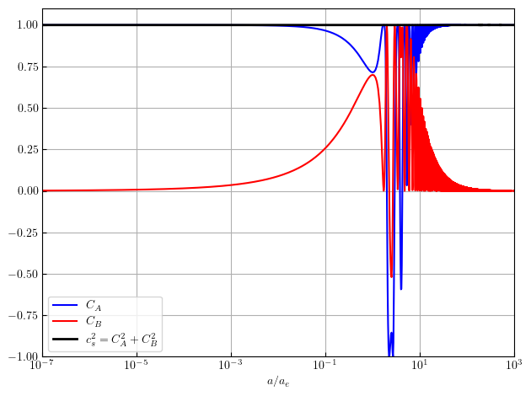
Varying R-S mass?
Even with |c_{s}|² = 1, can still have catastrophic production.
Sound speed is complex: c_{s} = C_{A} + i C_{B} .
It can be pure imaginary when C_{A} = 0 !

Slide 23
Gravitino in FRW background
Spin-3/2 particles arise in theories of supergravity; s = 3/2 gravitino is superpartner of s = 2 graviton
Does supergravity have a catastropic production of gravitinos? It depends on the model!
For models with a single chiral superfield Φ with Kahler potential , superpotential
Time-dependent gravitino mass (depends on rolling inflaton) ⇒ |c_{s}| = 1 at all times & no catastrophic production.
But issues:
1. SUSY restored at late times when φ = 0
2. model doesn’t inflate
EWK, Long, McDonough (2021) × 2
EWK, Long, McDonough, Wang (2025)

Slide 24
Gravitino in FRW background
For models with two chiral superfields
|c_{s}| depends on relative orientation of inflaton direction & SUSY breaking direction
|c_{s}| = 0 occurs in models with a nilpotent superfield S² = 0 and orthogonal constraint
EWK, Long, McDonough (2021) × 2
But even more complications:
why not three chiral superfields
gravitino may mix with inflation
mixing between the goldstino & inflatino can avoid the catastrophe (explicit calculation needed)
many other fields
vanishing sound speed may not be catastrophic
Dudas, Garcia, Mambrini, Olive, Peloso, Verner (2021)
Antoniadis, Benaki, Ke (2021)

Slide 25

Rarita-Schwinger Fields and Cosmology
Preliminary results!
It’s still a work in progress (things take longer than they do).
What we (EWK, Long, McDonough, Wang) plan to accomplish in the first paper:
  Convincingly demonstrate (again) that Boltzmann approach is not the compete picture.
  Calculate relic density for R-S fields, including possibility of zero sound speed.
  (Kaneta, Ke, Mambrini, Olive, Verner (2023) ignored zero sound speed and only
  considered Boltzmann)
    If constant mass RS, must employ cutoff for low masses.
  Explore parameter space for R-S field (raritron) to be dark matter.
  Explore possibilities for an R-S field for varying m.
In a subsequent paper we will consider CGPP of gravitino, inflatino, goldstino,
(s)goldstino, whateverino in several Supergravity models.
My experience with Supergravity
https://youtu.be/ozA0VmIsCNs?feature=shared

Slide 26
Rarita-Schwinger Fields and Cosmology
Sep 22 – 25, 2025
University of Warsaw, Faculty of Physics
Rocky Kolb

